Slide 1
China 2014 Nolan Tomboulian Barbara Pound Kate Williams David Ball Stewart Good

Slide 2
We are all
“Seed Planters”.
We may never know the harvest that is produced because of the seeds we sow today.
Everything we do and say is an example and tells a message to anyone watching.

Slide 3
YunTian

Slide 4
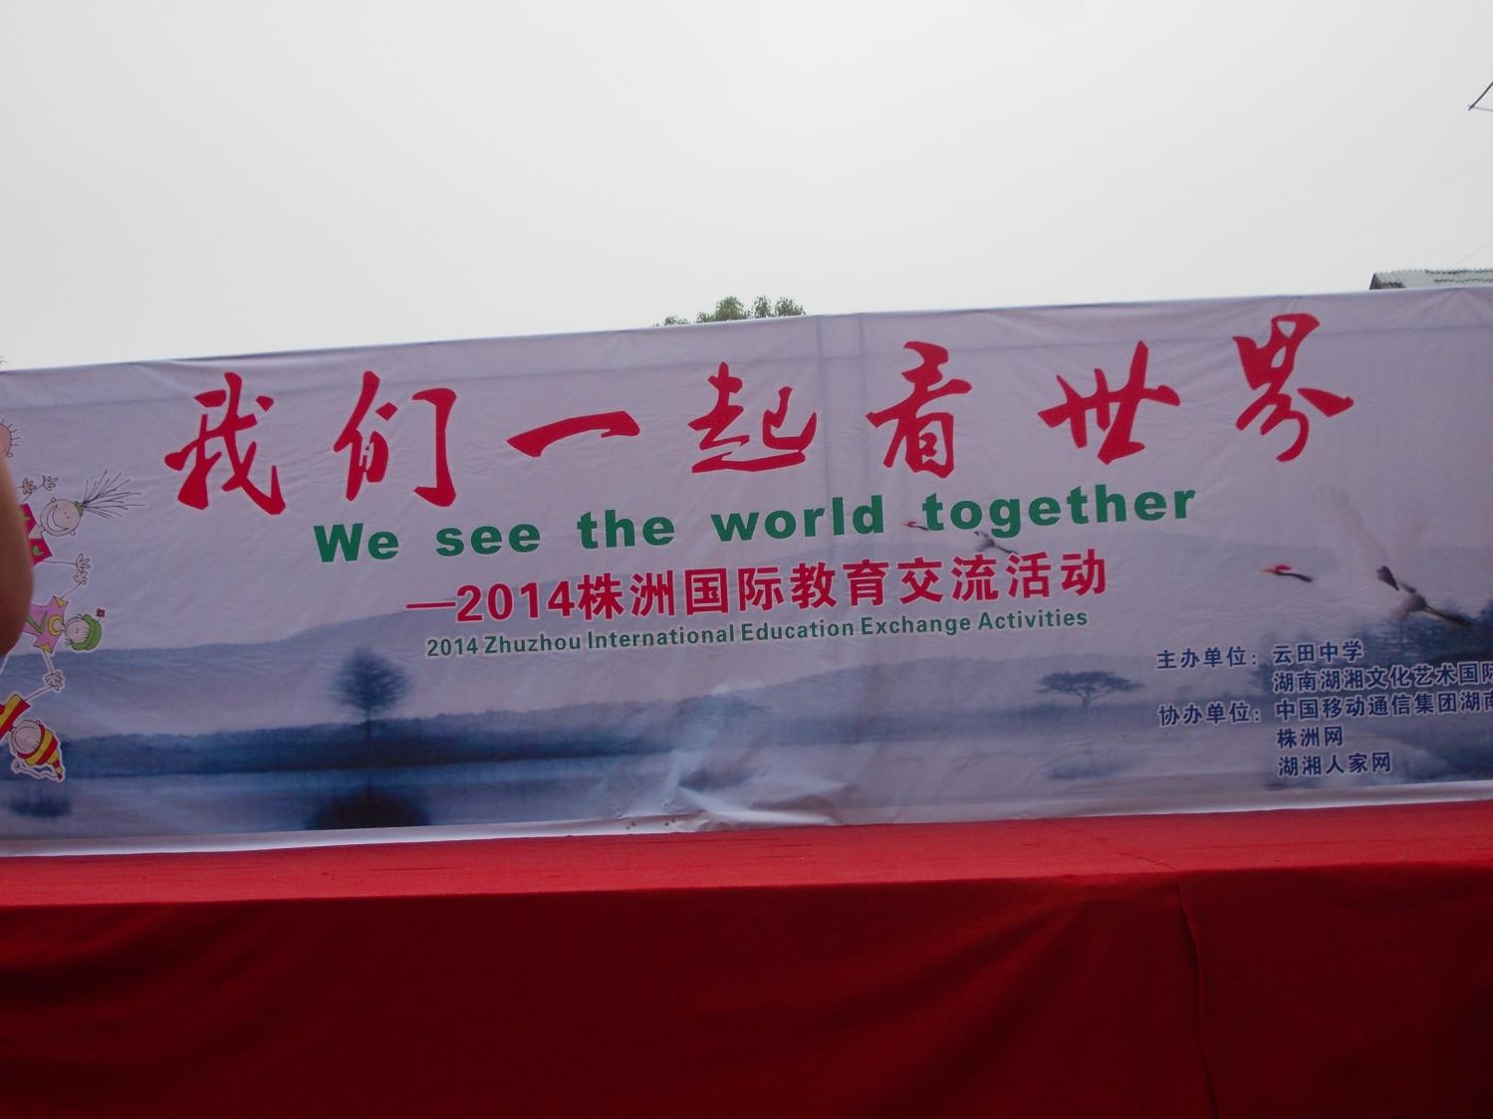
YunTian School

Slide 5
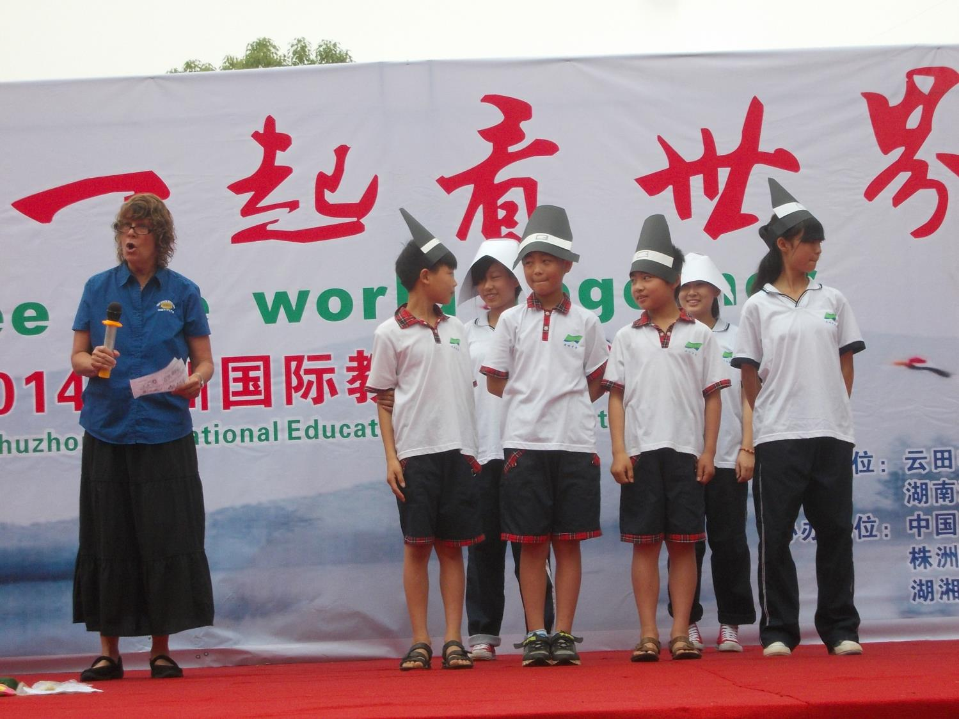
Kate with students presenting the history of Thanksgiving

Slide 6
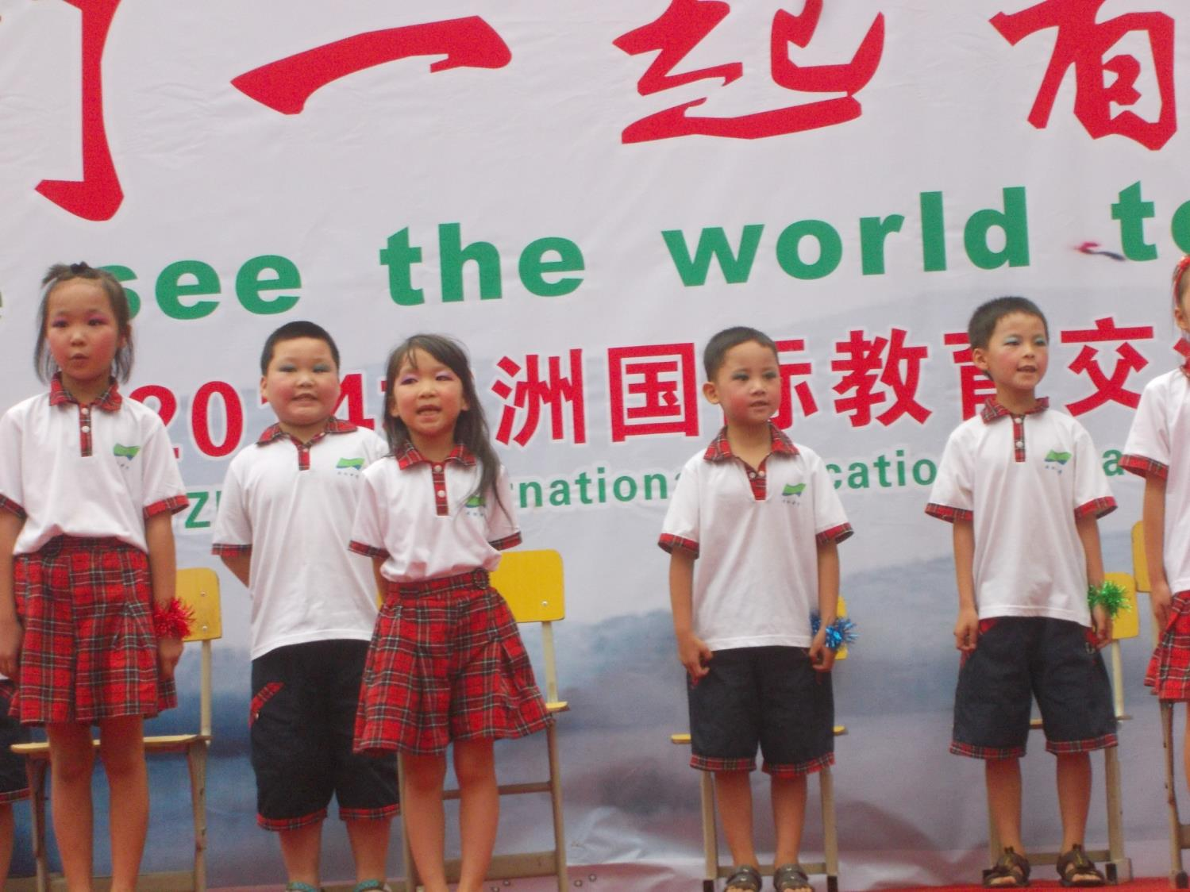

Slide 7
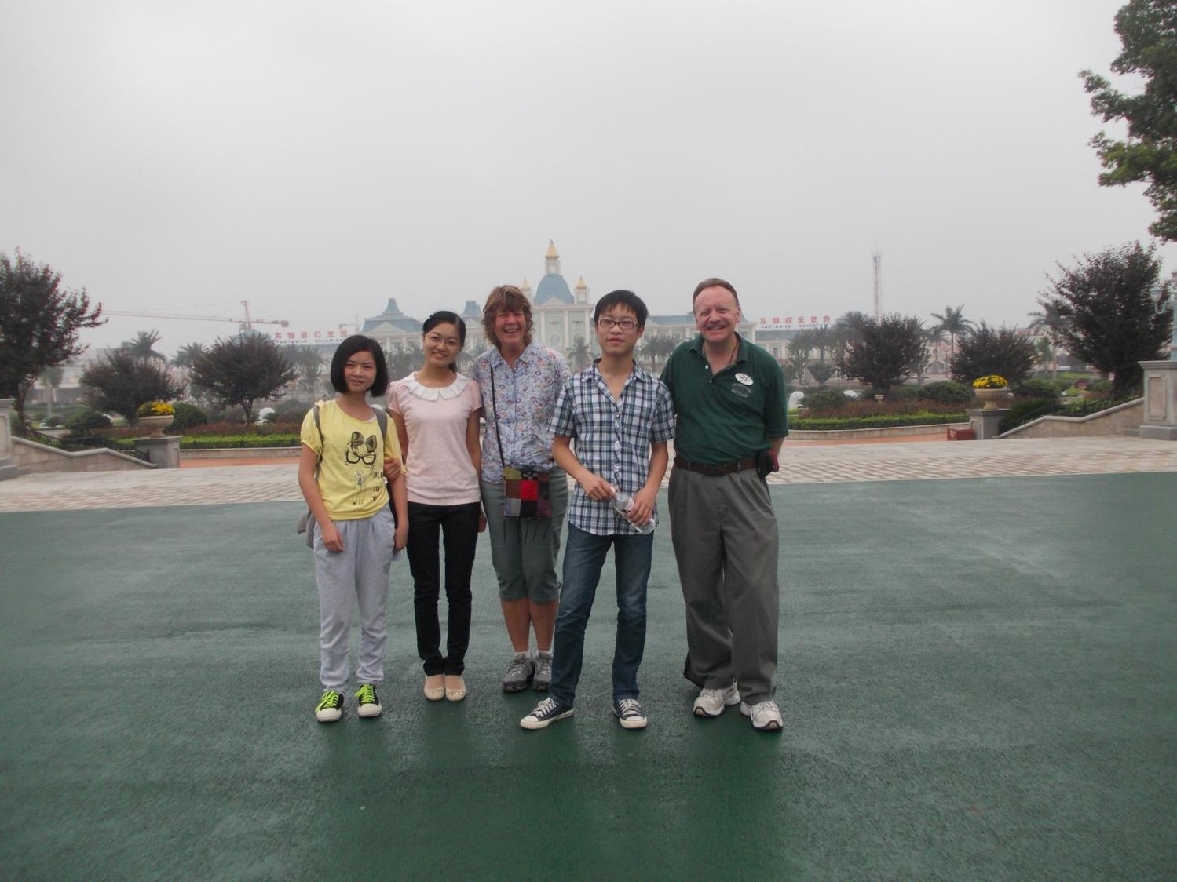
Fanta Wild Amusement Park,

Slide 8
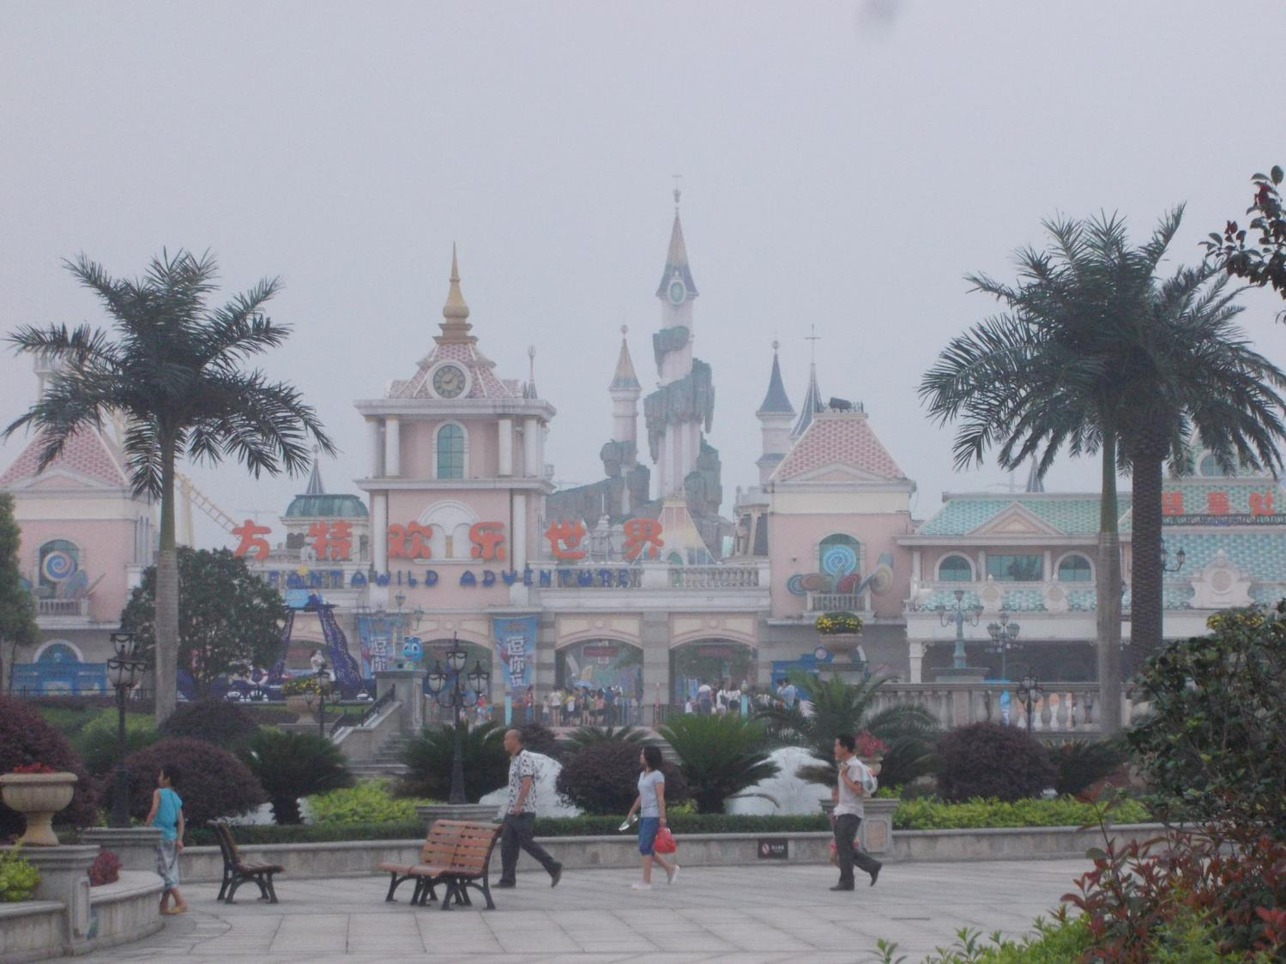

Slide 9
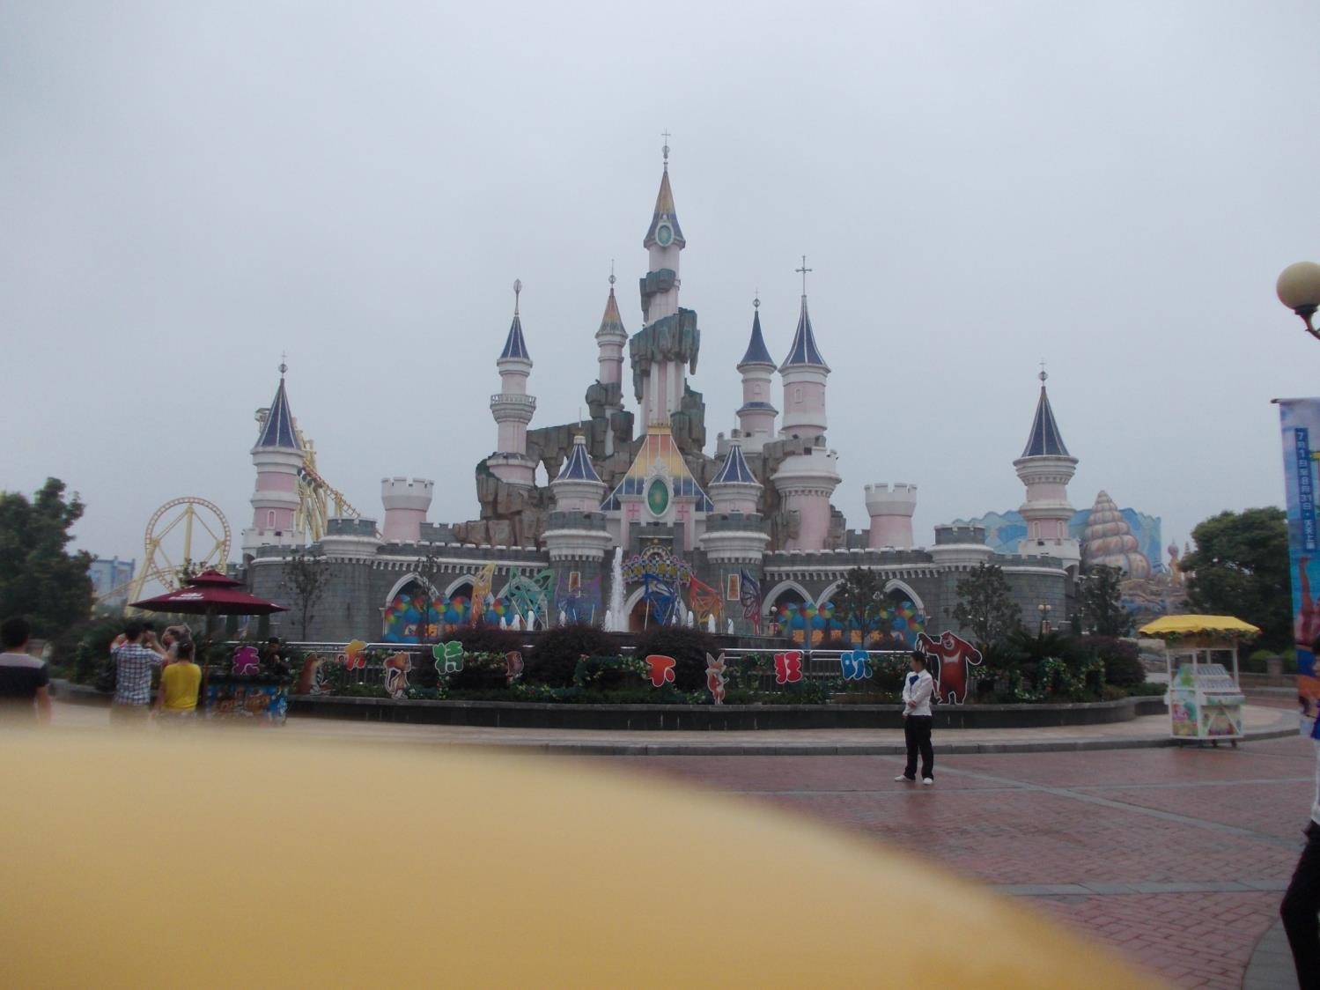

Slide 10
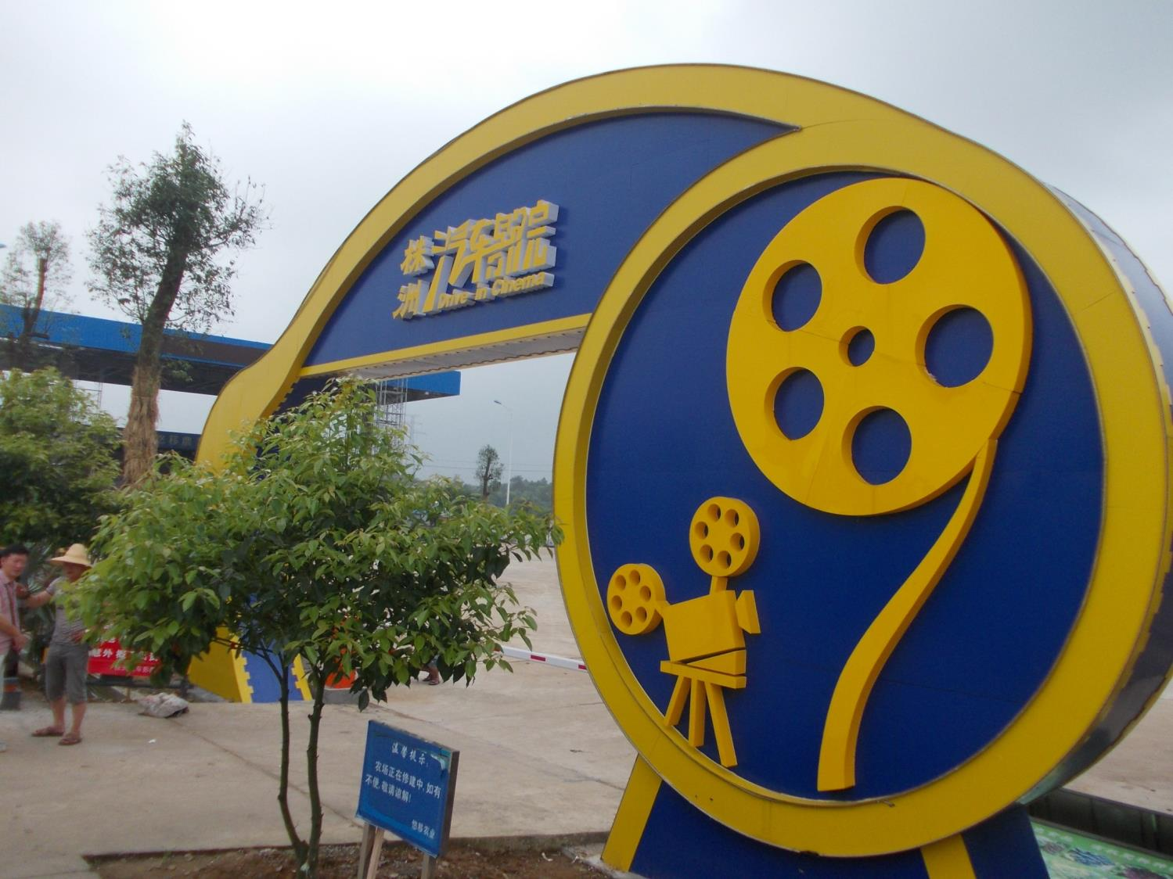
Building a “Drive-in” movie theater

Slide 11
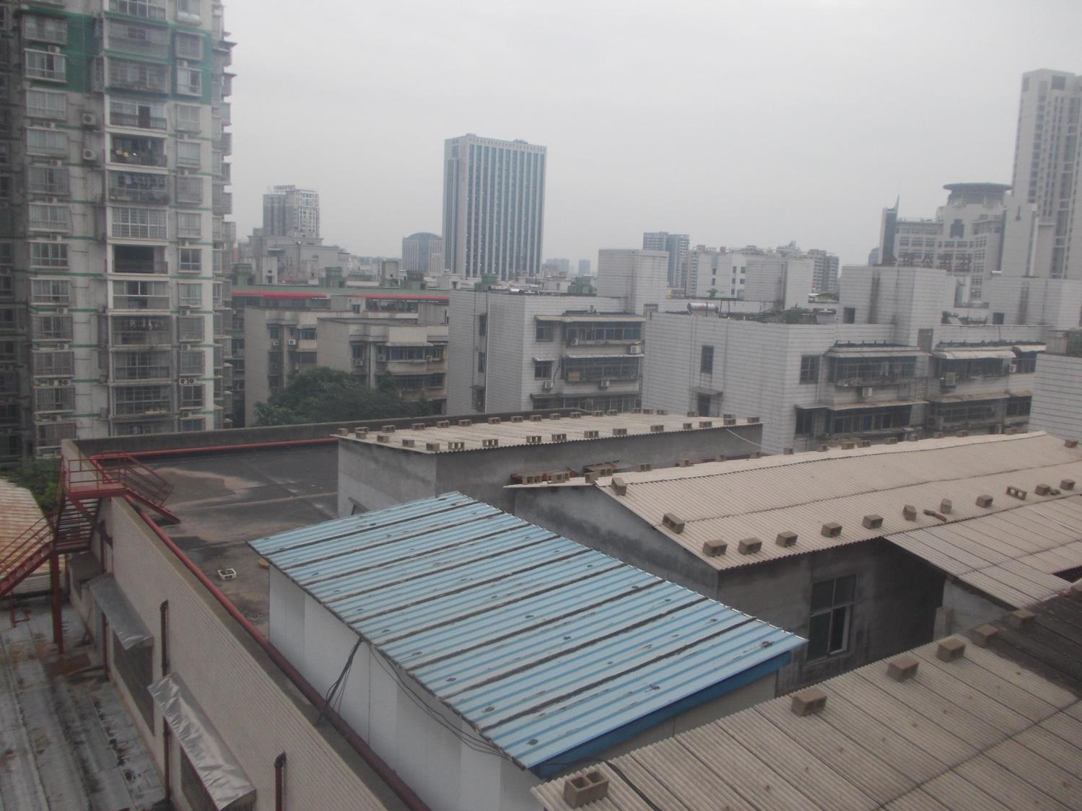
View from Panlongwan Hotel, ZhuZhou

Slide 12
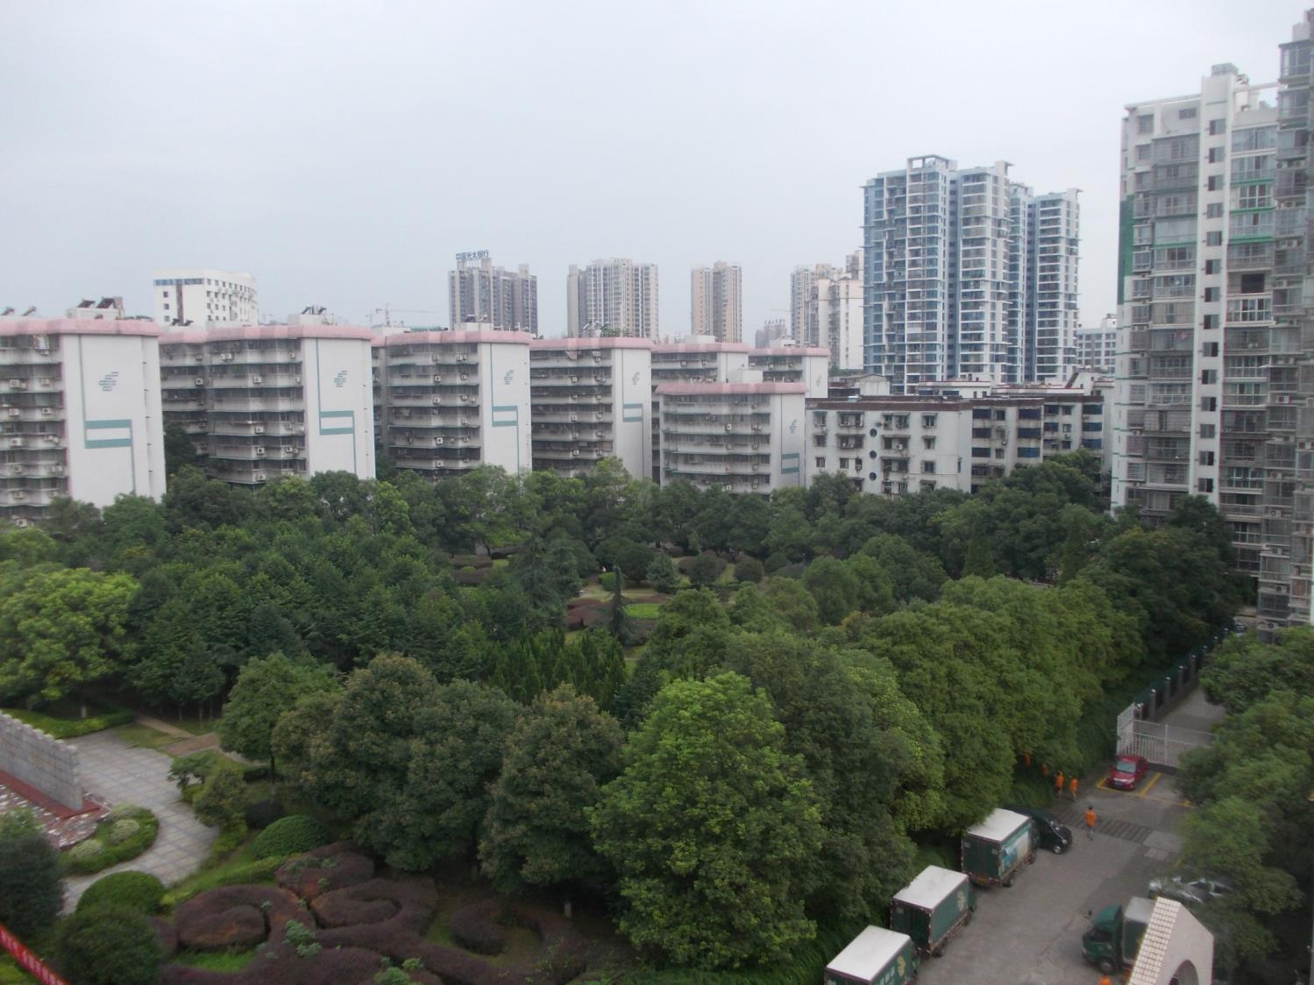

Slide 13
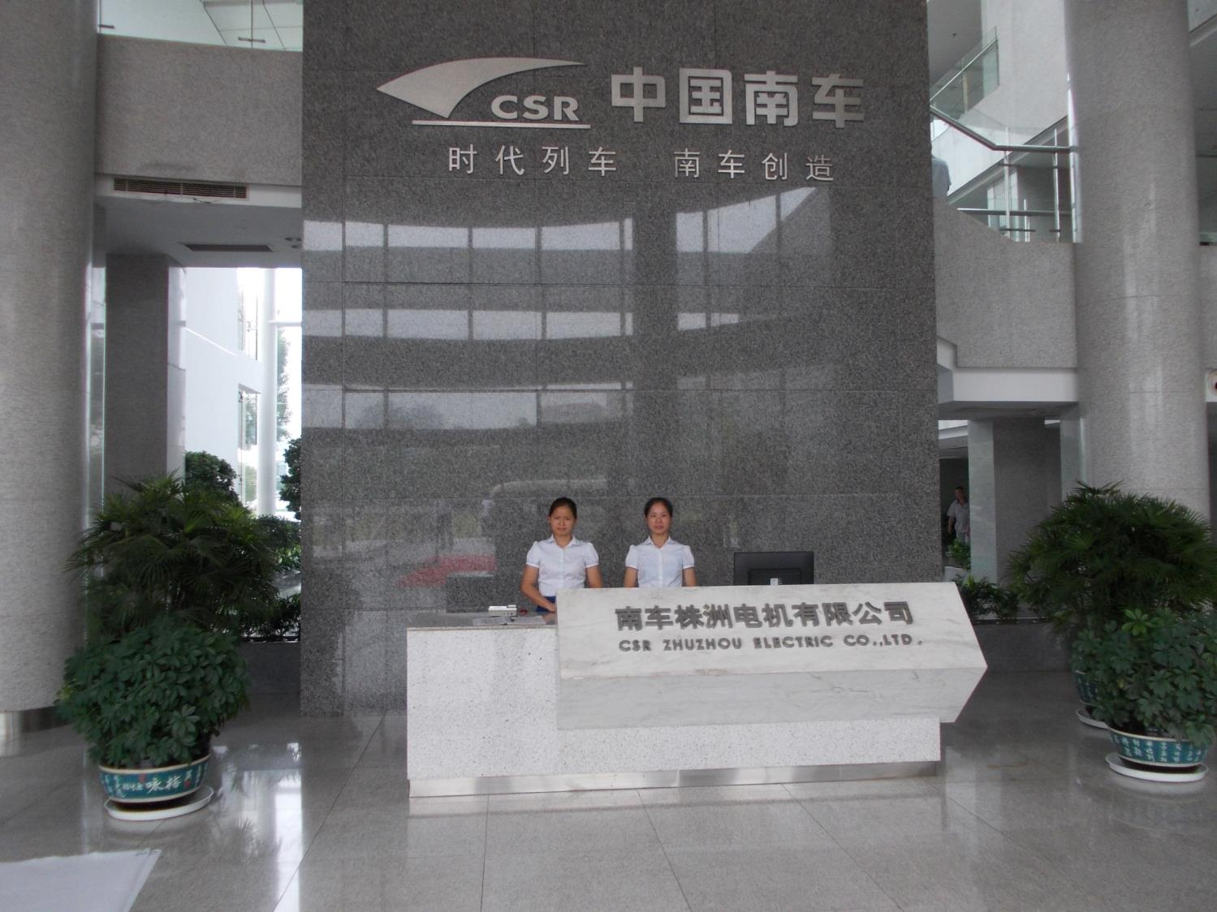
High Speed Rail Company

Slide 14
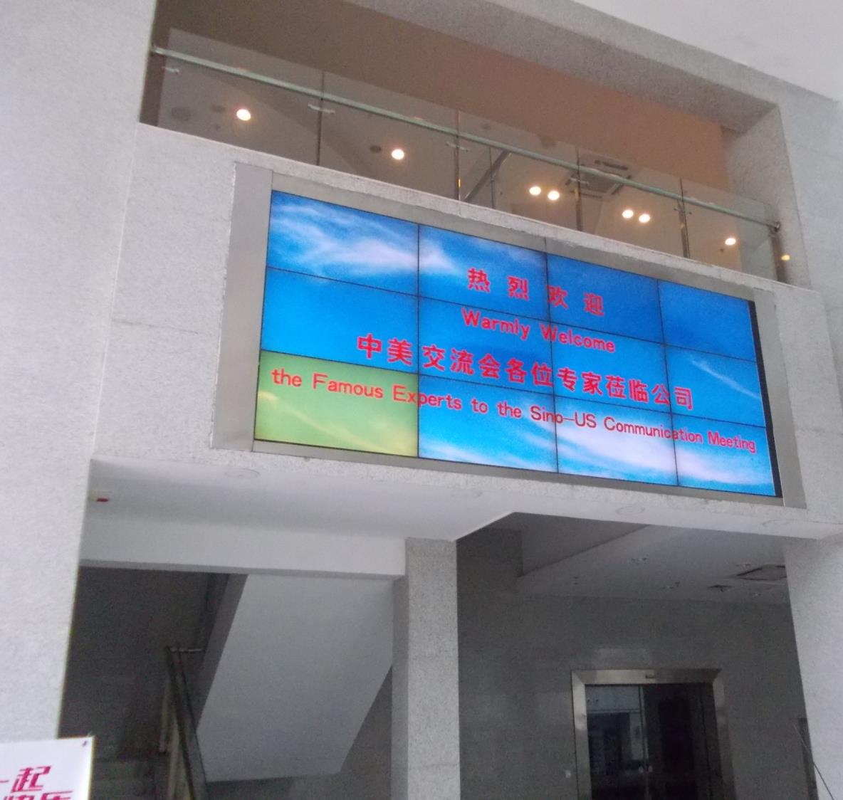

Slide 15
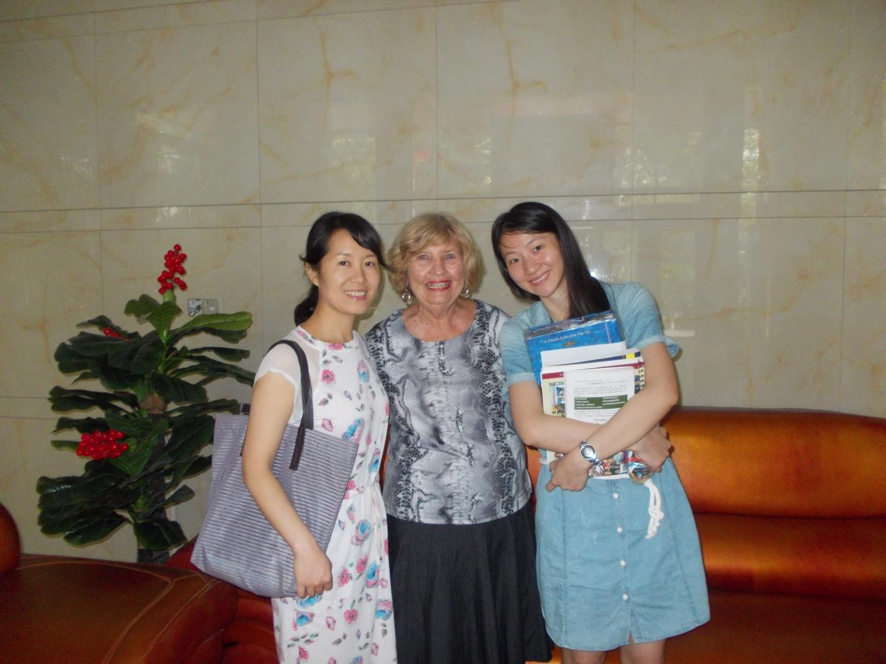
Old friends from 2011, Catherine and HER
(and Margie Williams from the USA )

Slide 16
2,000+ students from age 2-6

Slide 19
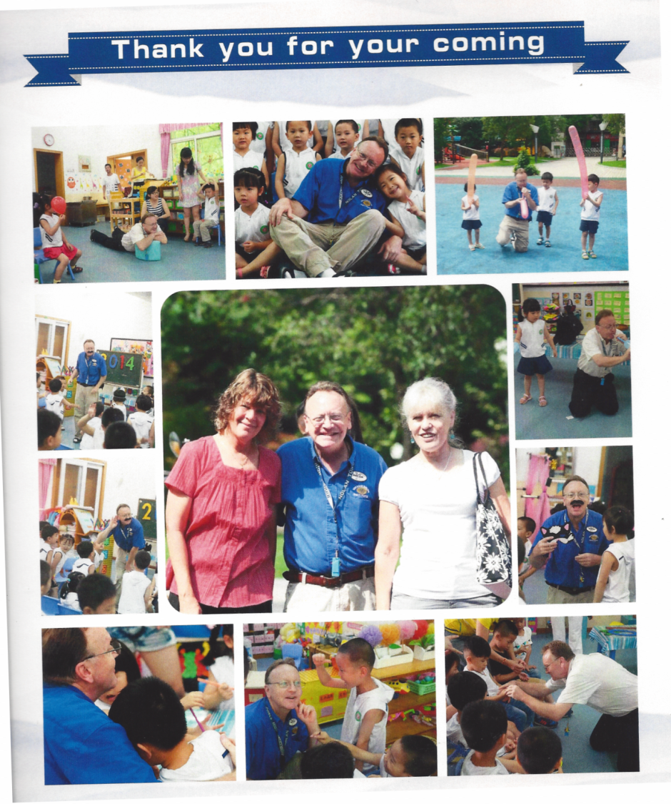

Slide 20
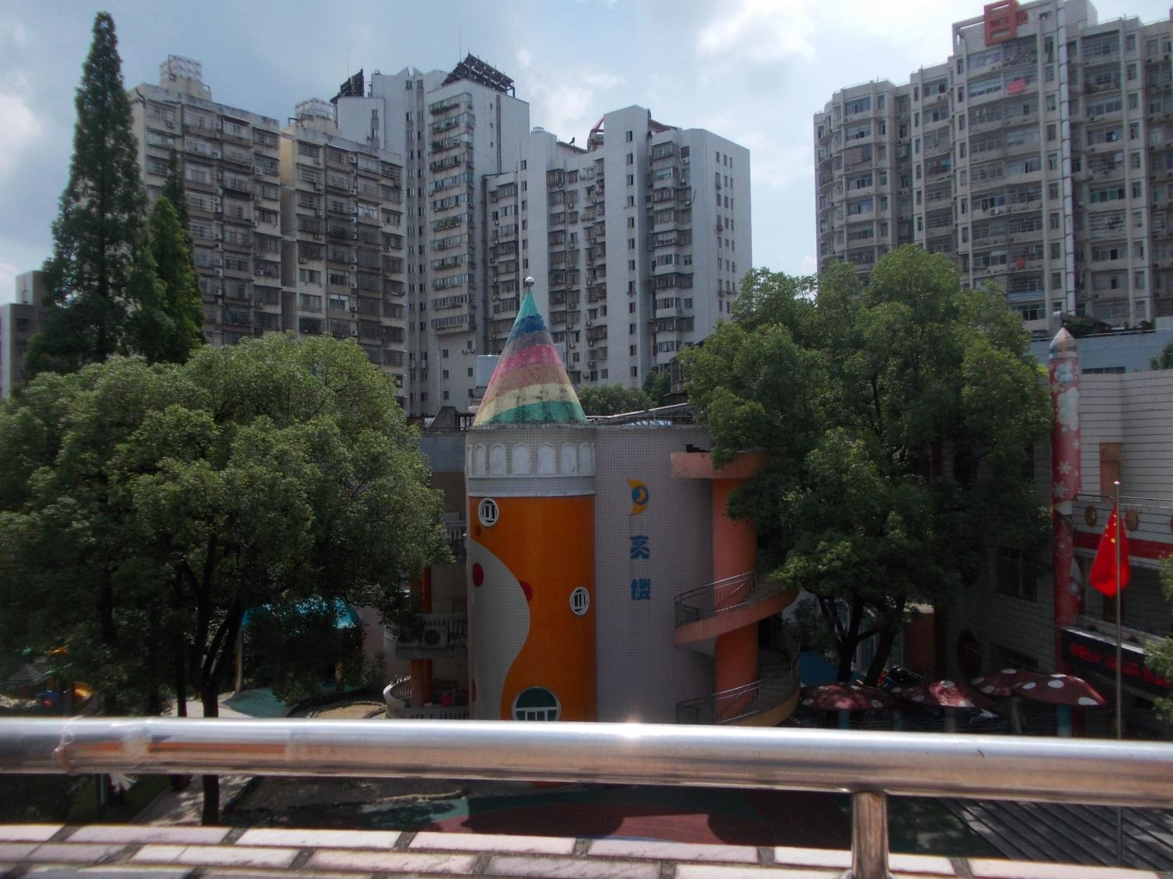
Looking down into school court yard – clear sky and city in background

Slide 21
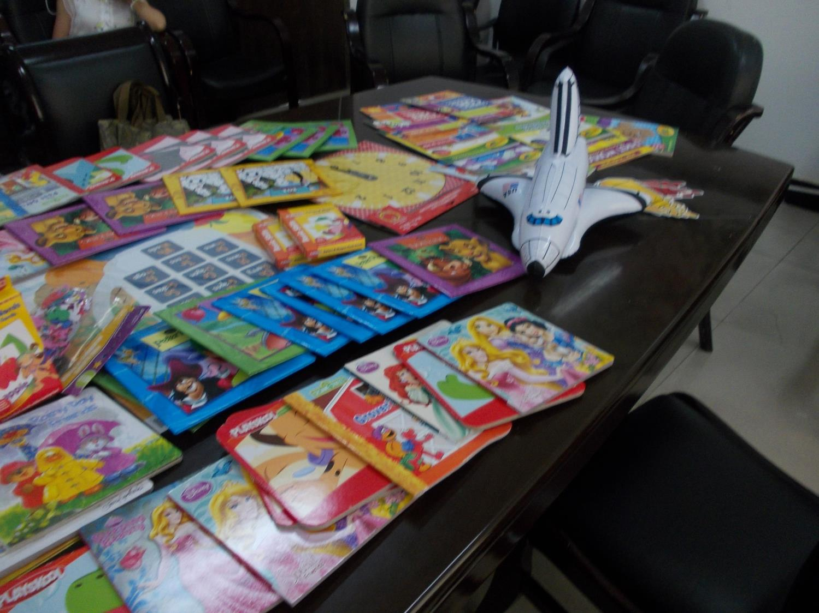
Donated supplies and teaching items to the school

Slide 22
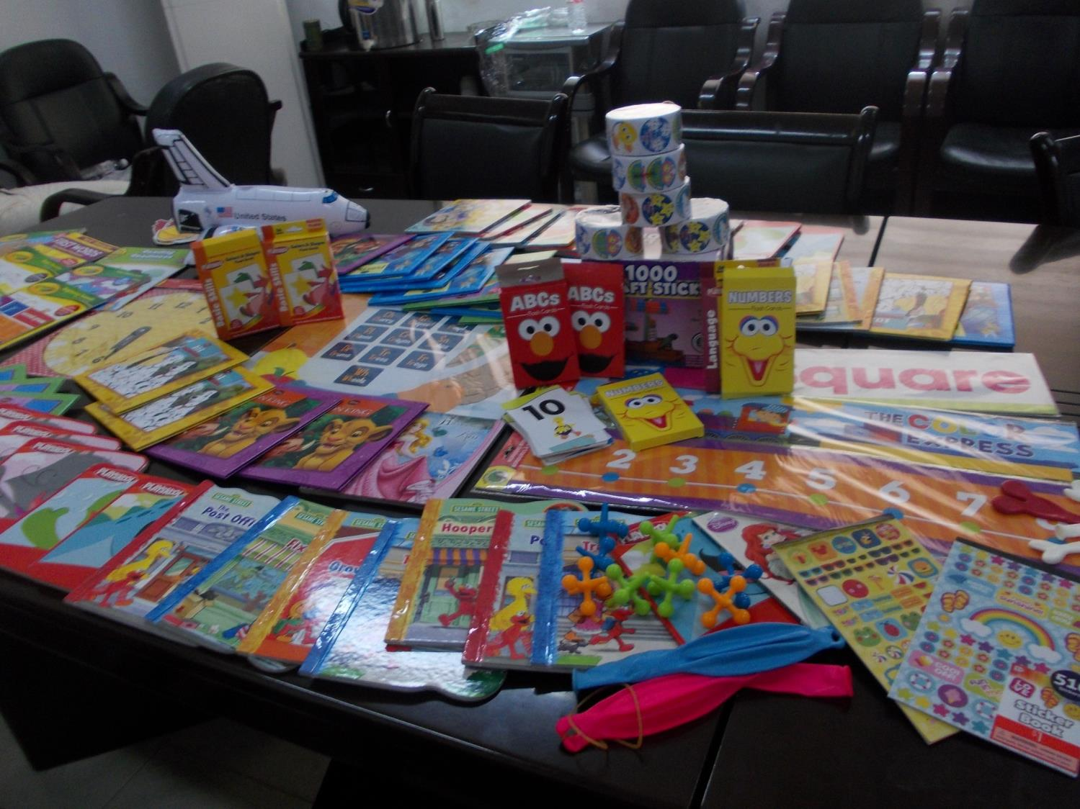

Slide 23
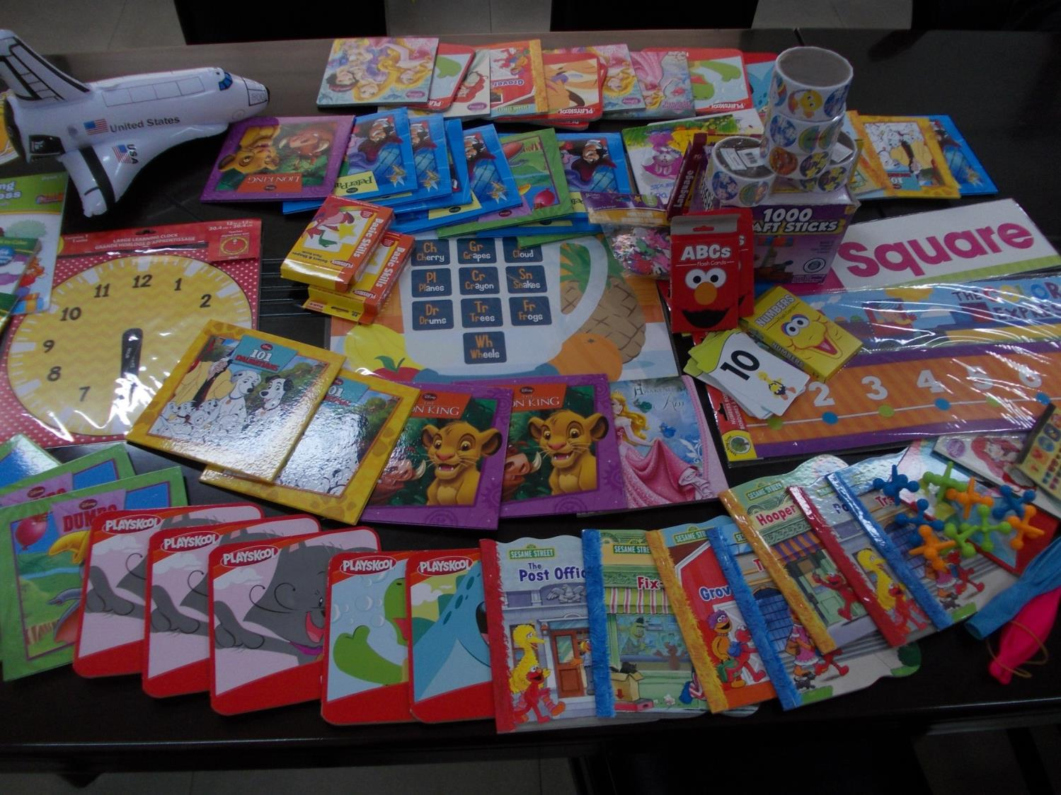

Slide 24
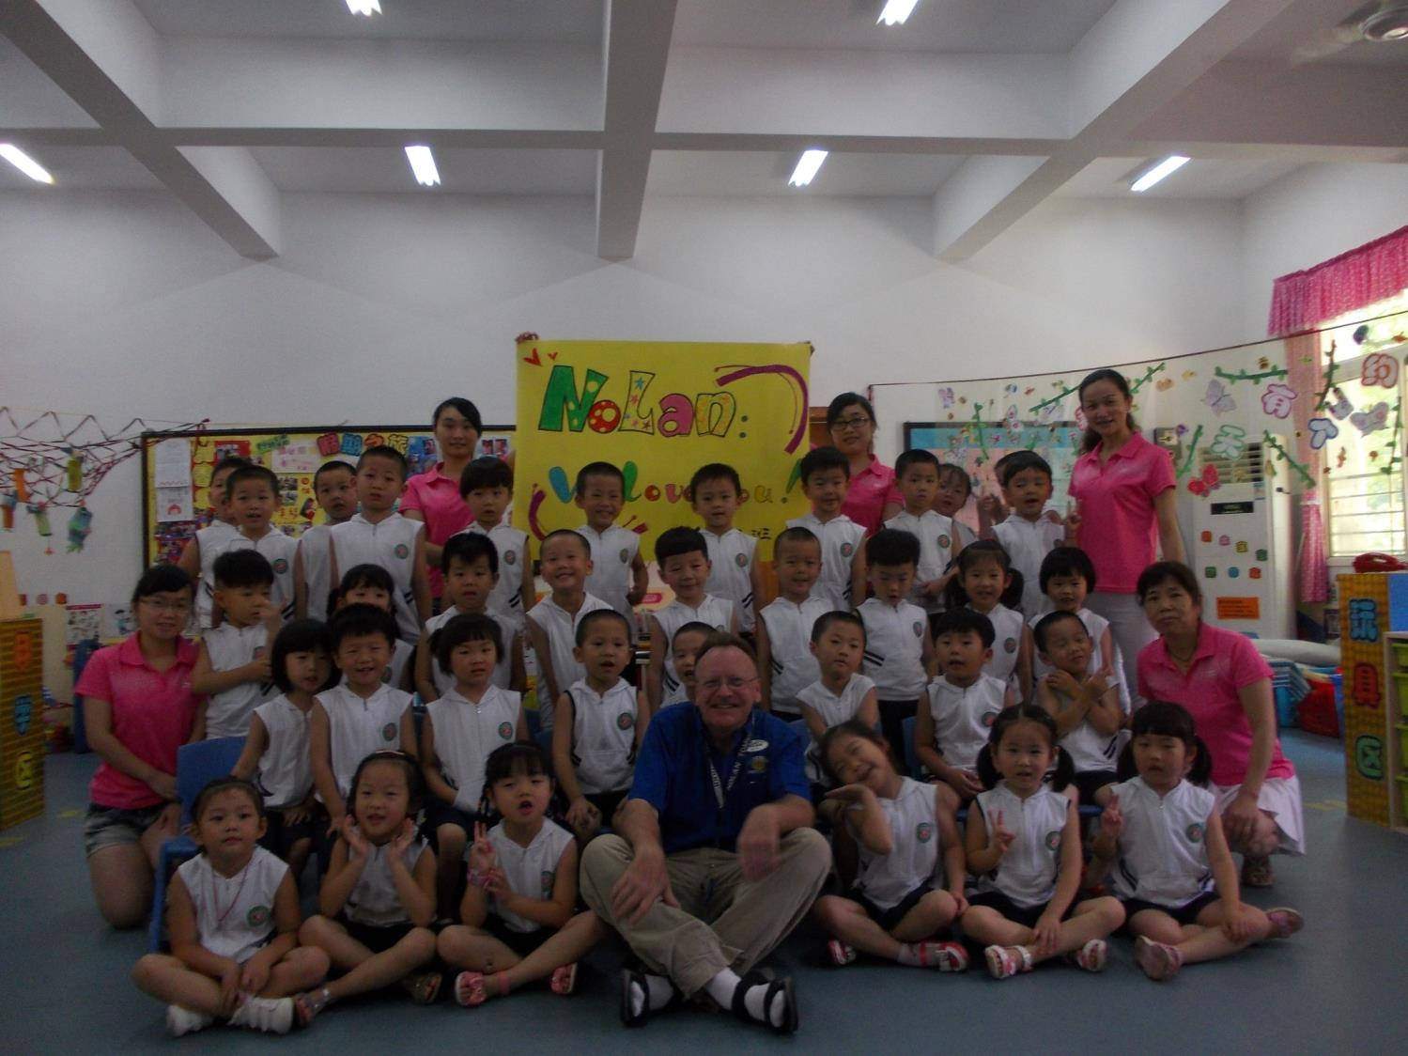
Nolan’s Class with mostly 4 & 5 year old students

Slide 25
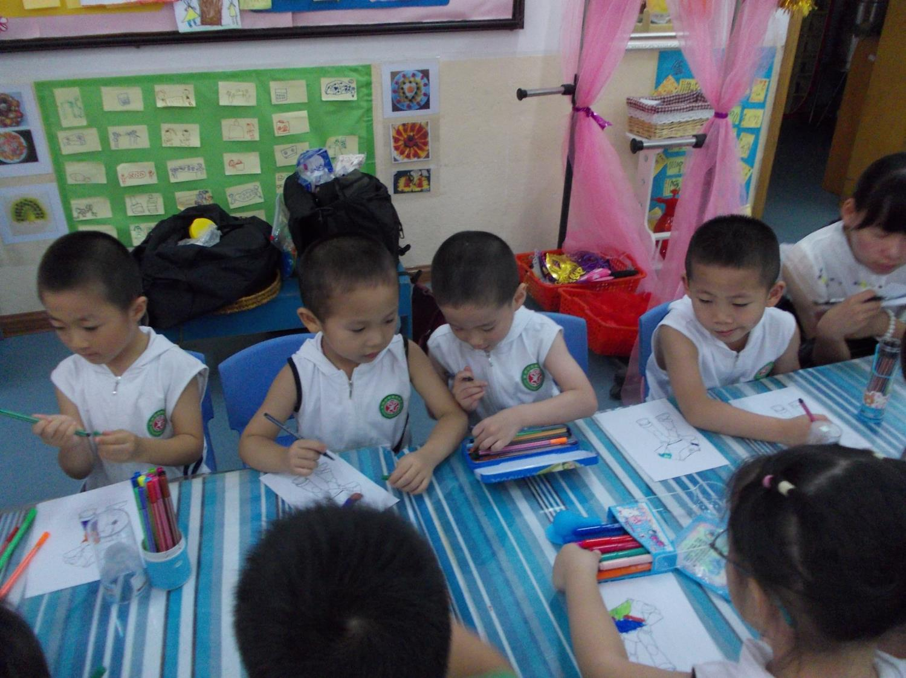

Slide 26
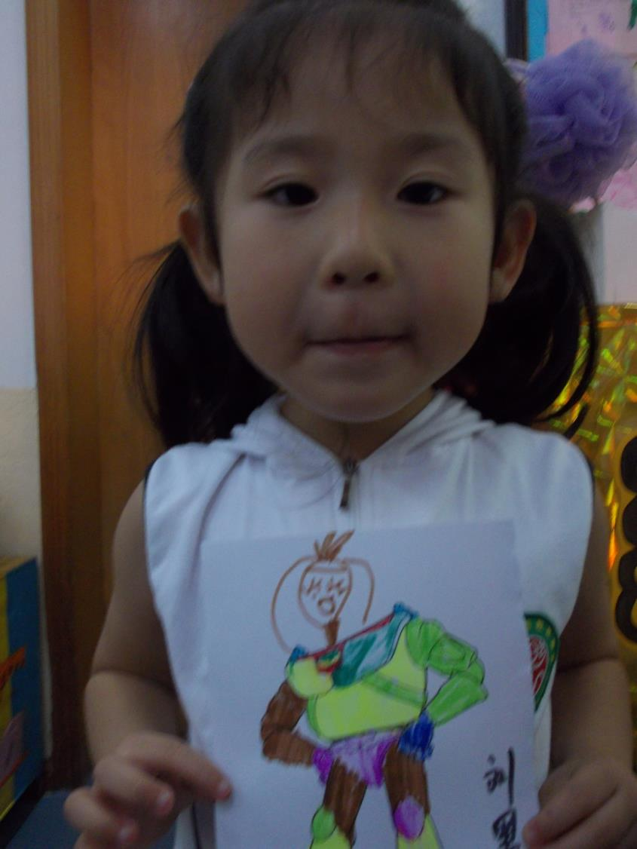

Slide 27
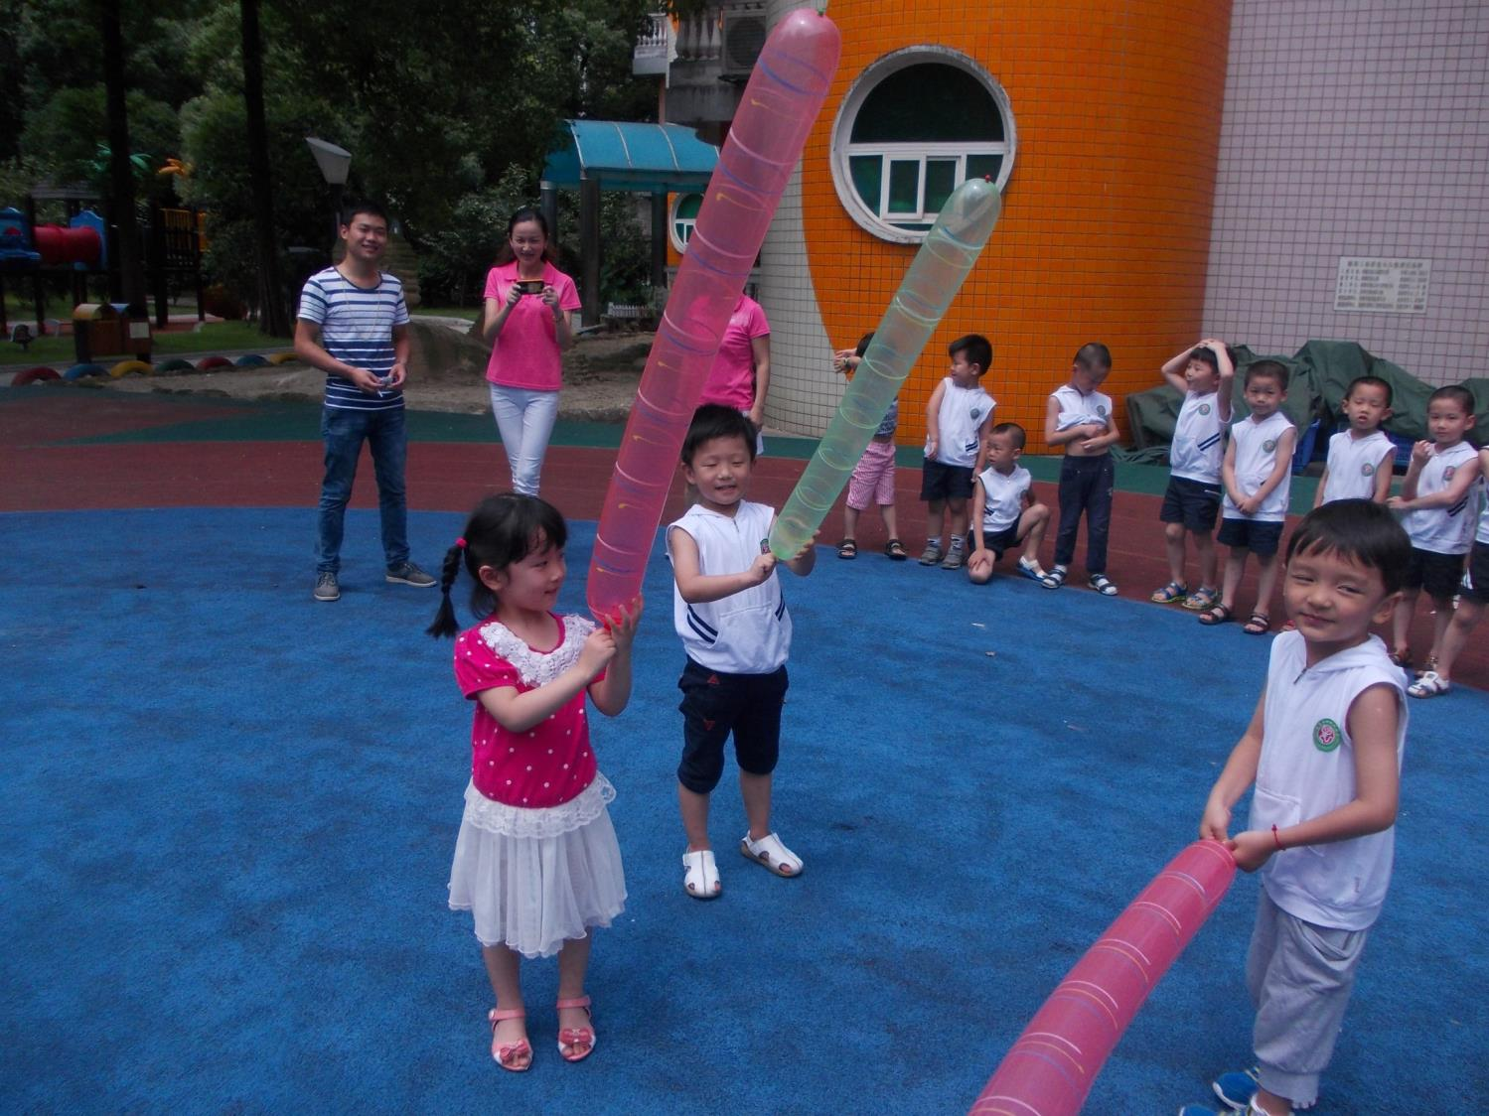
ROCKET
BALLOONS

Slide 28
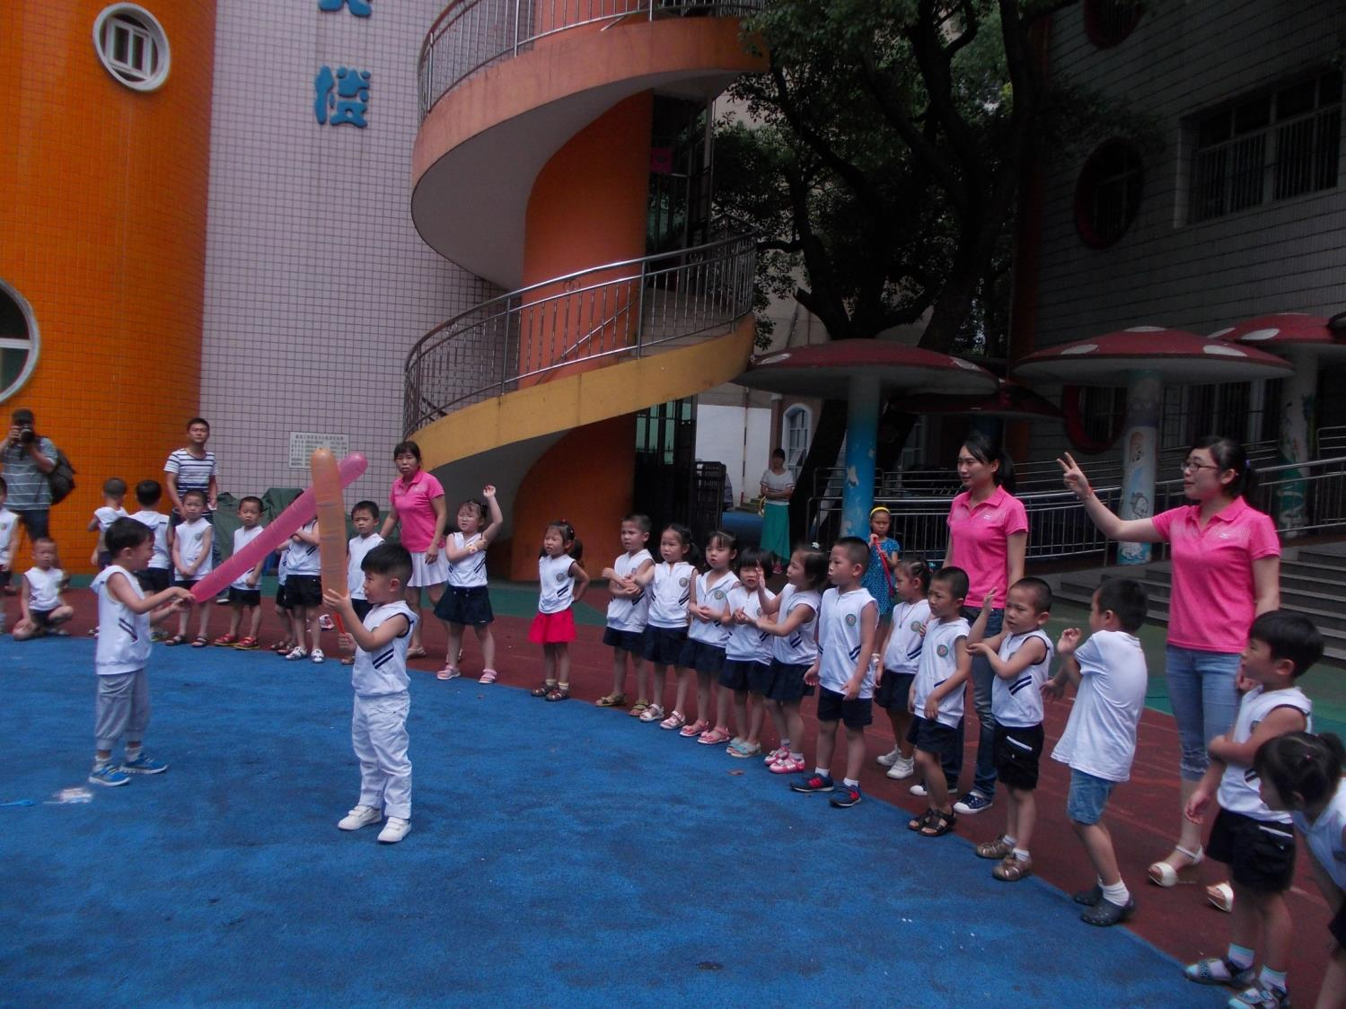

Slide 29
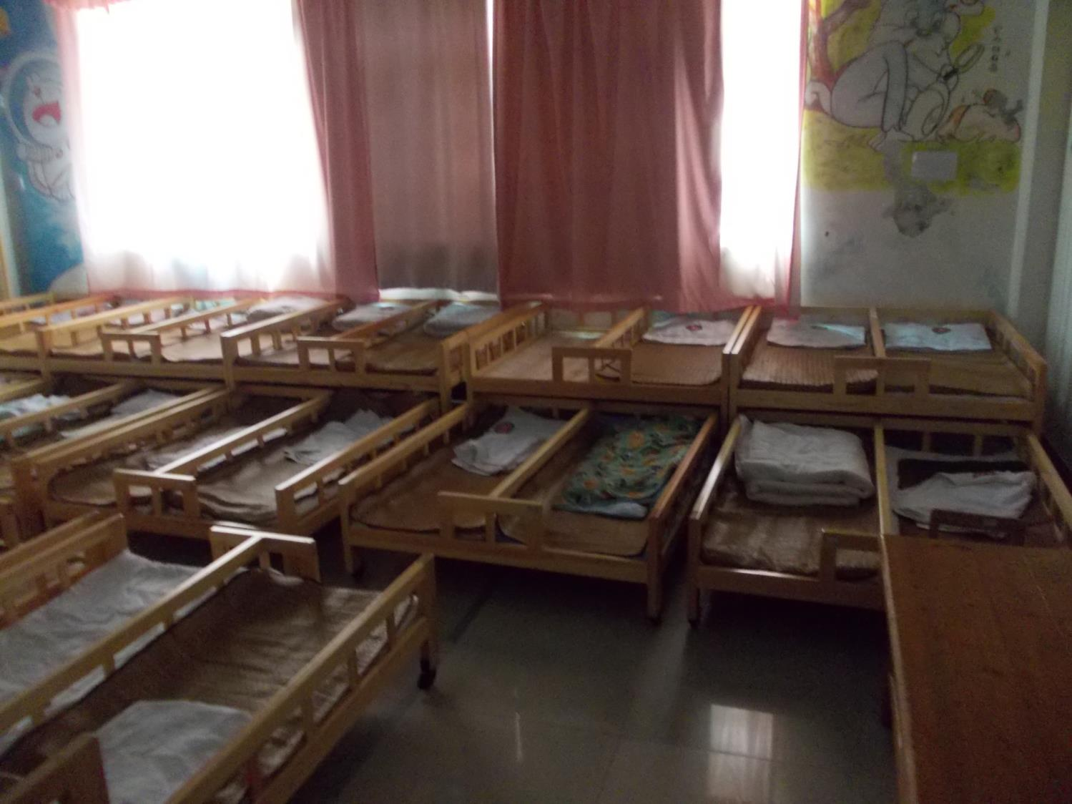
Sleeping nap room

Slide 30
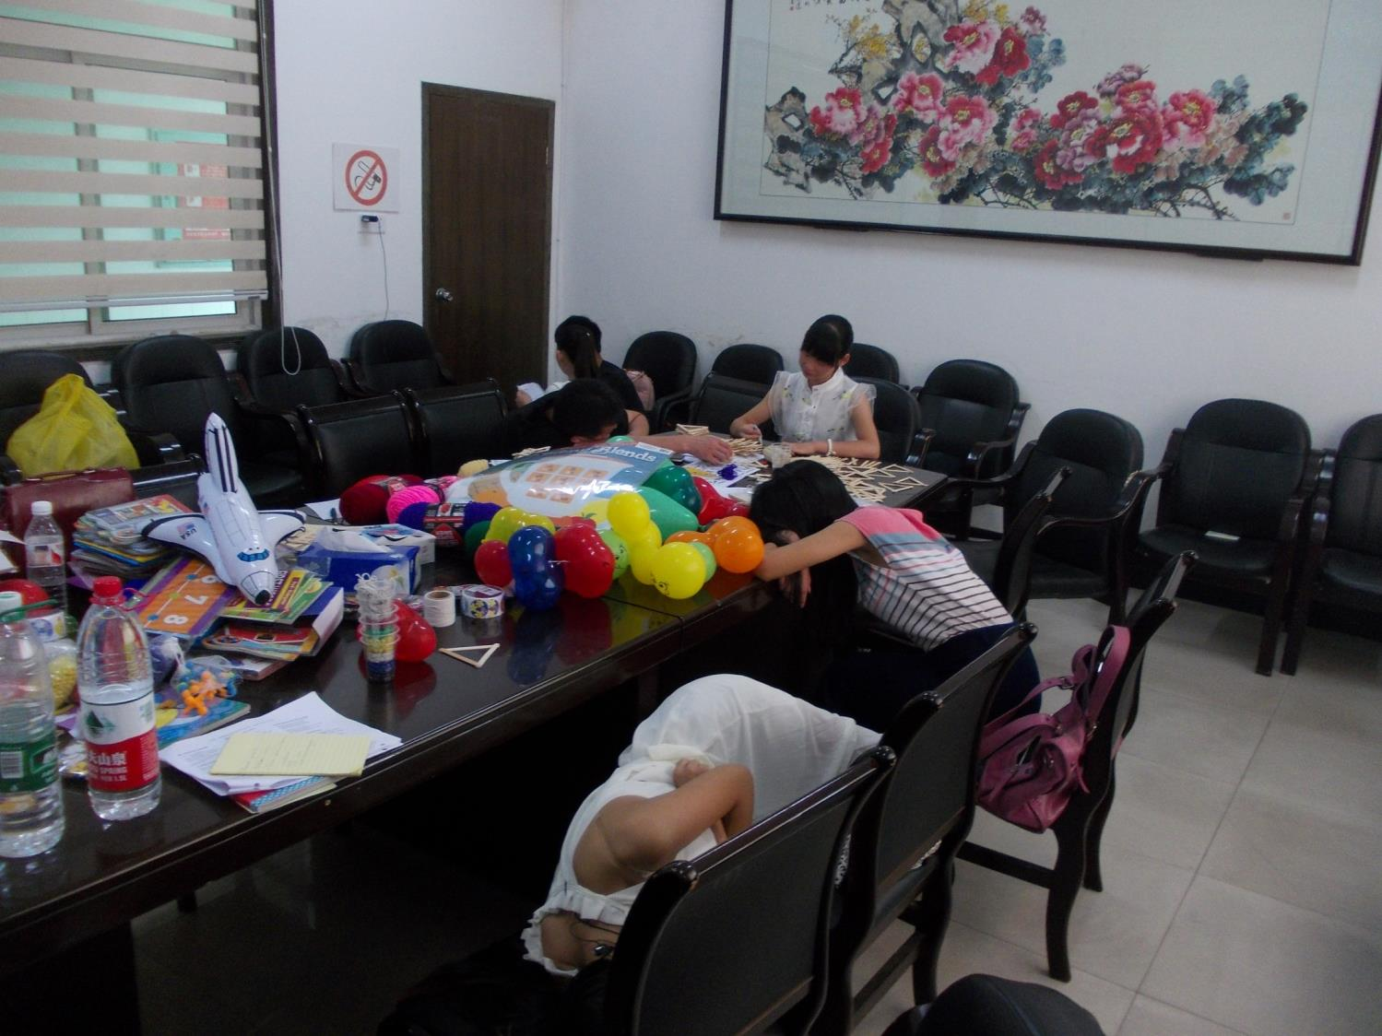
Teacher Work Room (on 6th floor)
(Student helpers resting during afternoon break.)

Slide 31
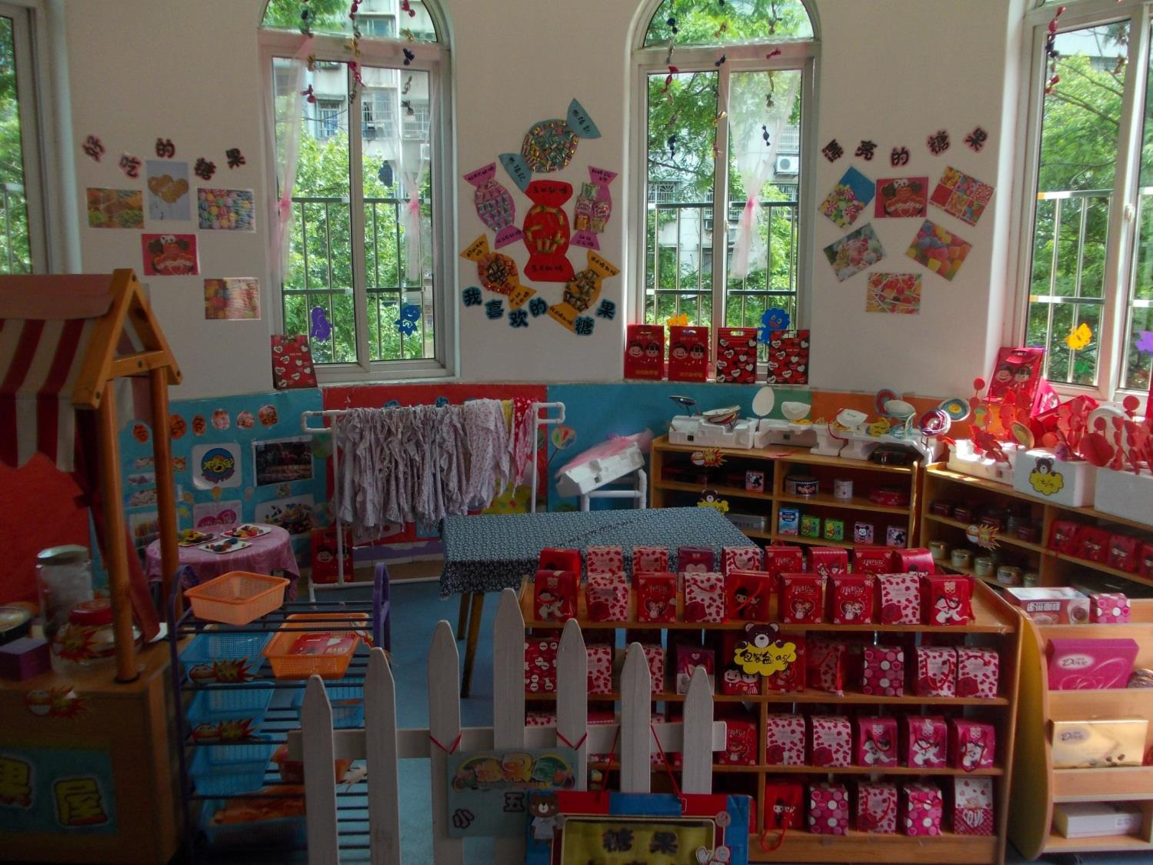
Indoor Play / Pretend Area

Slide 32
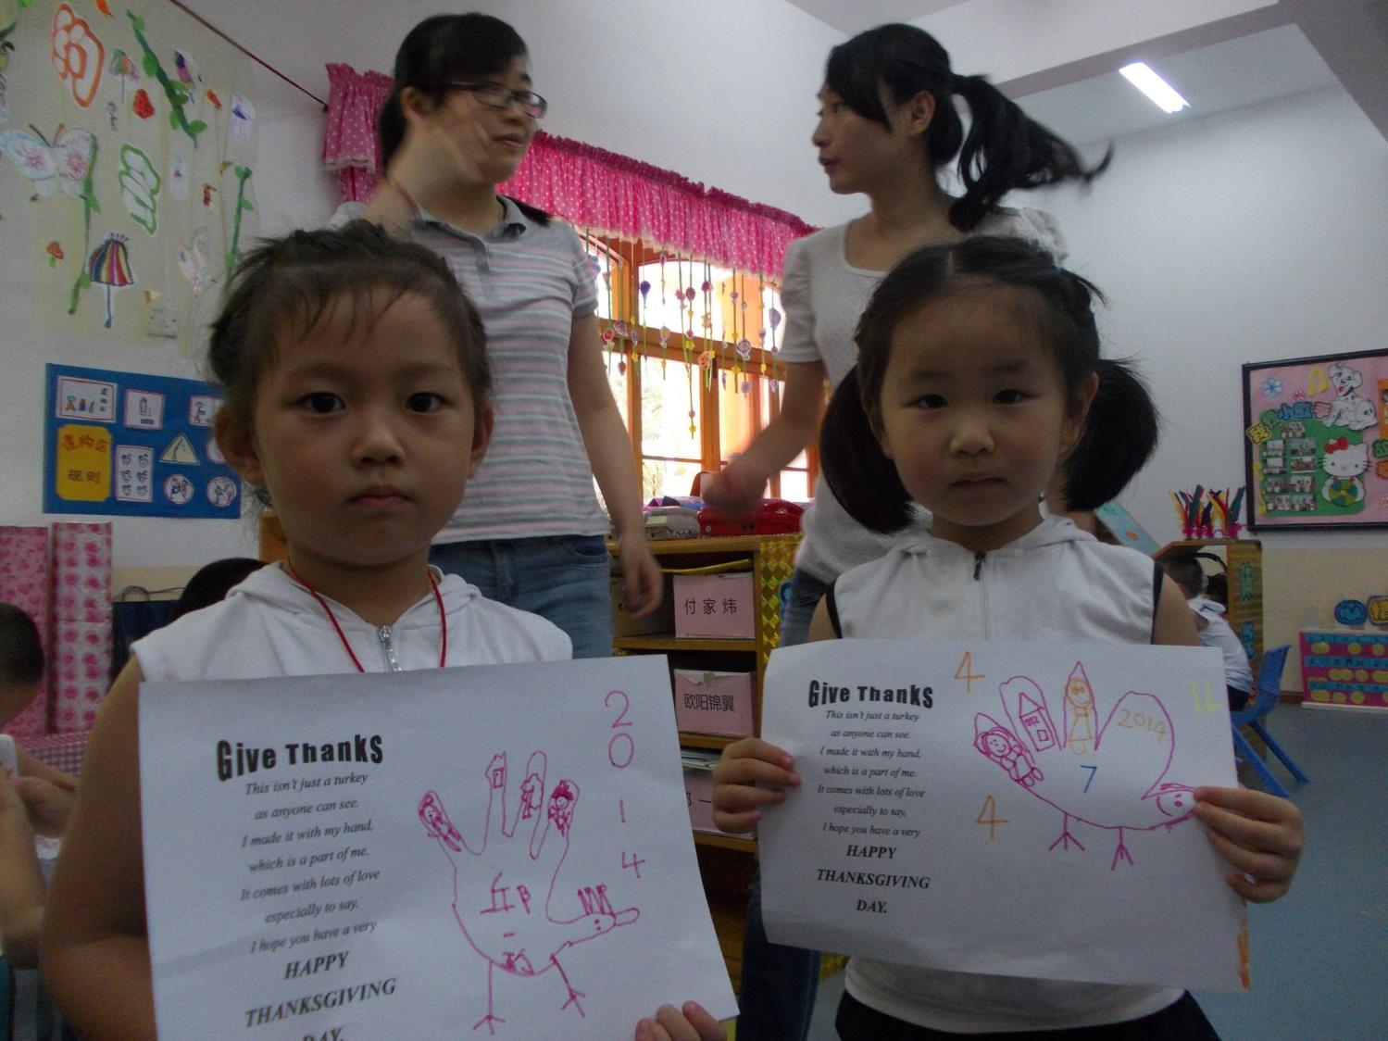

Slide 33
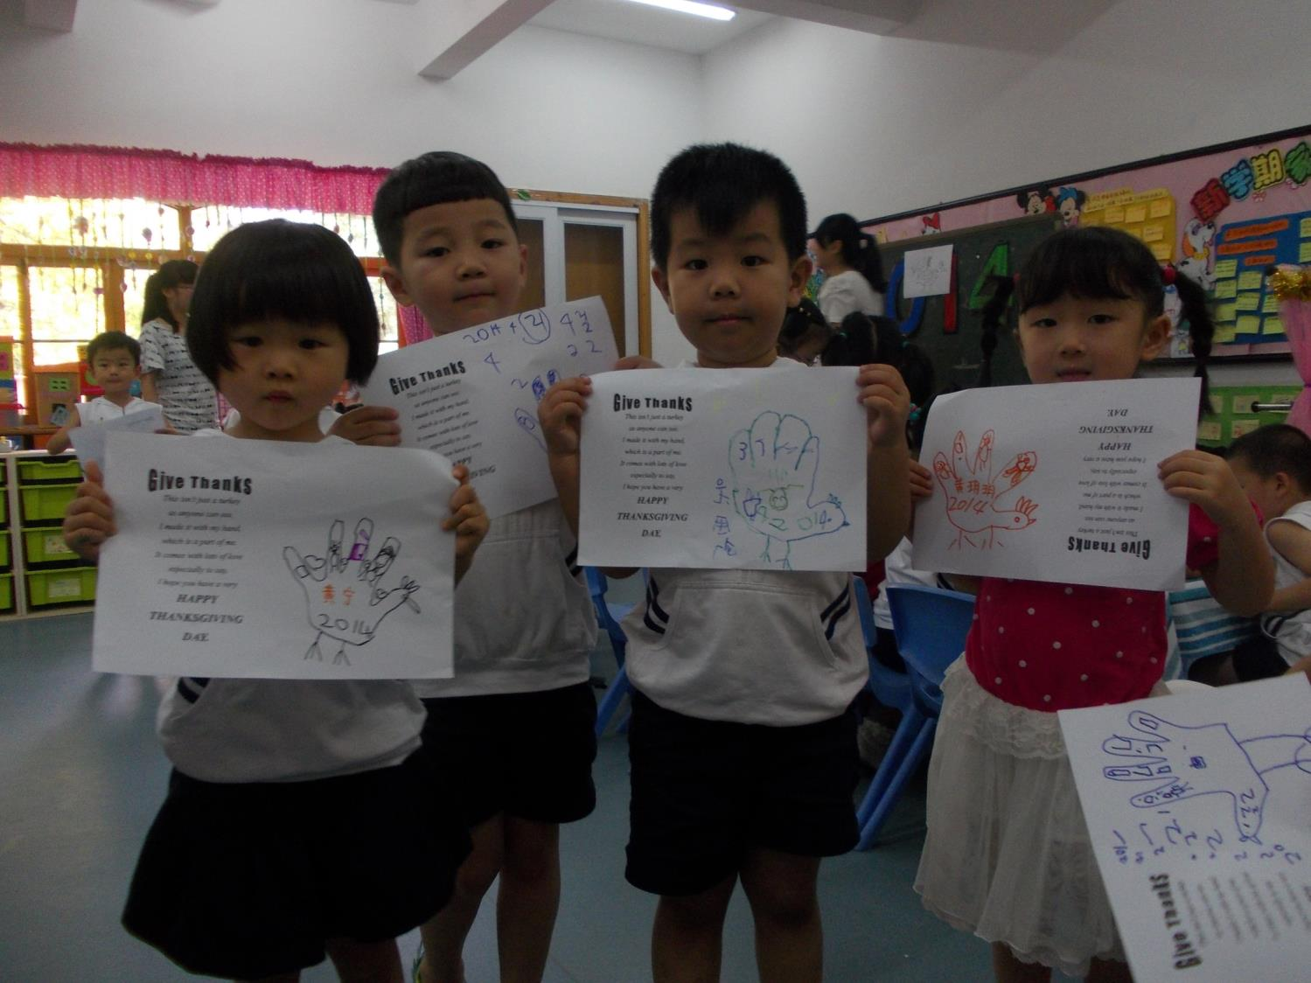

Slide 34
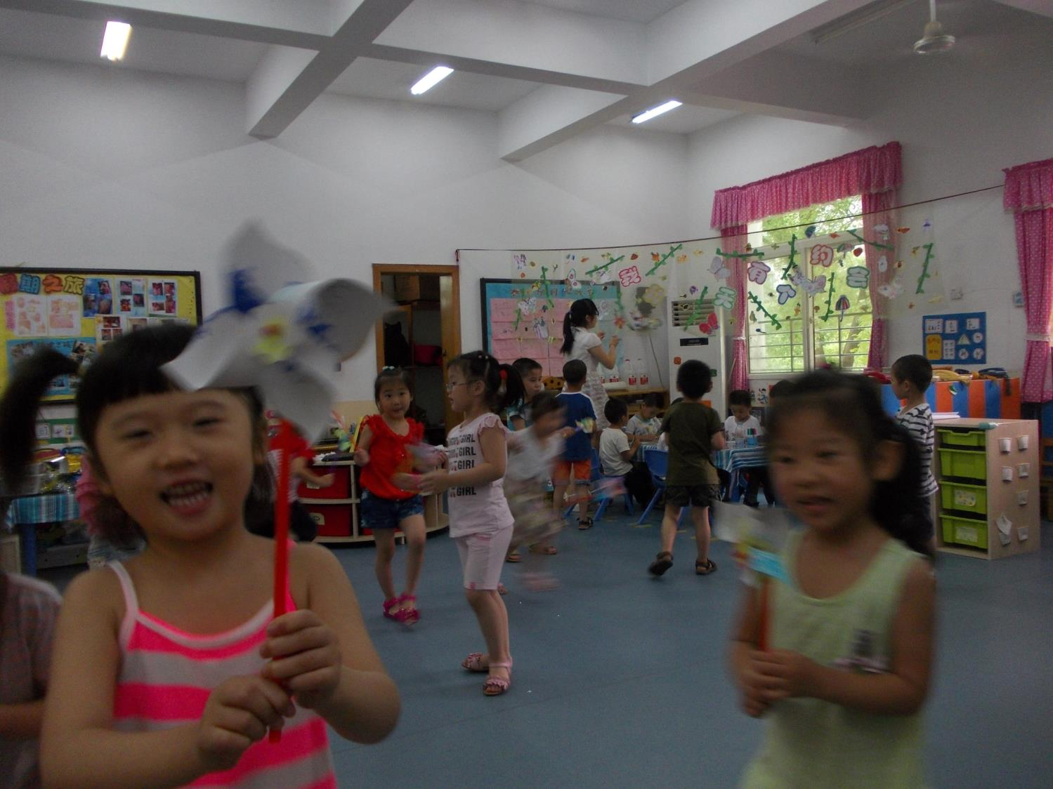
PINWHEELS FOR PEACE

Slide 35
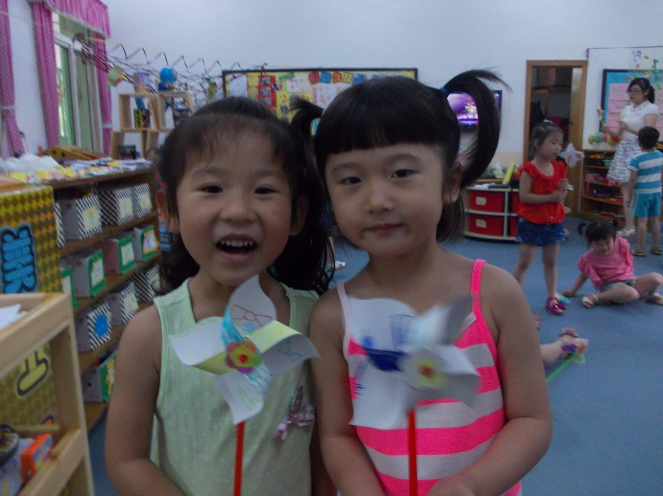

Slide 36
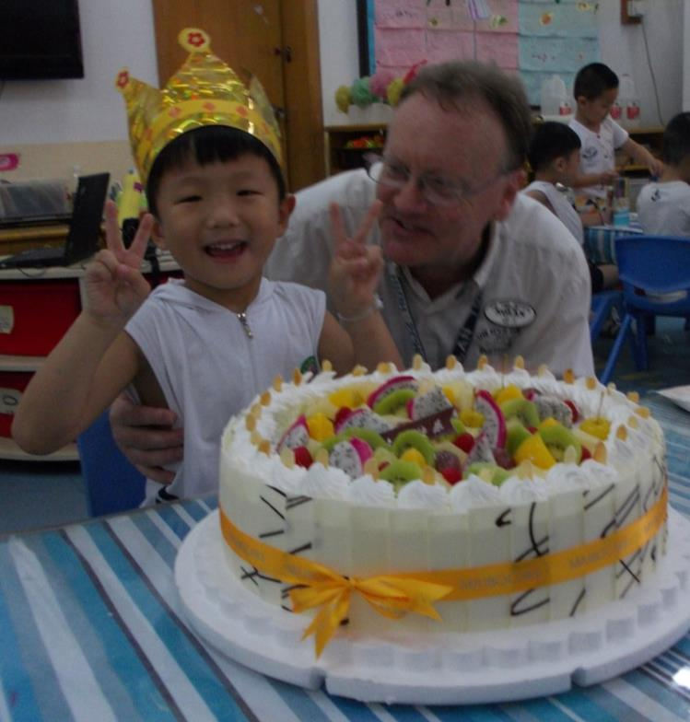
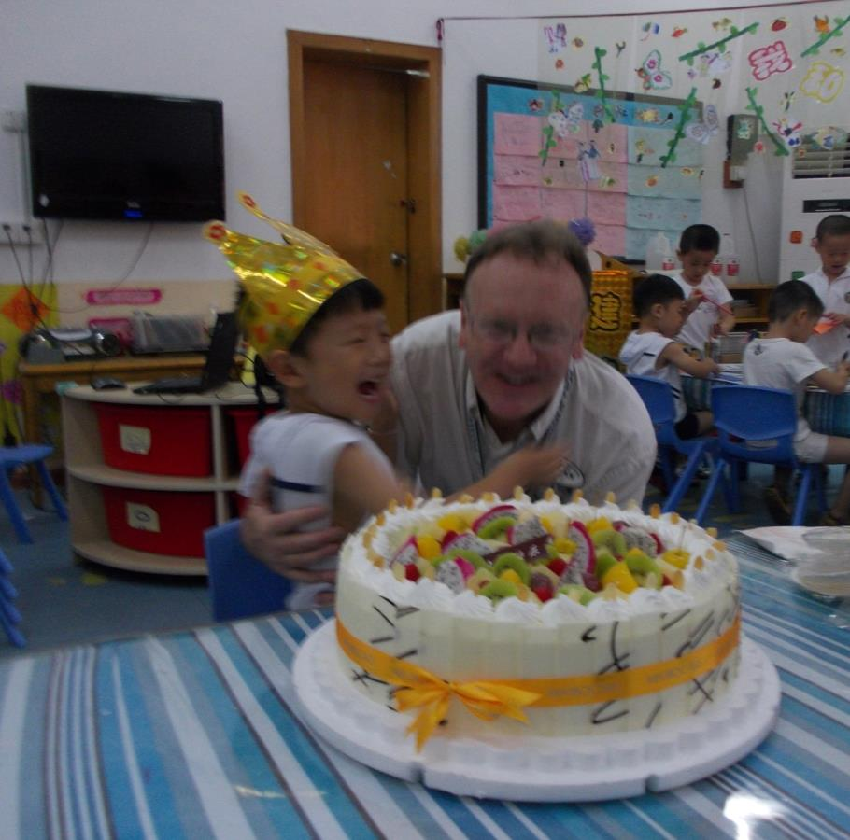

Slide 37
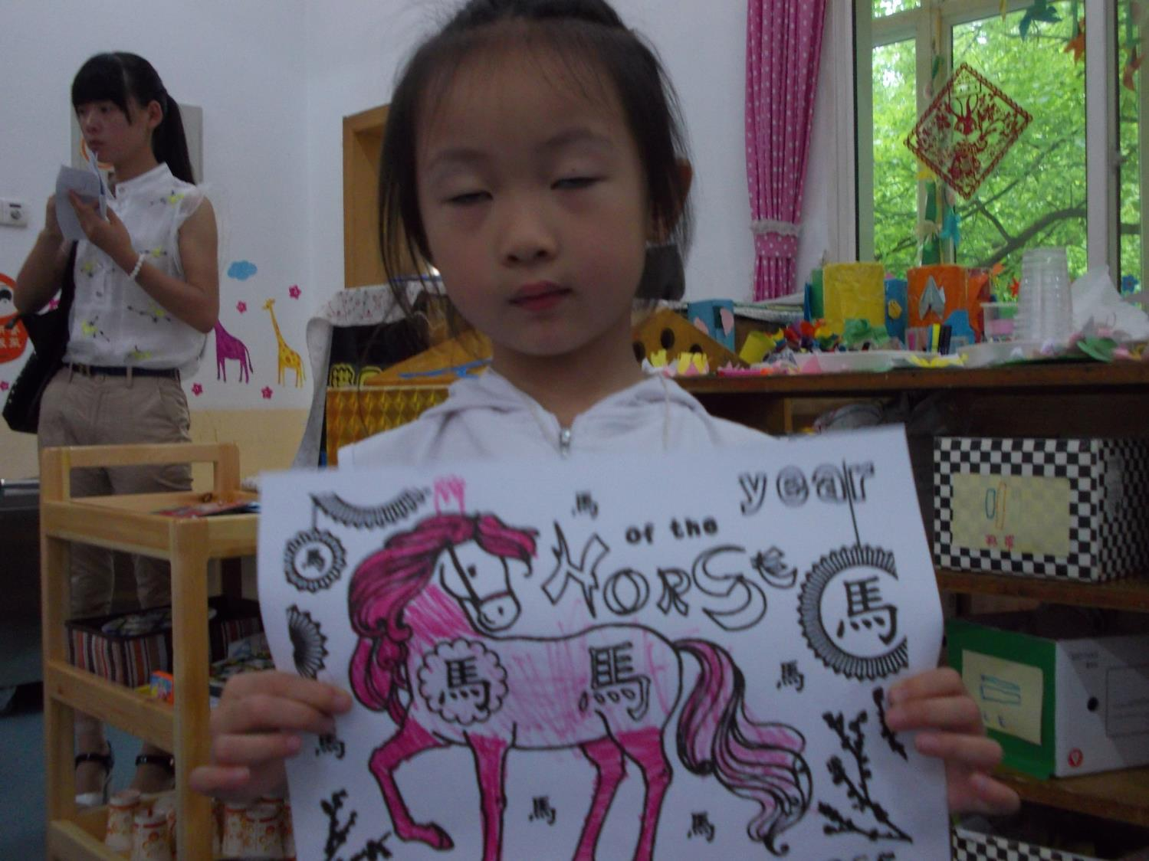
Coloring Sheet Activity and all students were given little horses.

Slide 38
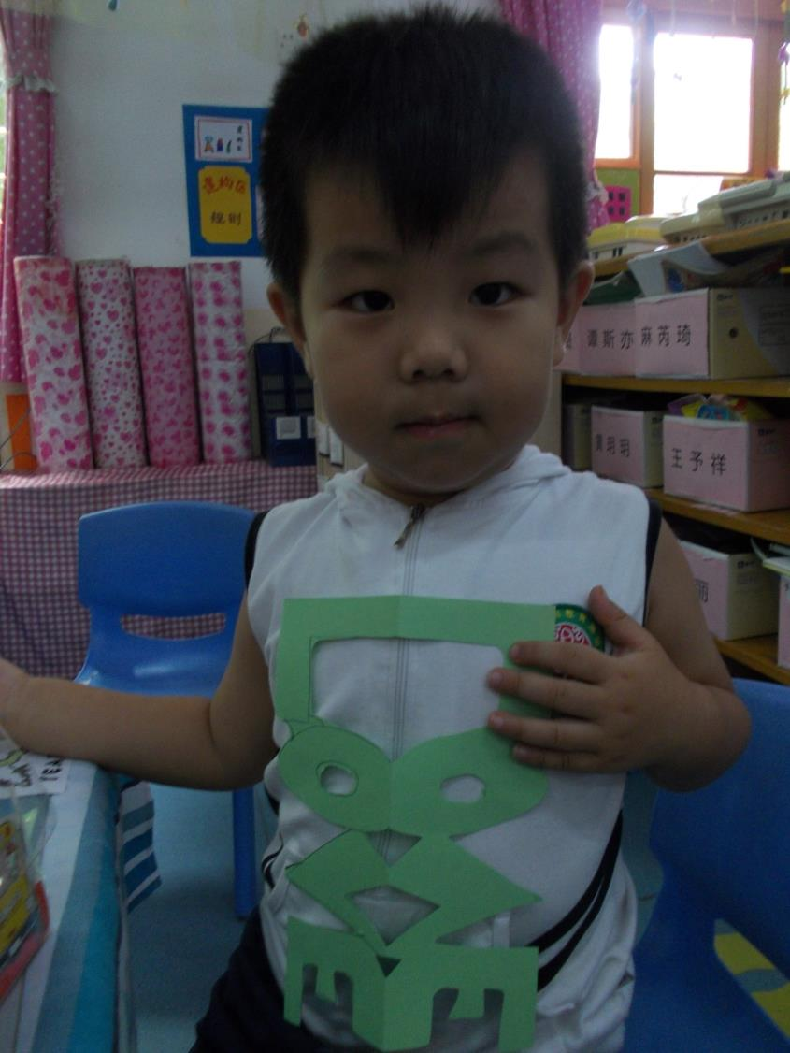
It
is
LOVE

Slide 39
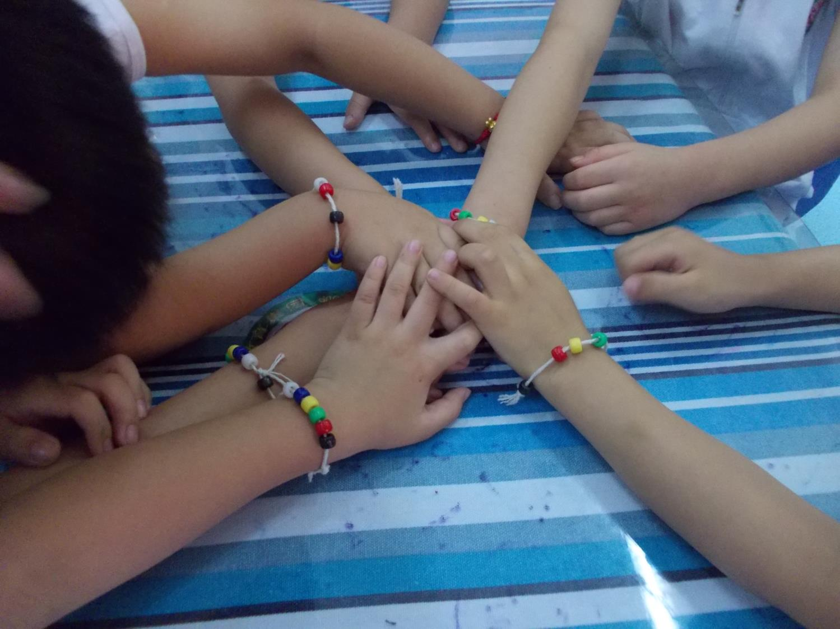
Friendship Bead Bracelets

Slide 40
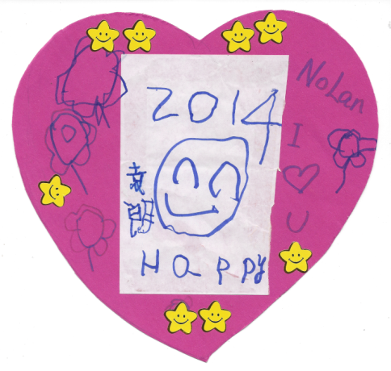
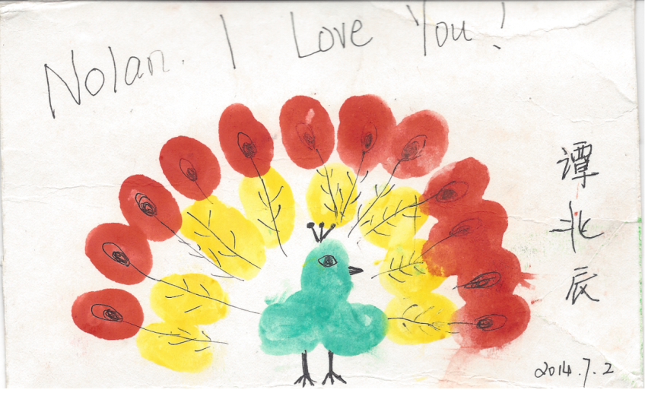
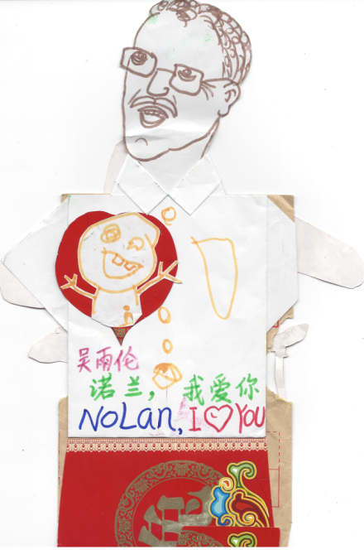
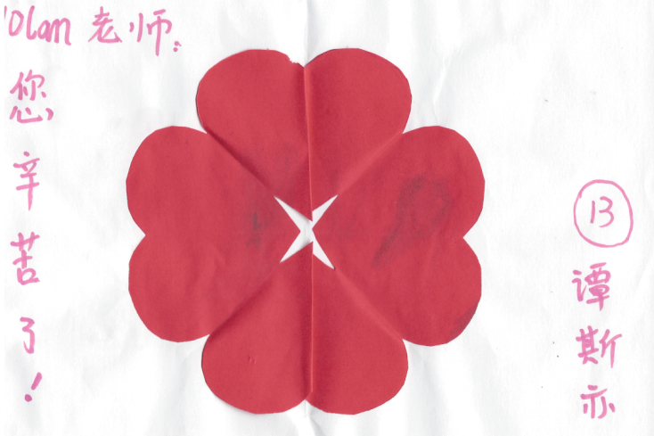
Sample of Student Cards.

Slide 41
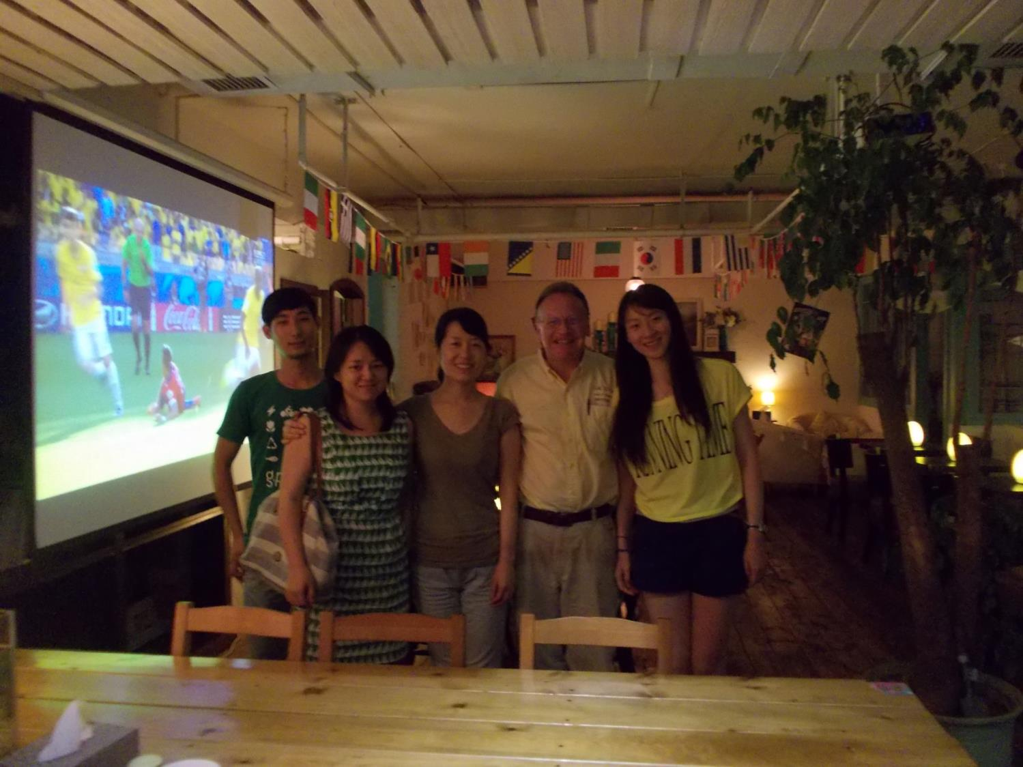
Visiting Catherine in her “KOREAN” restaurant

Slide 42
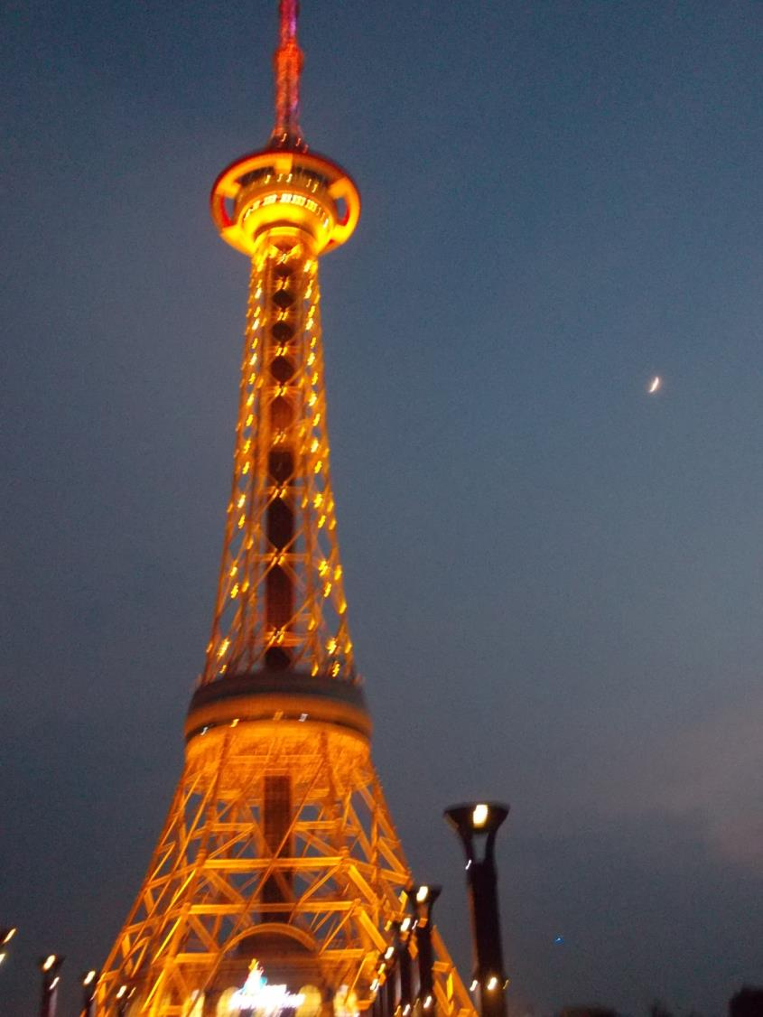
Zhuzhou Radio/TV tower at night .
(Moon
is on the
right)
I was tempted to ride up to the top but it was 80 RMB.

Slide 43
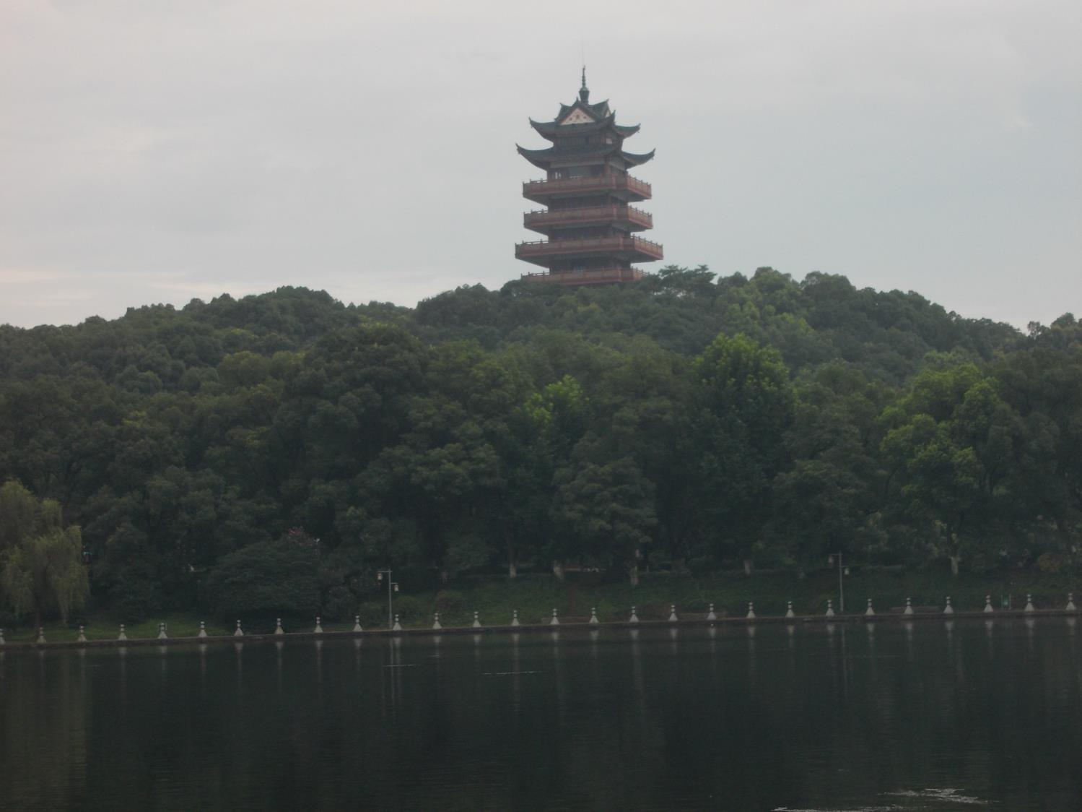
Closing Meal – at park with teachers and helpers

Slide 44
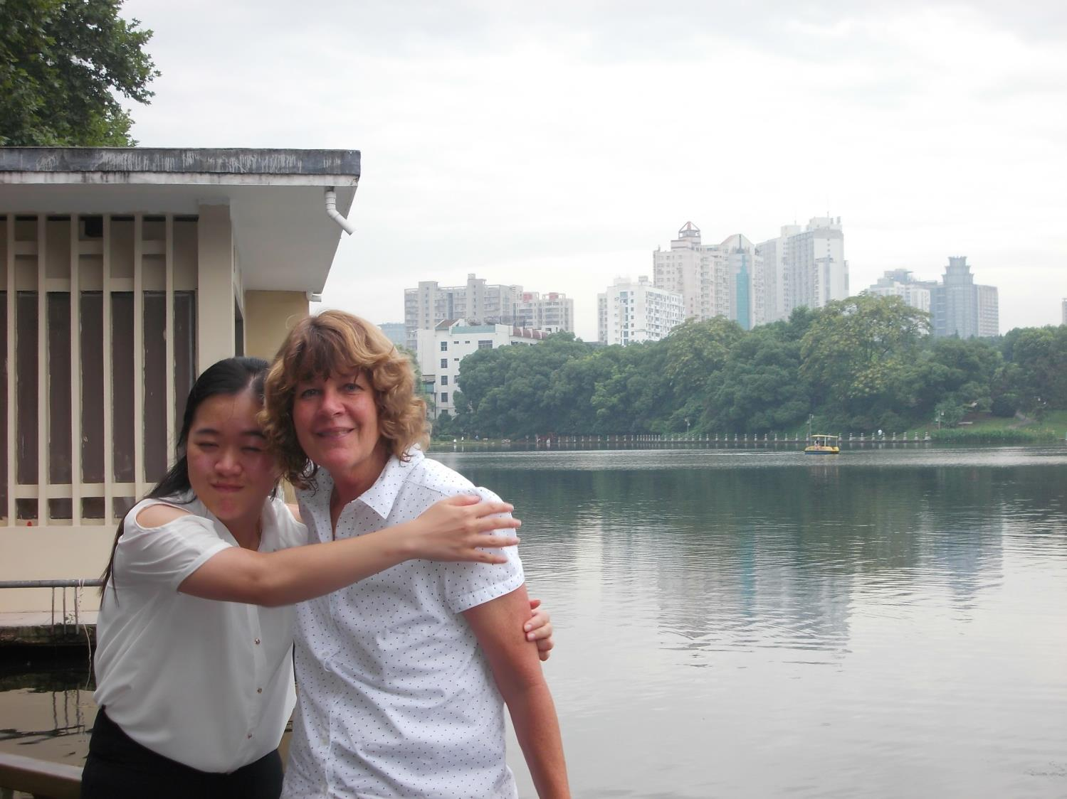
Kate with our liaison / helper/ translator and friend,
LESLIE.

Slide 45
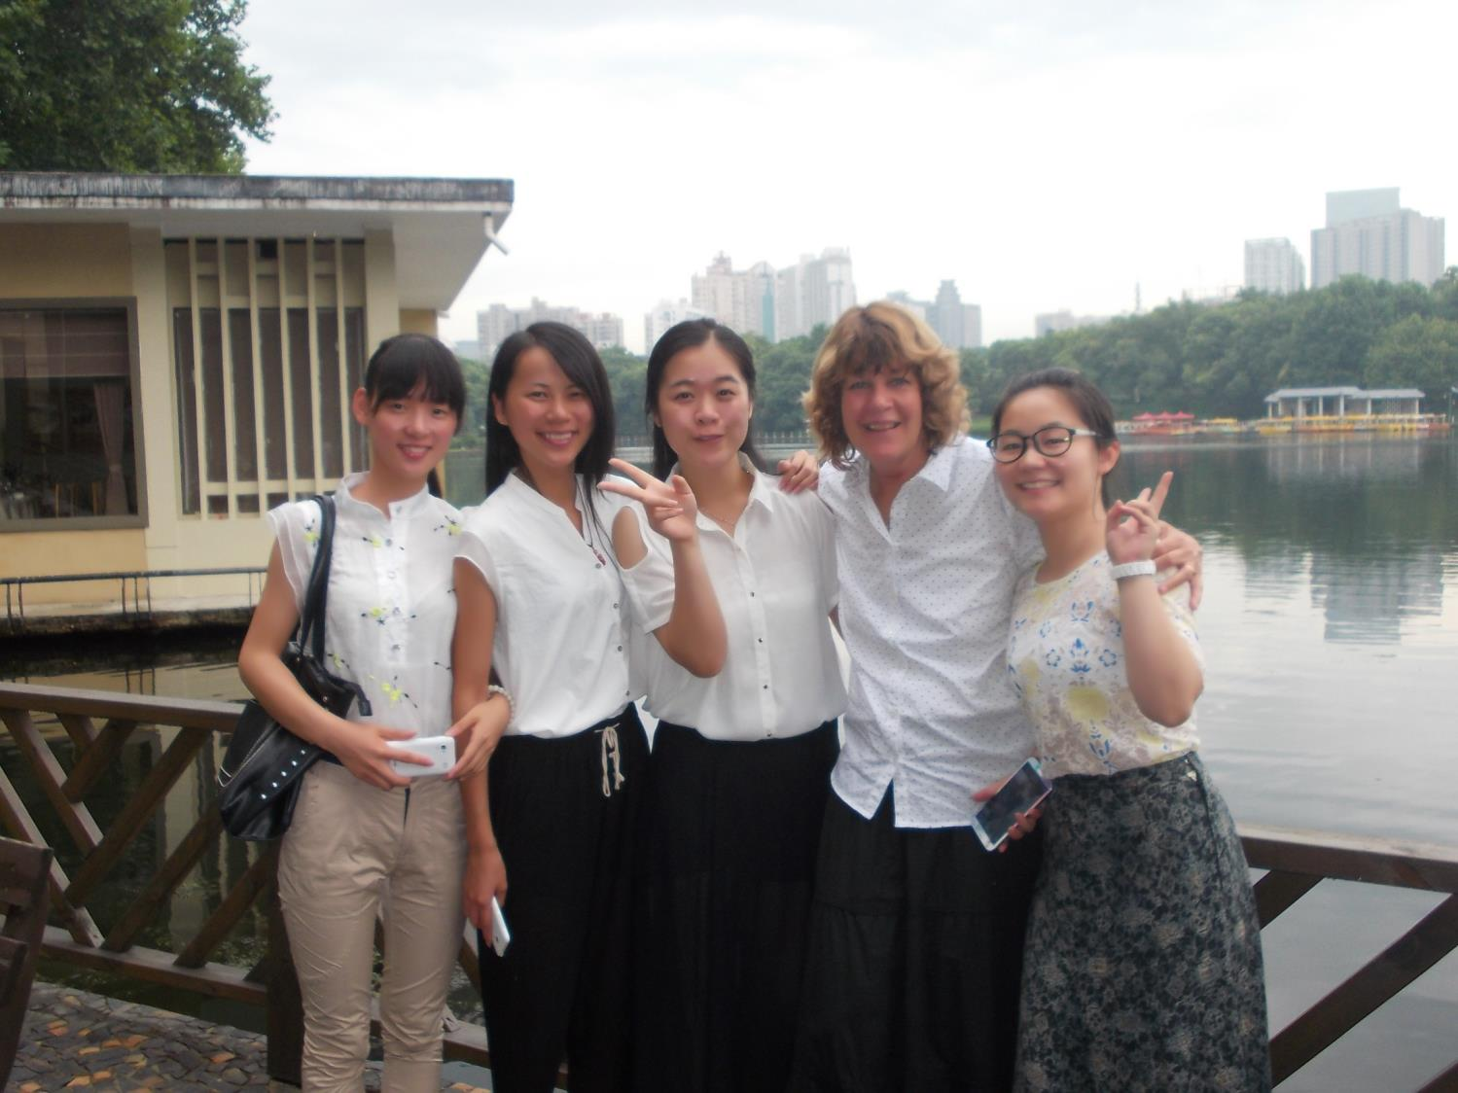

Slide 46
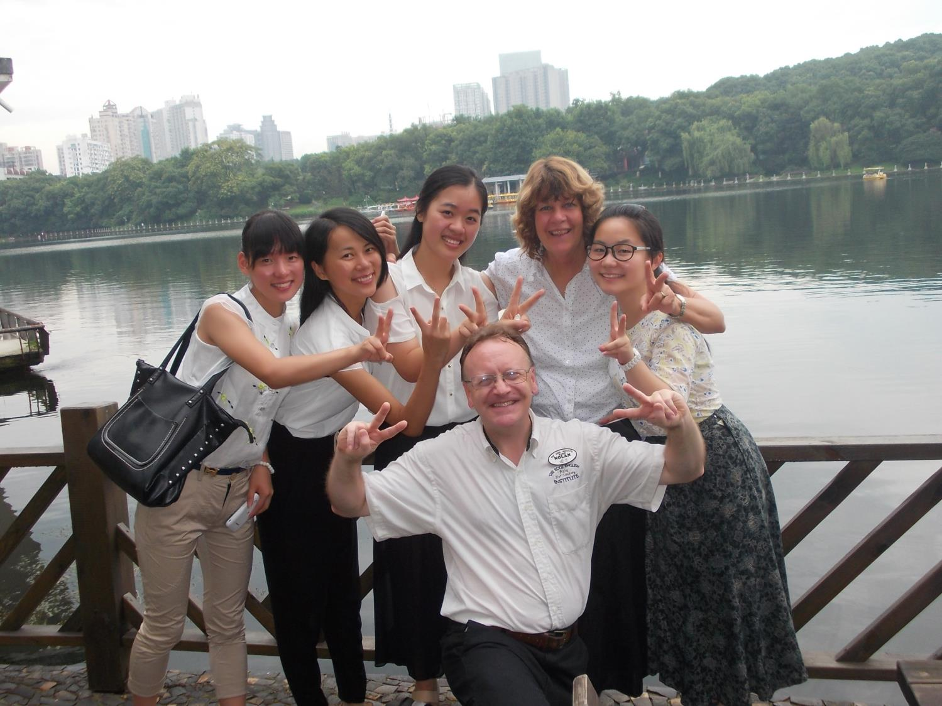

Slide 47
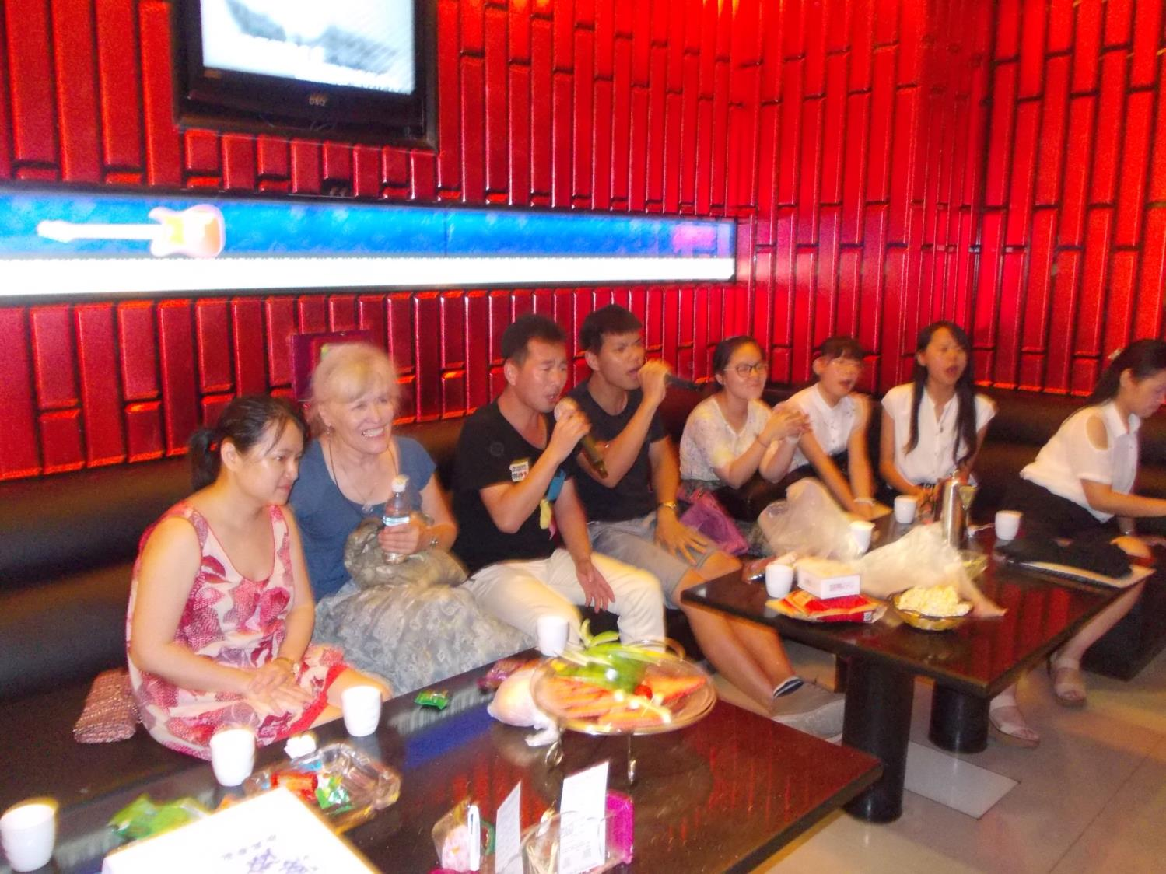
Night of fun at the Karaoke Bar

Slide 48
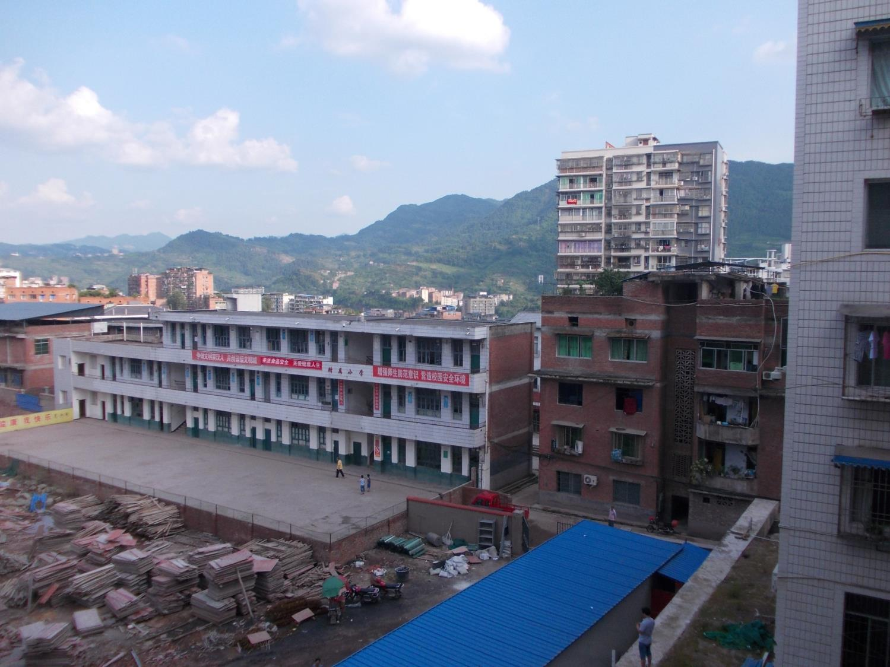
School at Xuanhan (Turned out to be a 9 hour bus trip from Chengdu – not 5) – We could not stay and teach here because we had TOURIST visas.
Took an 11 hour bus ride back to Dujiangyan City (center of 2008 earthquake) to work at the Guangya International School.

Slide 49
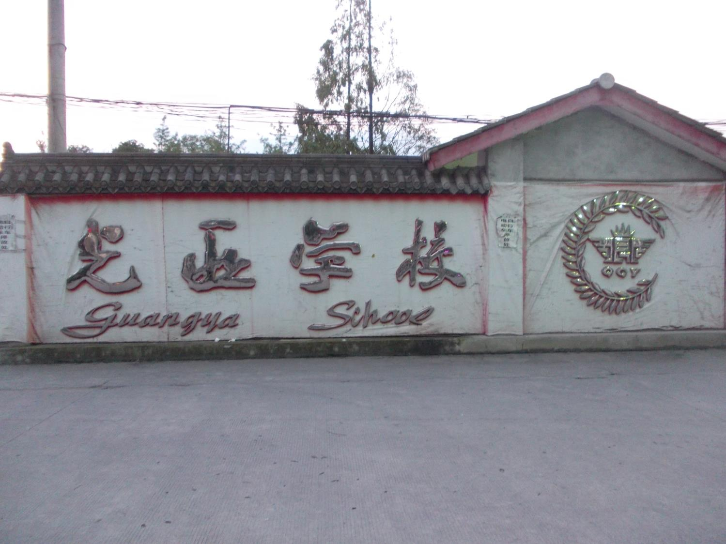

Slide 50
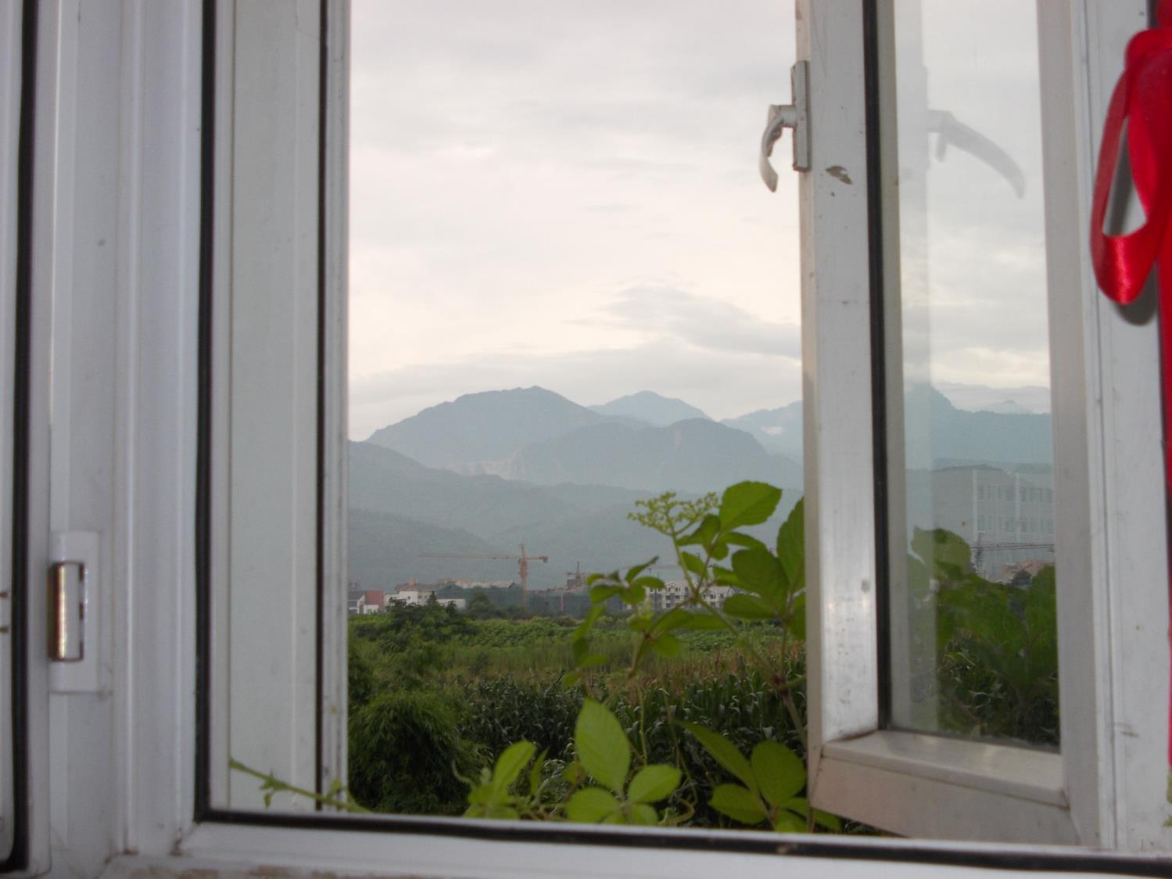
View from school classroom

Slide 51
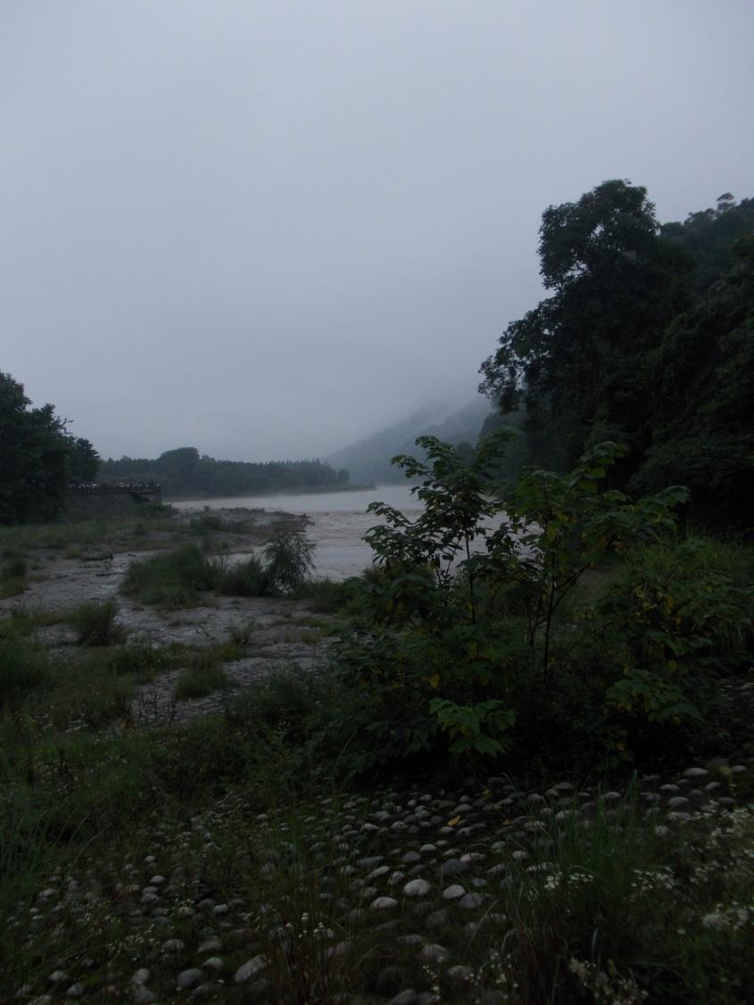

Slide 52
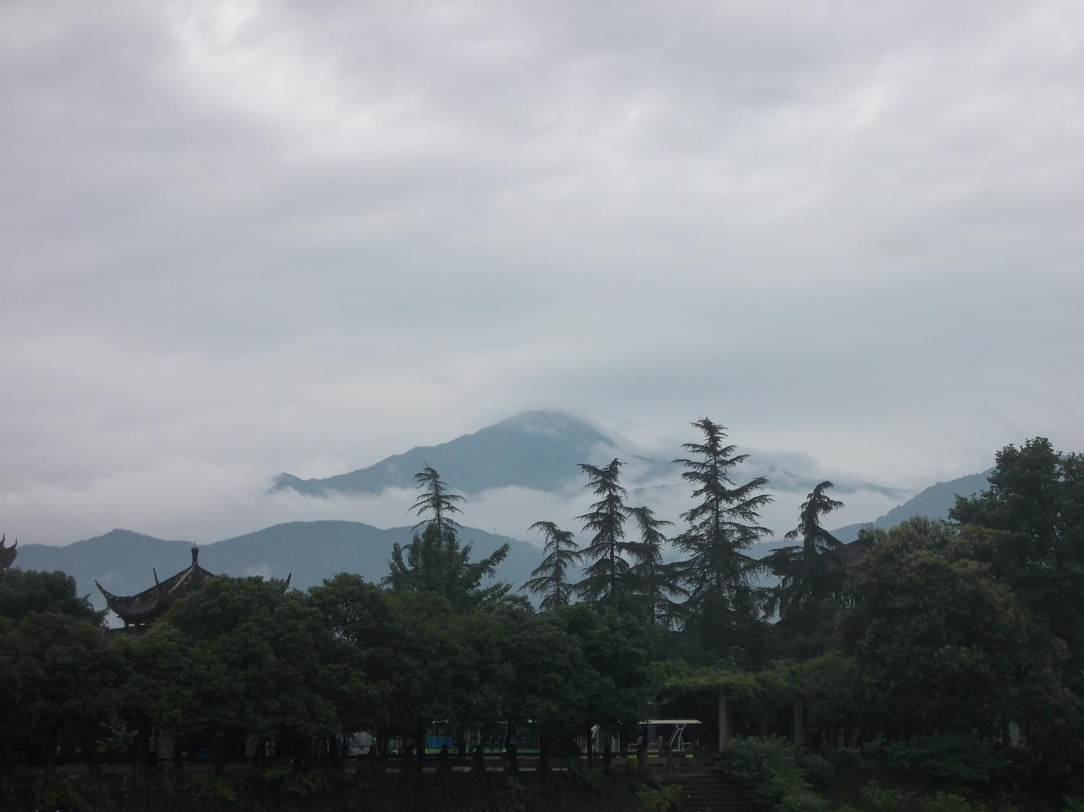

Slide 54
Teaching the Teachers

Slide 55
Students with their Ojo-De-Dios

Slide 56
Working on
PINWHEELS for PEACE

Slide 58
Sunset behind the mountains looking over the fence from the school

Slide 60
DaZhou – Training Center (8th floor) and Hotel

Slide 61
Nolan making balloons
and
Connecting with the people

Slide 62
Boys
Will
Be
Boys!

Slide 63
Students working together on the “Year of the H.O.R.S.E.”

Slide 64
There’s Something About That Name

Slide 65
Where am I going? – What are my dreams

Slide 66
Line Dancing

Slide 67
Barbara doing music with David and Stewart

Slide 68
Barbara doing music in Kate’s Class

Slide 69
2014 Dazhou students and staff

Slide 70
Good-bye from children in the street

Slide 71
Photo of the World EXPO building, the “largest” building in the world just outside of Chengdu.
CHINA – a country in contrast.

Slide 72
A clear day in Chengdu looking out from the World Expo building

Slide 73
Platforms for the preformed Railway lines to be “dropped” into place.

Slide 74
A street that goes to nowhere?
To the left was a large city area – Planning for the future?

Slide 75
Chengdu
2nd Ring Raised Road.
There is also a 3rd and 4th ring road around the city.

Slide 76
Street vendors still exist but are being pushed out by the government as being “Backward”
Pedi-cabs and street markets have mostly been phased out / shut down
(except in some “Tourist” areas)

Slide 78
Auto repair garage. A full block of little shops each doing car repair, service or selling parts or supplies.

Slide 83
This was a cloud at sunset in Chengdu I thought was amazing.
Other people did too as I saw many people stopping and looking up and taking pictures.

Slide 85
Nolan, Jayson, Joyce, and Jay - Chengdu

Slide 86
Barbara, Nolan, Chu - Chengdu

Slide 87
David Ball in Chengdu Railway Station EAST.
Daniel was assigned to help us while in DaZhou

Slide 88
Stewart, Amy, Barbara, David

Slide 89
Nolan and April in a “handcrafted” gift shop

Slide 90
The End…. Or just the Beginning….

