Slide 1
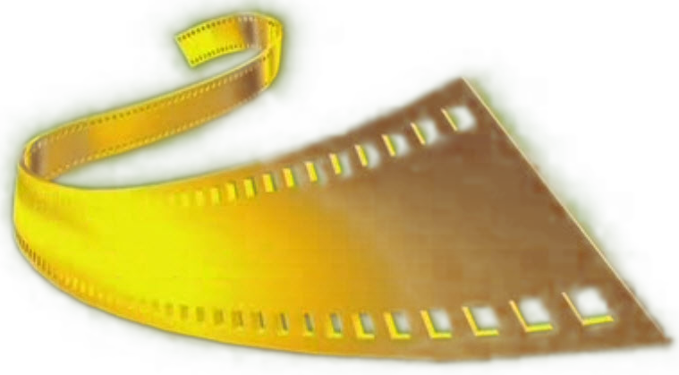
American
Summer Camp
美国名师沉浸式英语训练营
衡阳市成龙成章现代教育集团
Hengyang ChengLong Chengzhang Modern Education Group

Slide 2
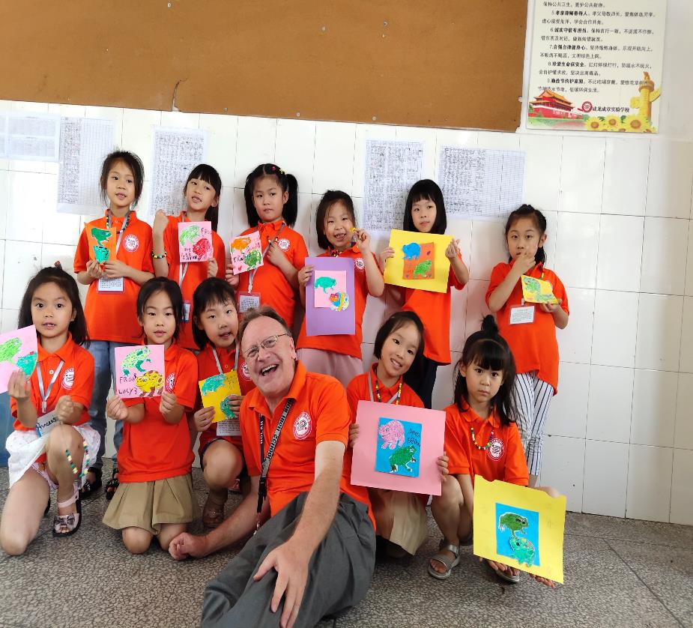
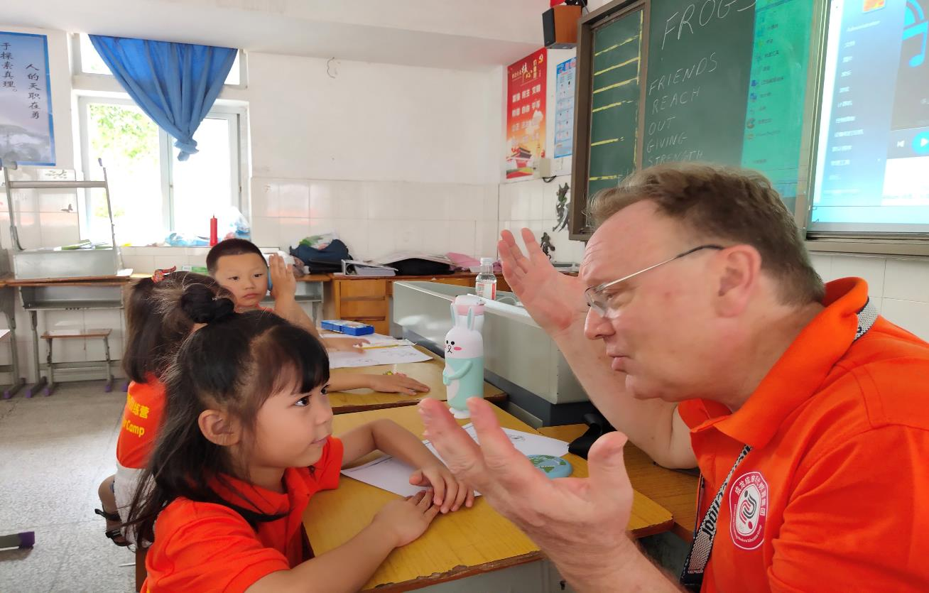
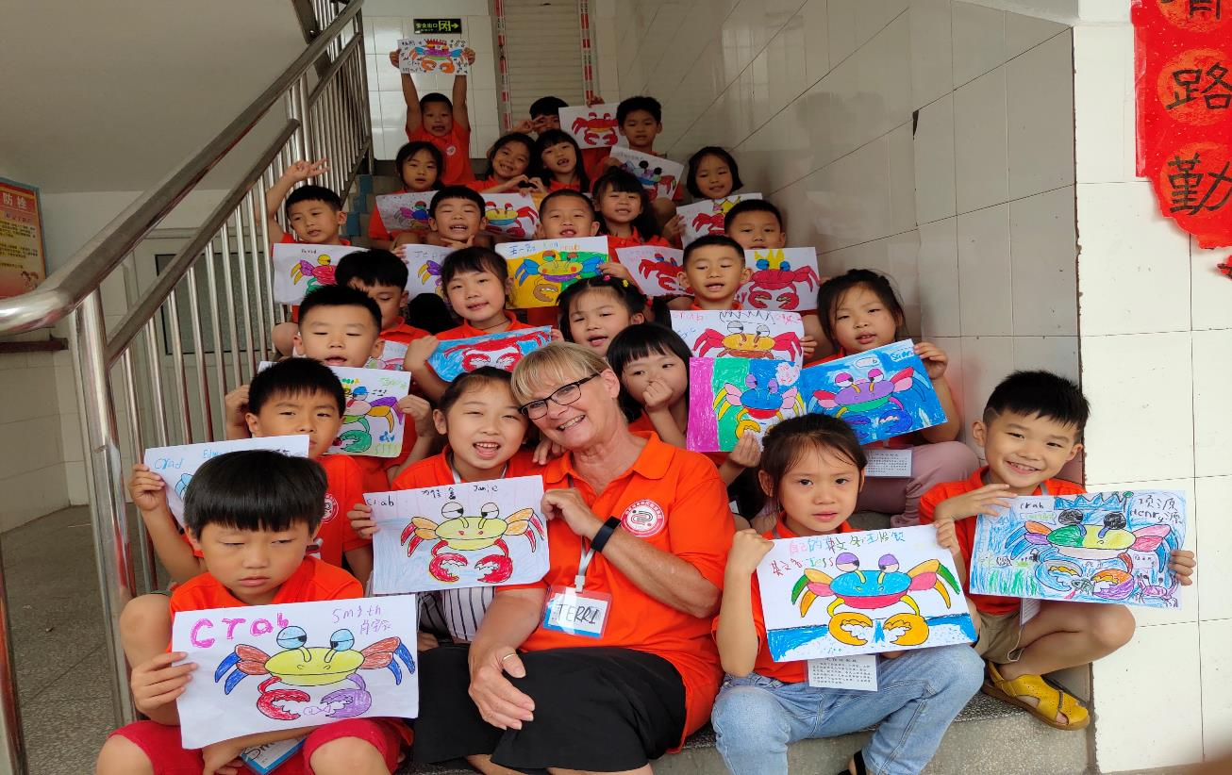
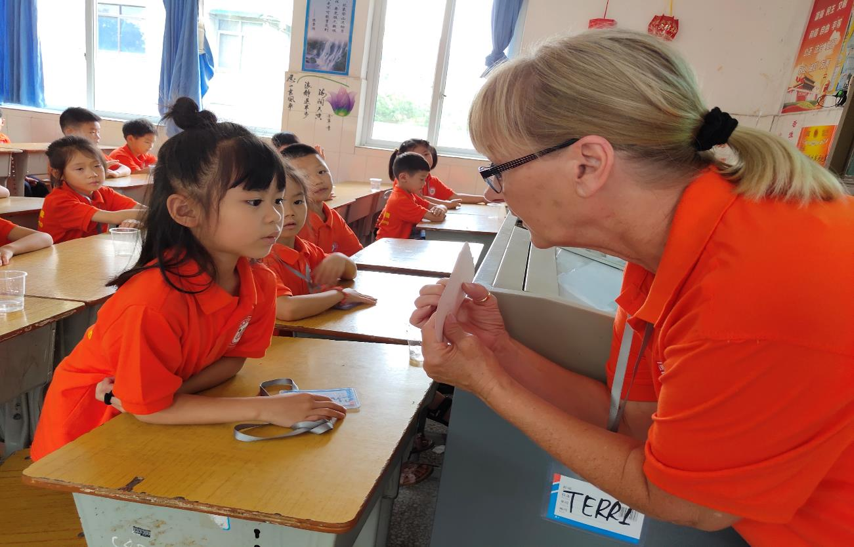
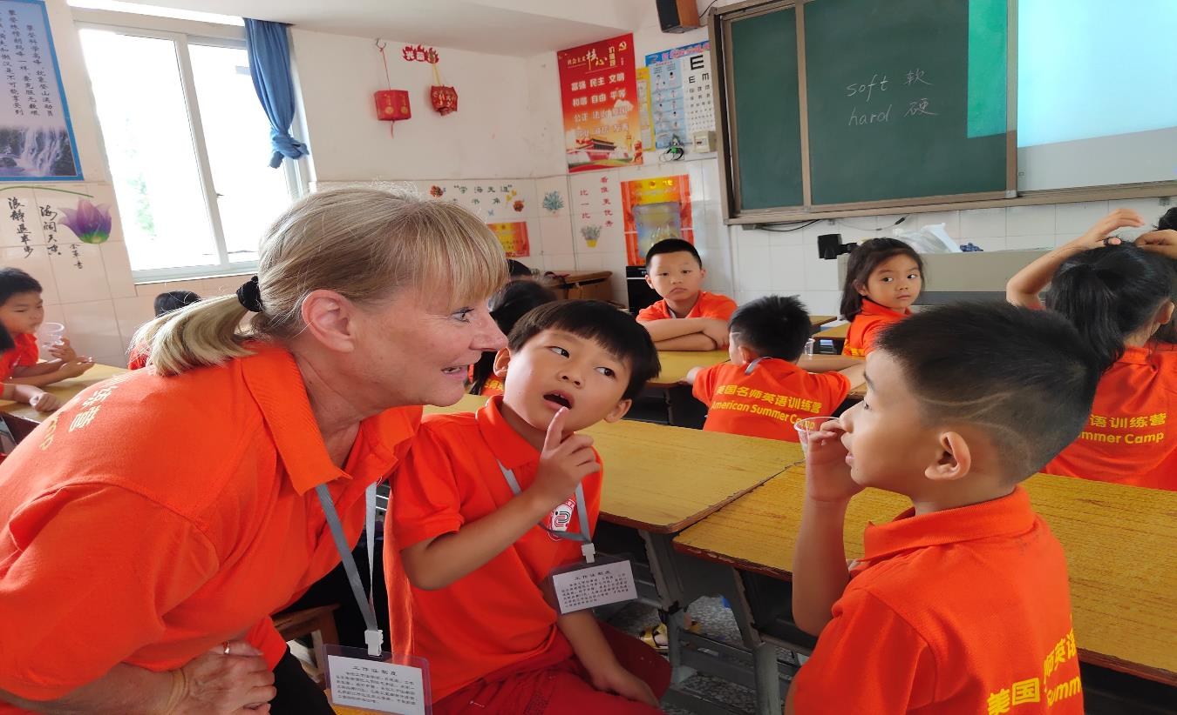
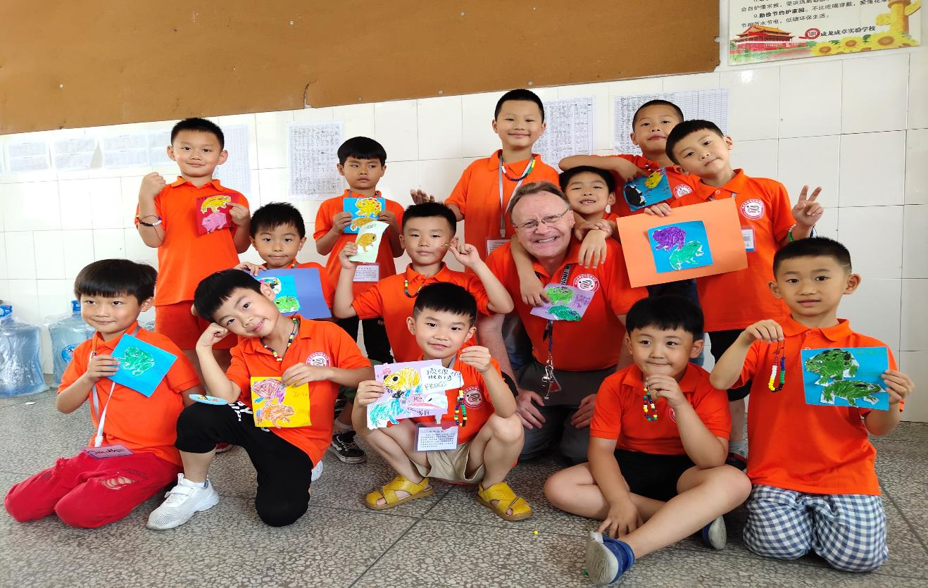
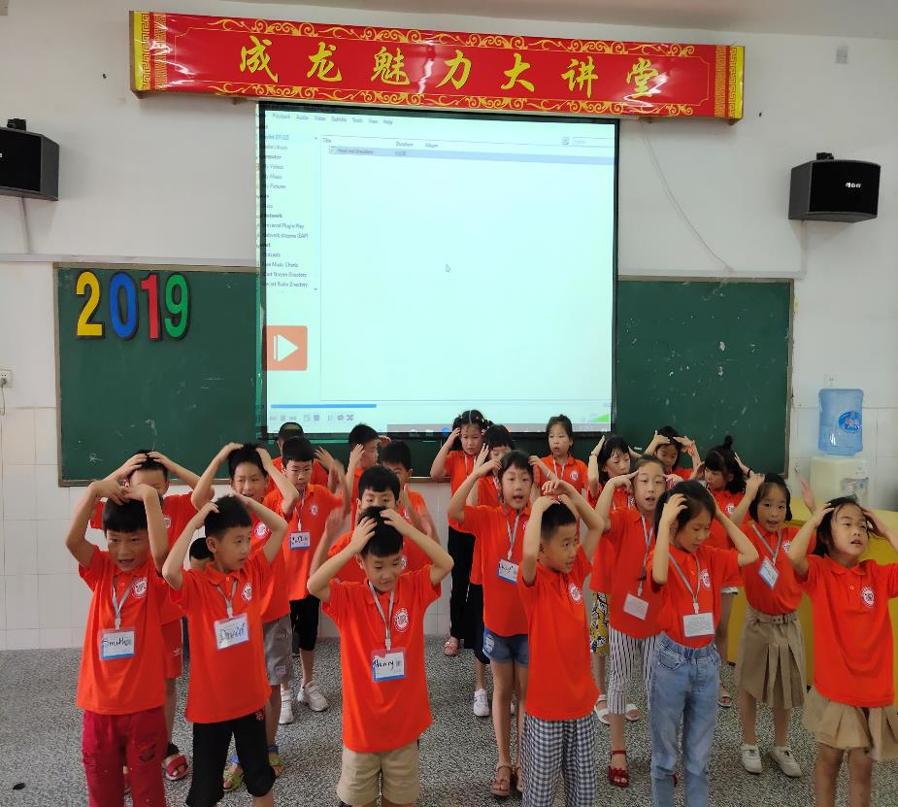
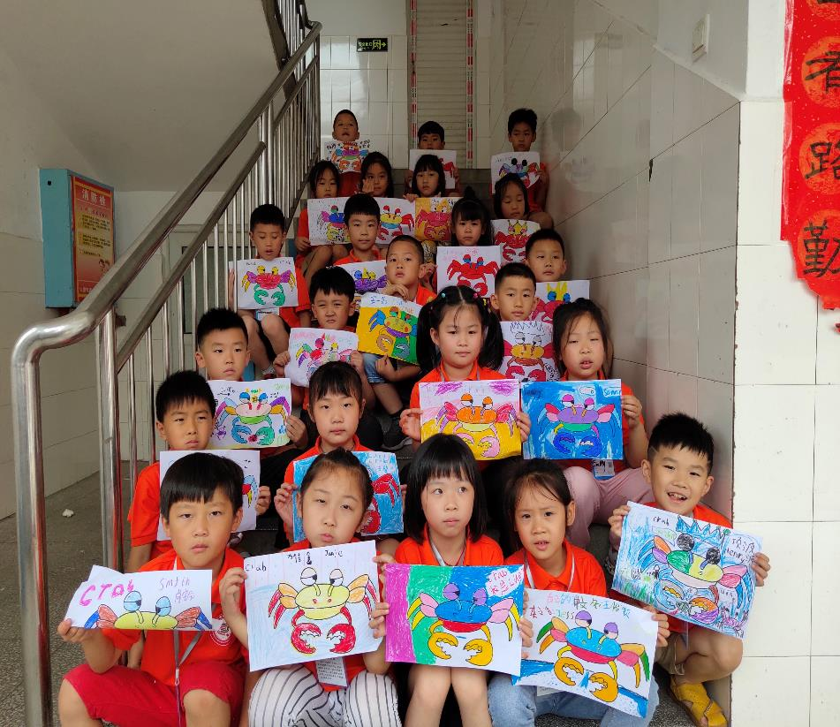
●
●
●
●
●
●
●
●
●
●
●
●
●
●
●
●
●
●
●
●
●
●
●
●
●
●
●
●
●
●
●
●
●
●
●
●
●
●
●●
●
●
●
●
●
●
●
●
●
●
●
●
●
●
●
●
●
●
●
●
●
●
●
●
●
●
●
●
●
●
●
●
●
●
●
●
●
●
●
●
●
●
●
●
●
●
●
●
●
●
●
●●
●
●
●
●
●
●
●
●
●
●
●
●
●

Slide 3
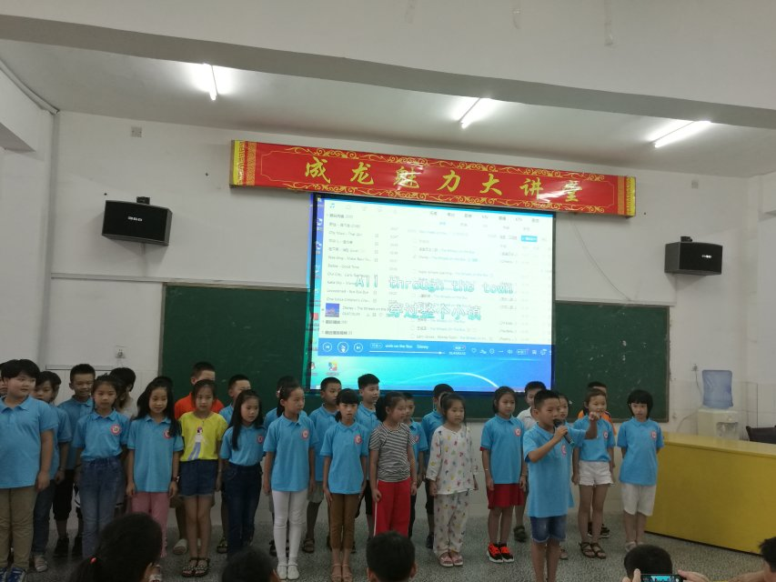
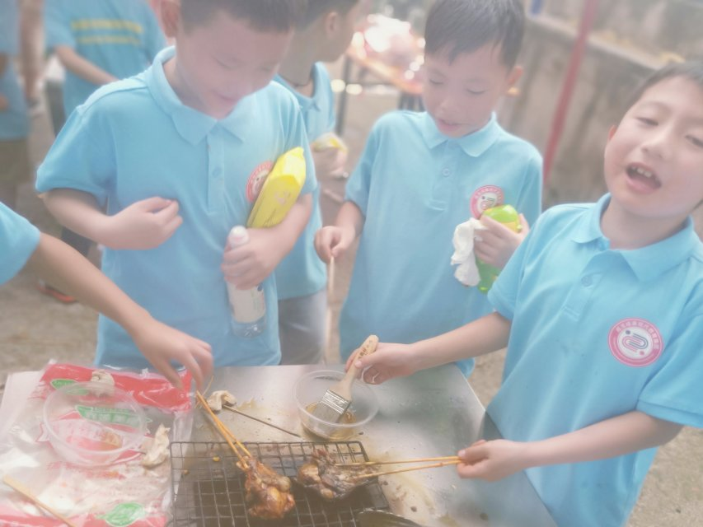
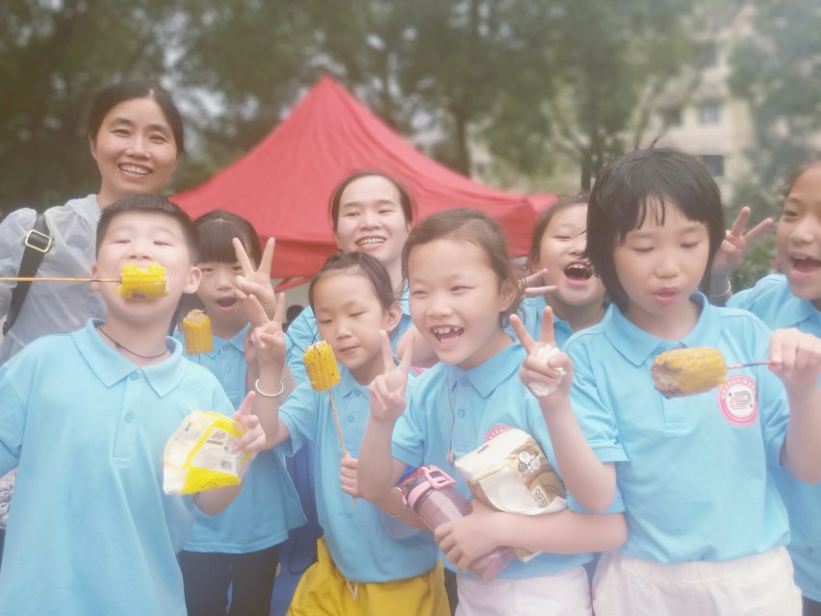
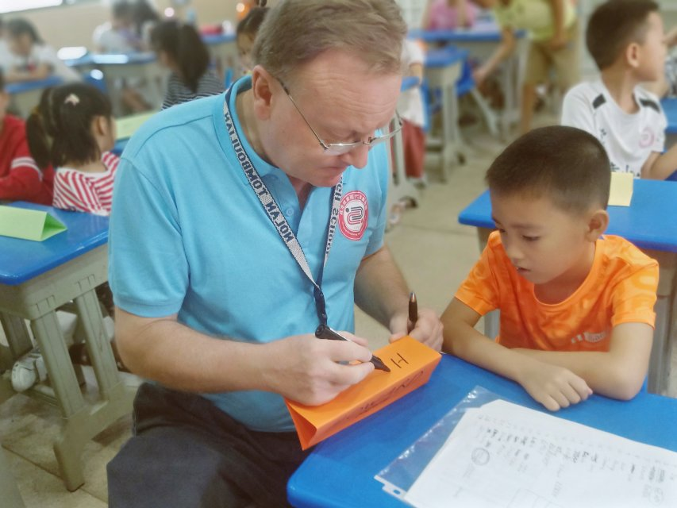
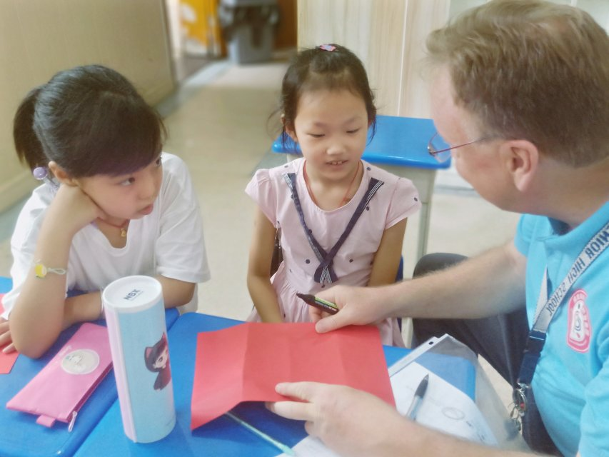
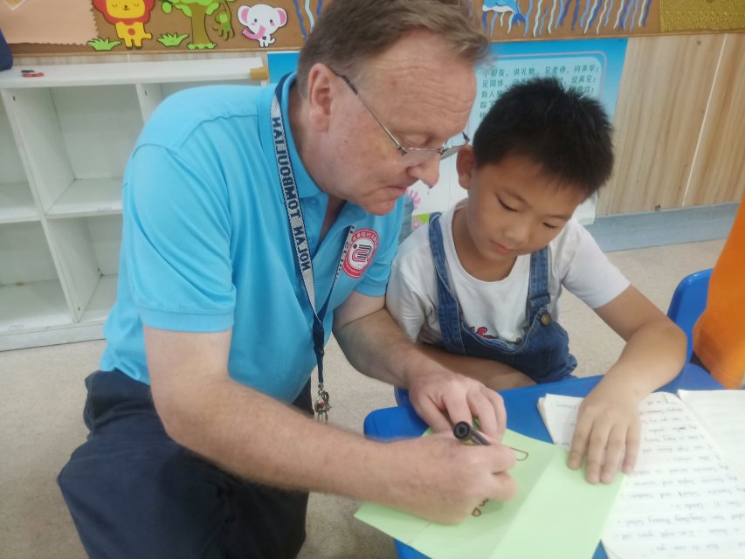
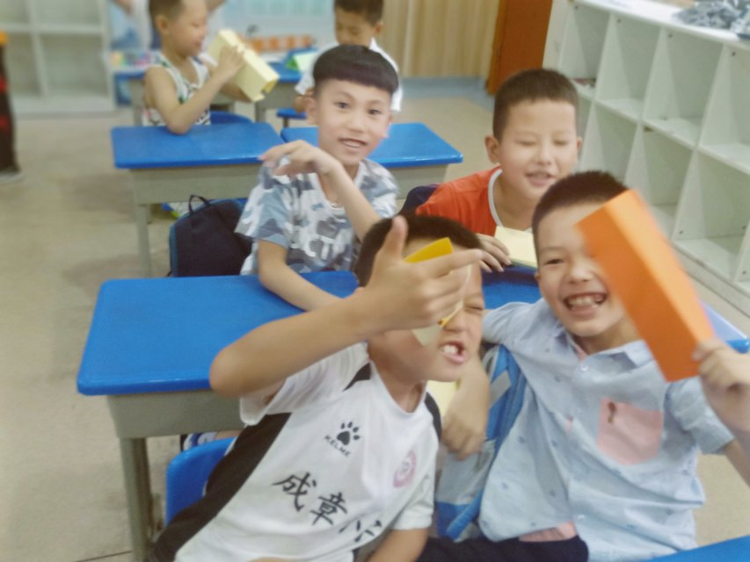
●
●
●
●
●
●
●
●
●
●
●
●
●
●
●
●
●
●
●
●
●
●
●
●
●
●
●
●
●
●
●
●
●
●
●
●
●
●
●●
●
●
●
●
●
●
●
●
●
●
●
●
●
●
●
●
●
●
●
●
●
●
●
●
●
●
●
●
●
●
●
●
●
●
●
●
●
●
●
●
●
●
●
●
●
●
●
●
●
●
●
●●
●
●
●
●
●
●
●
●
●
●
●
●
●

Slide 4
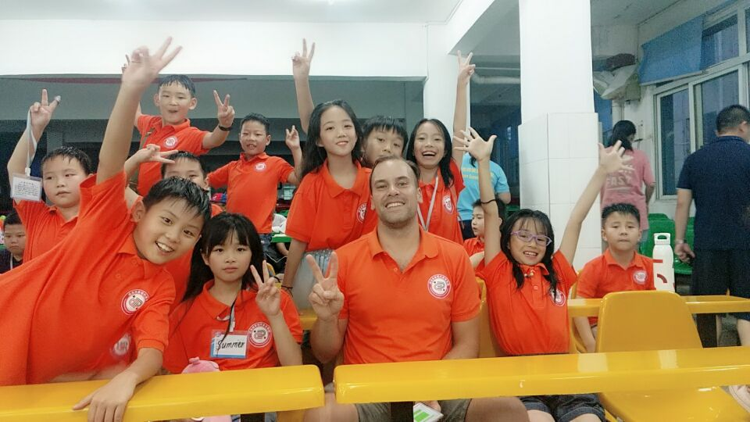
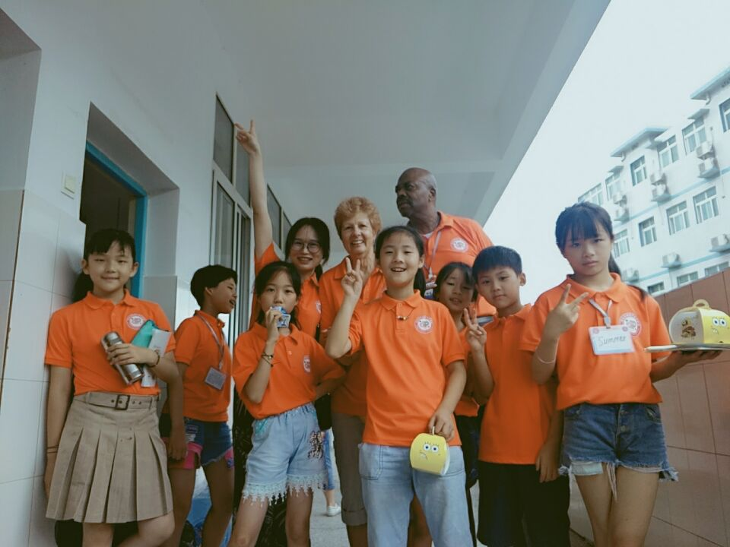
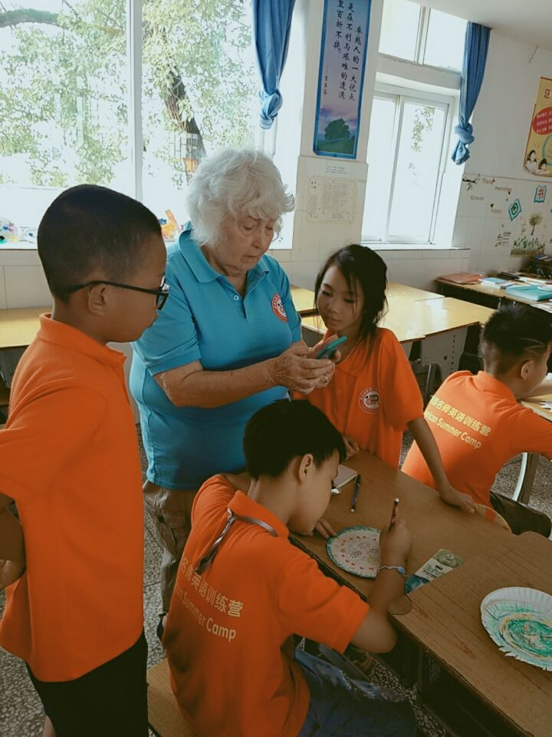
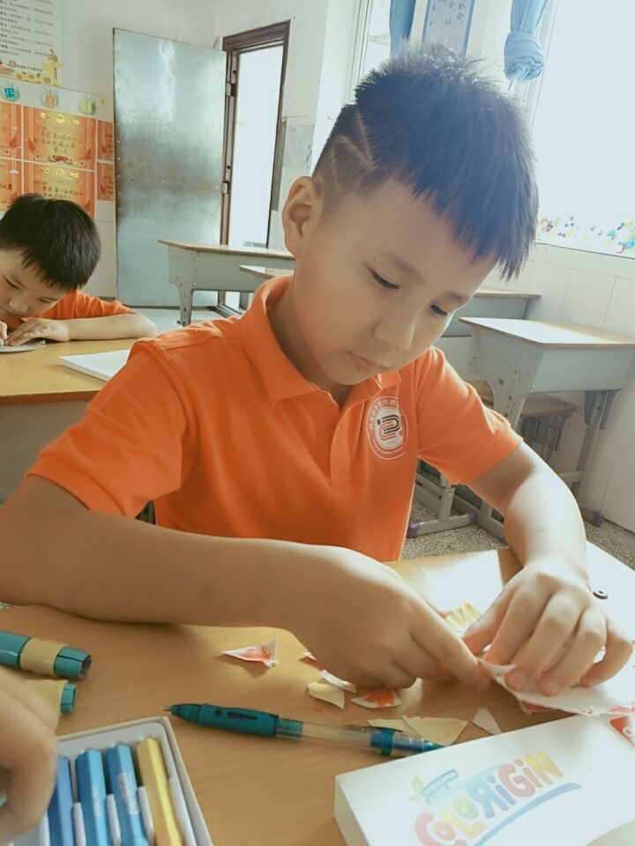
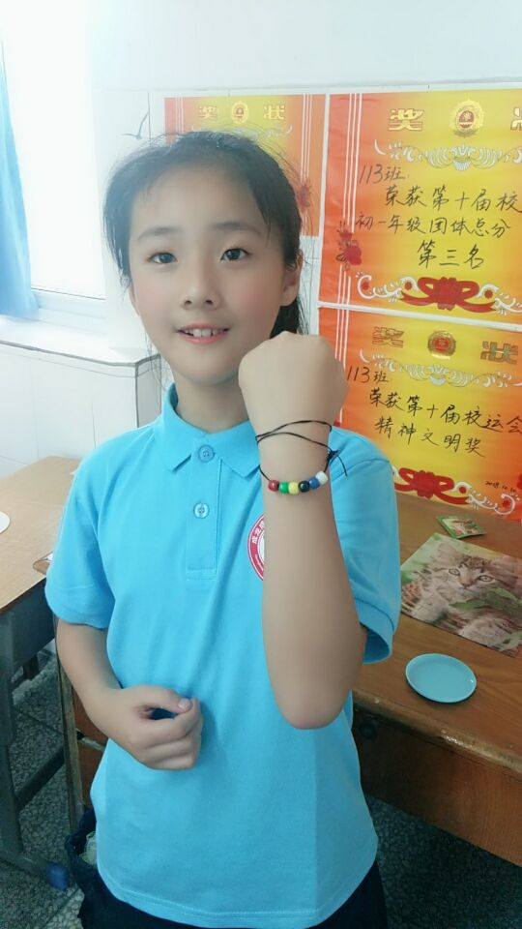

Slide 5
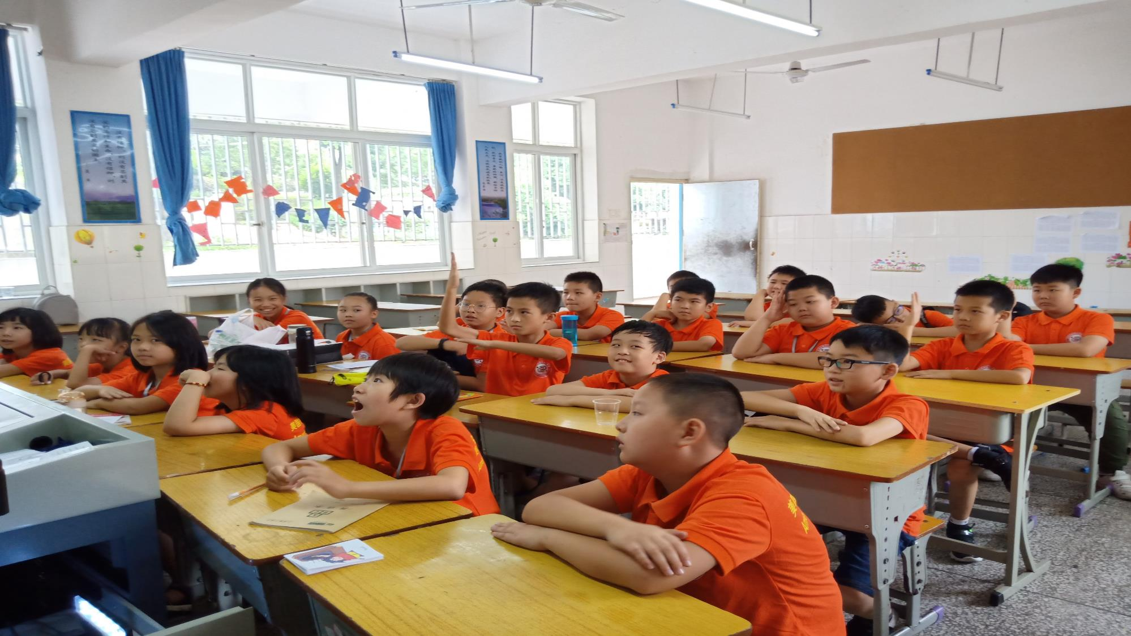

Slide 6
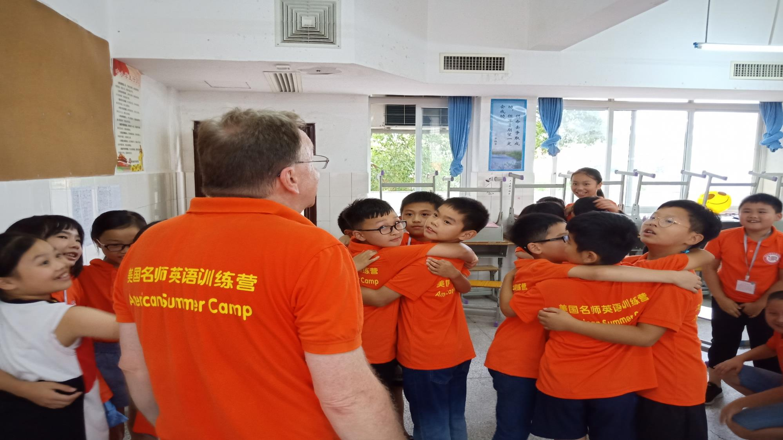

Slide 7
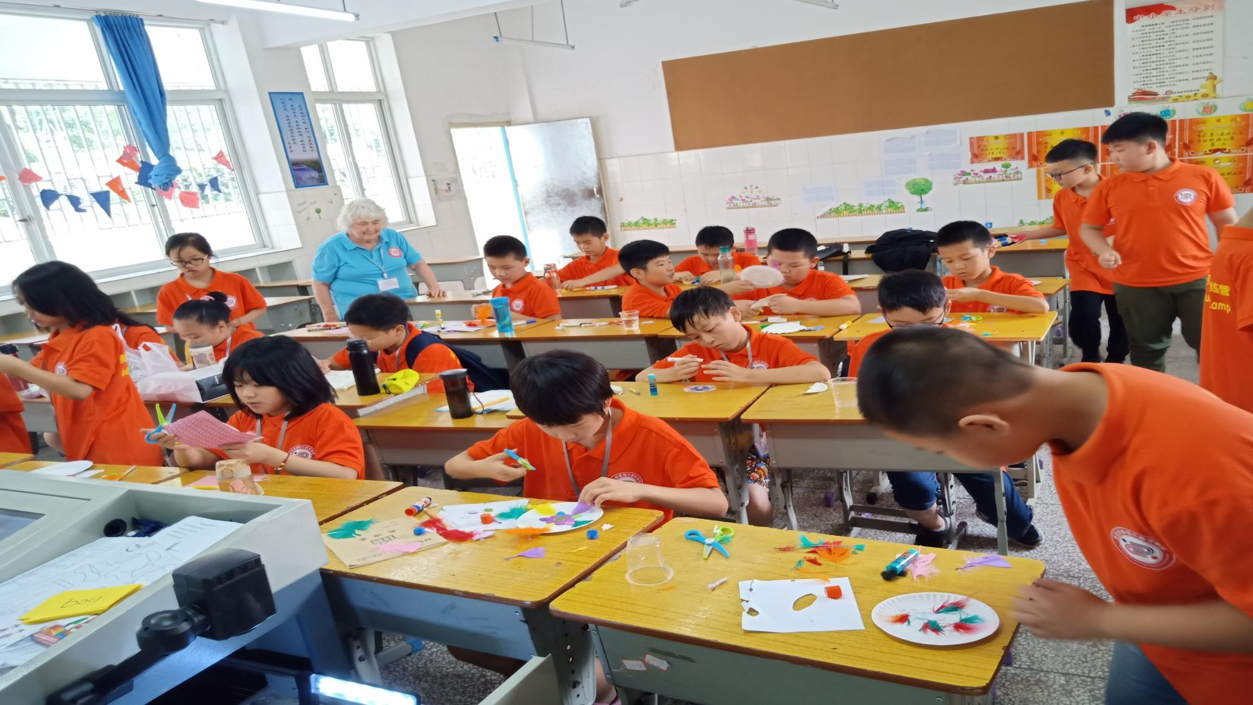

Slide 8
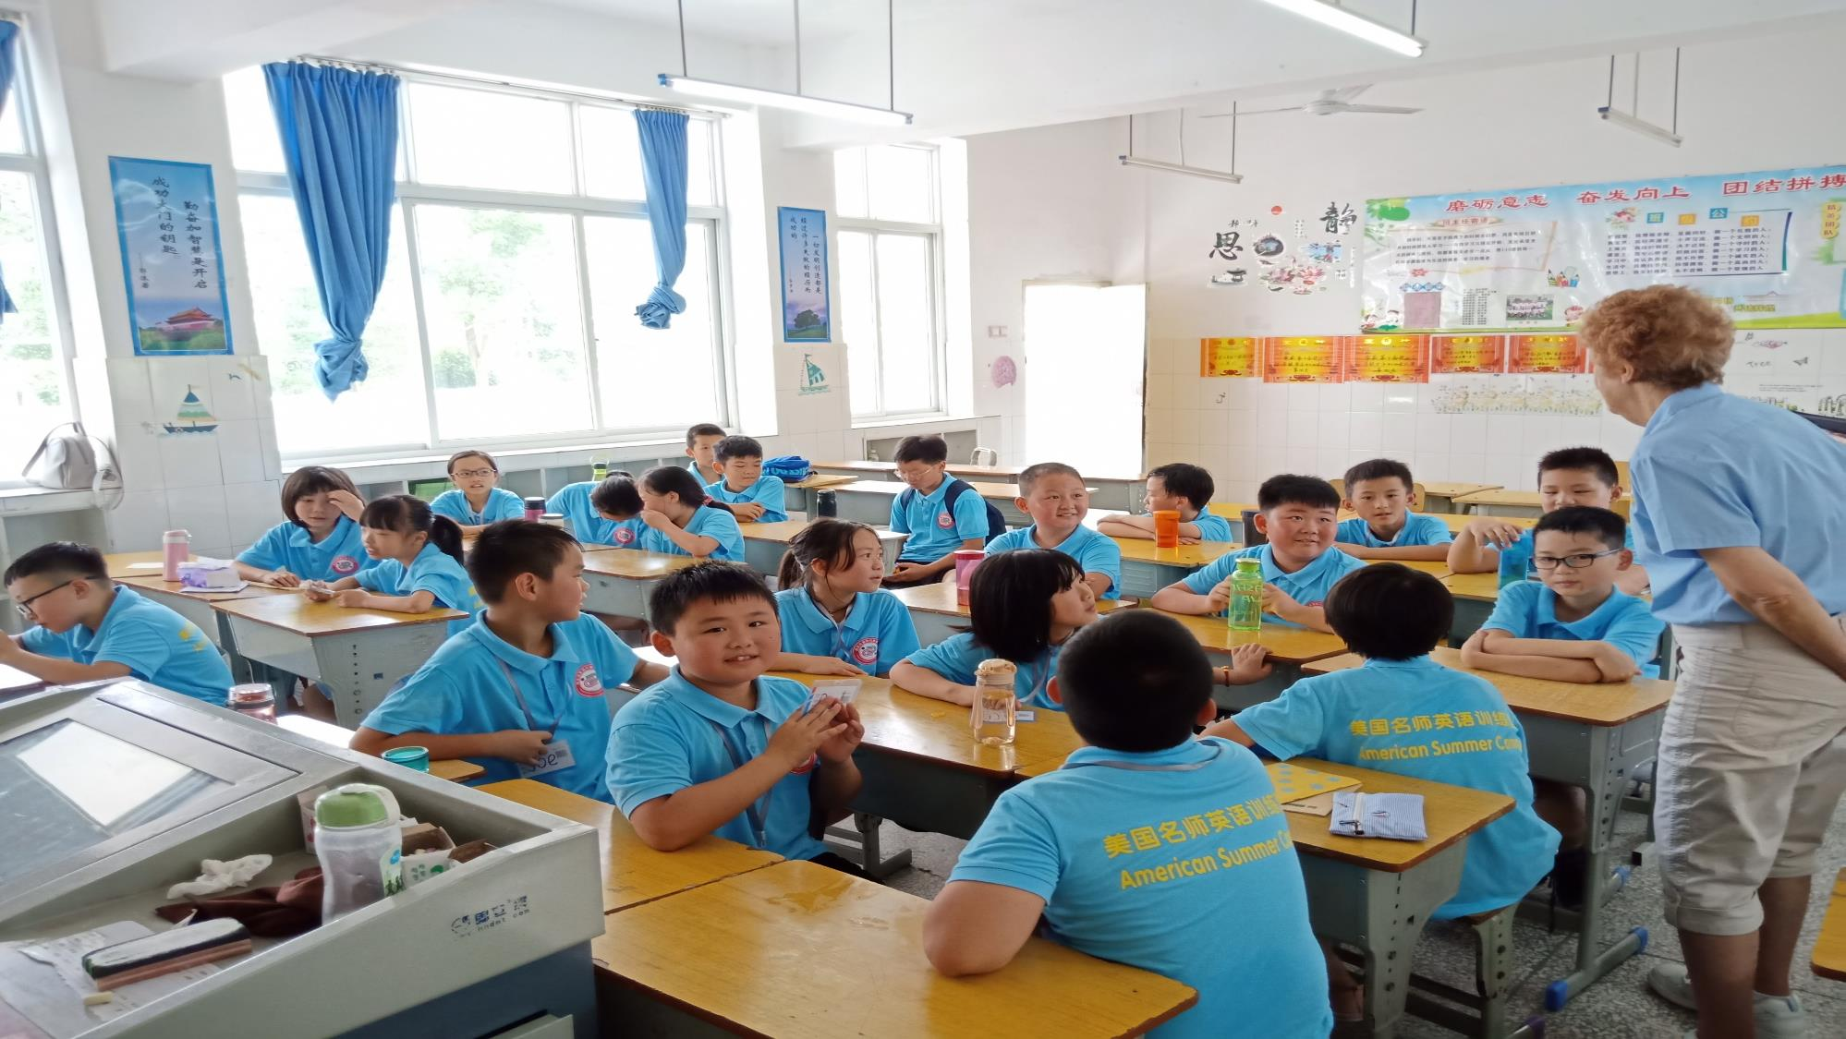

Slide 9
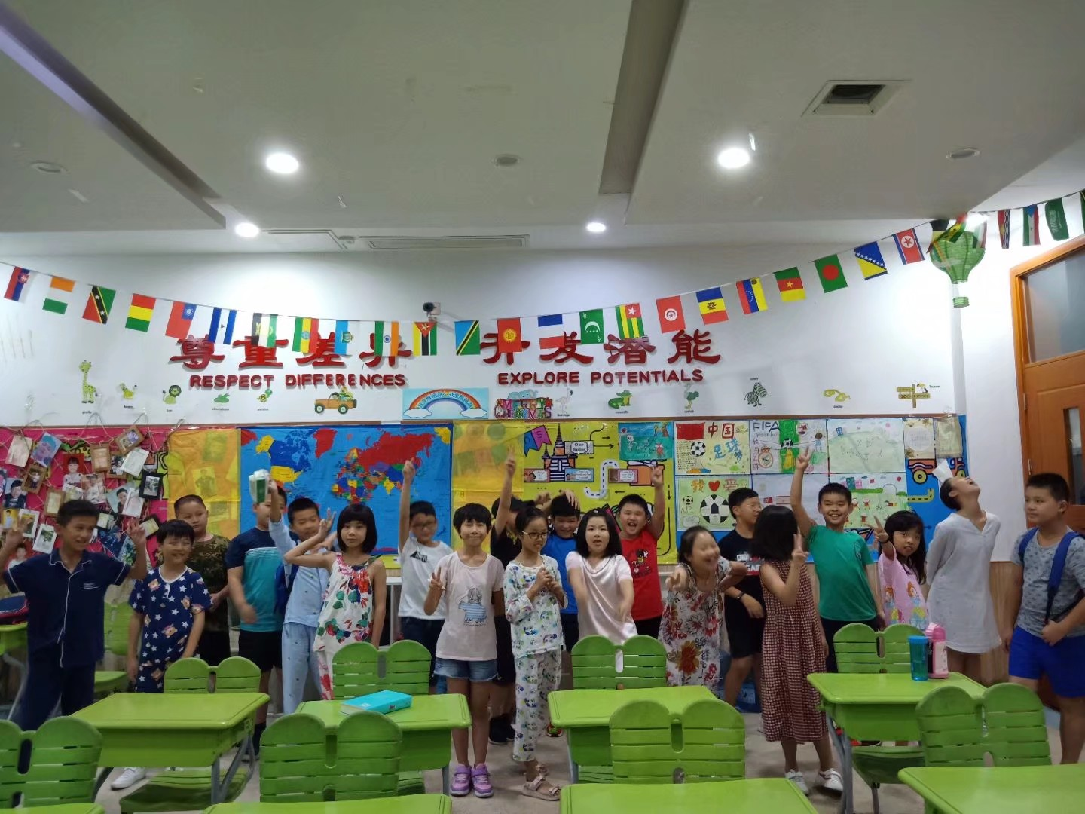

Slide 10
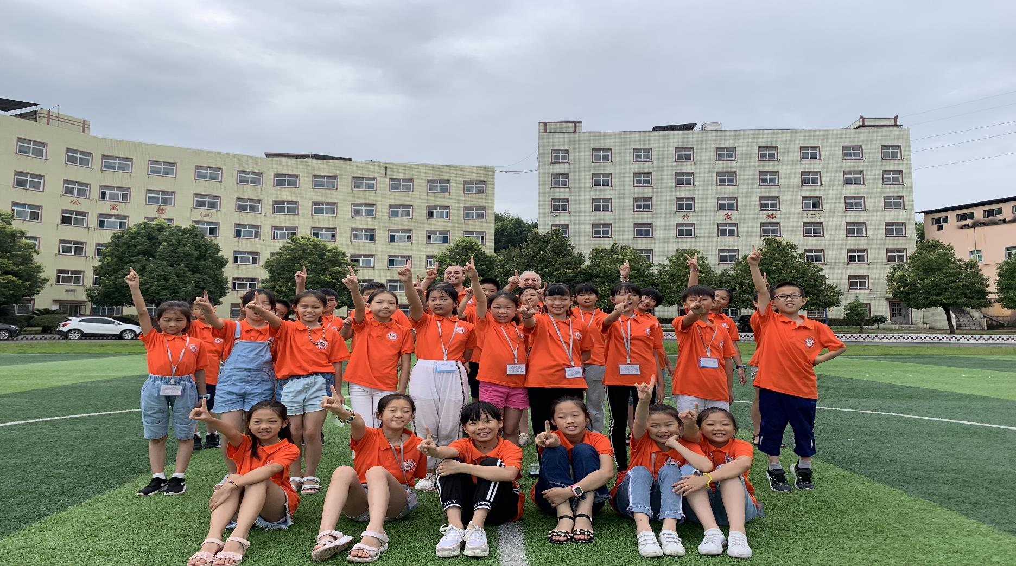
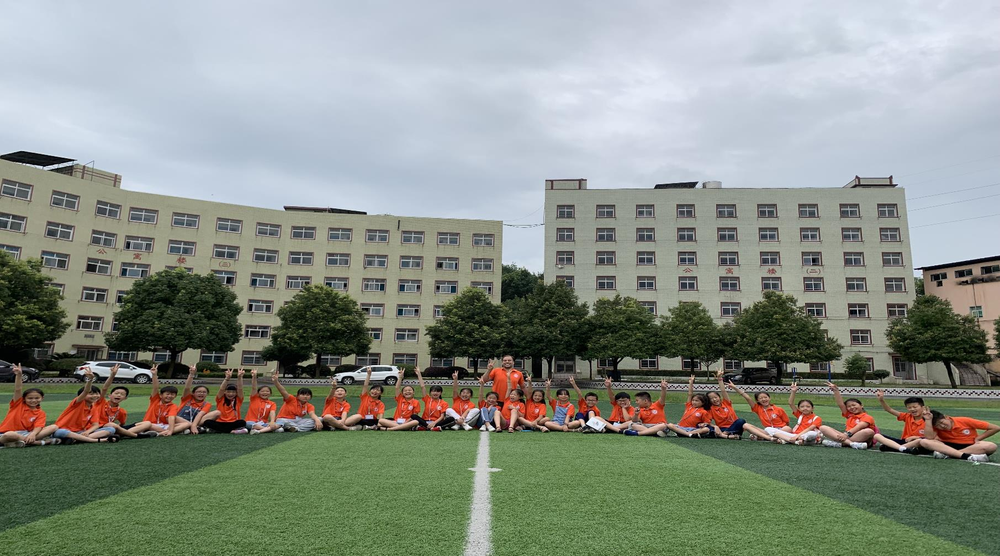
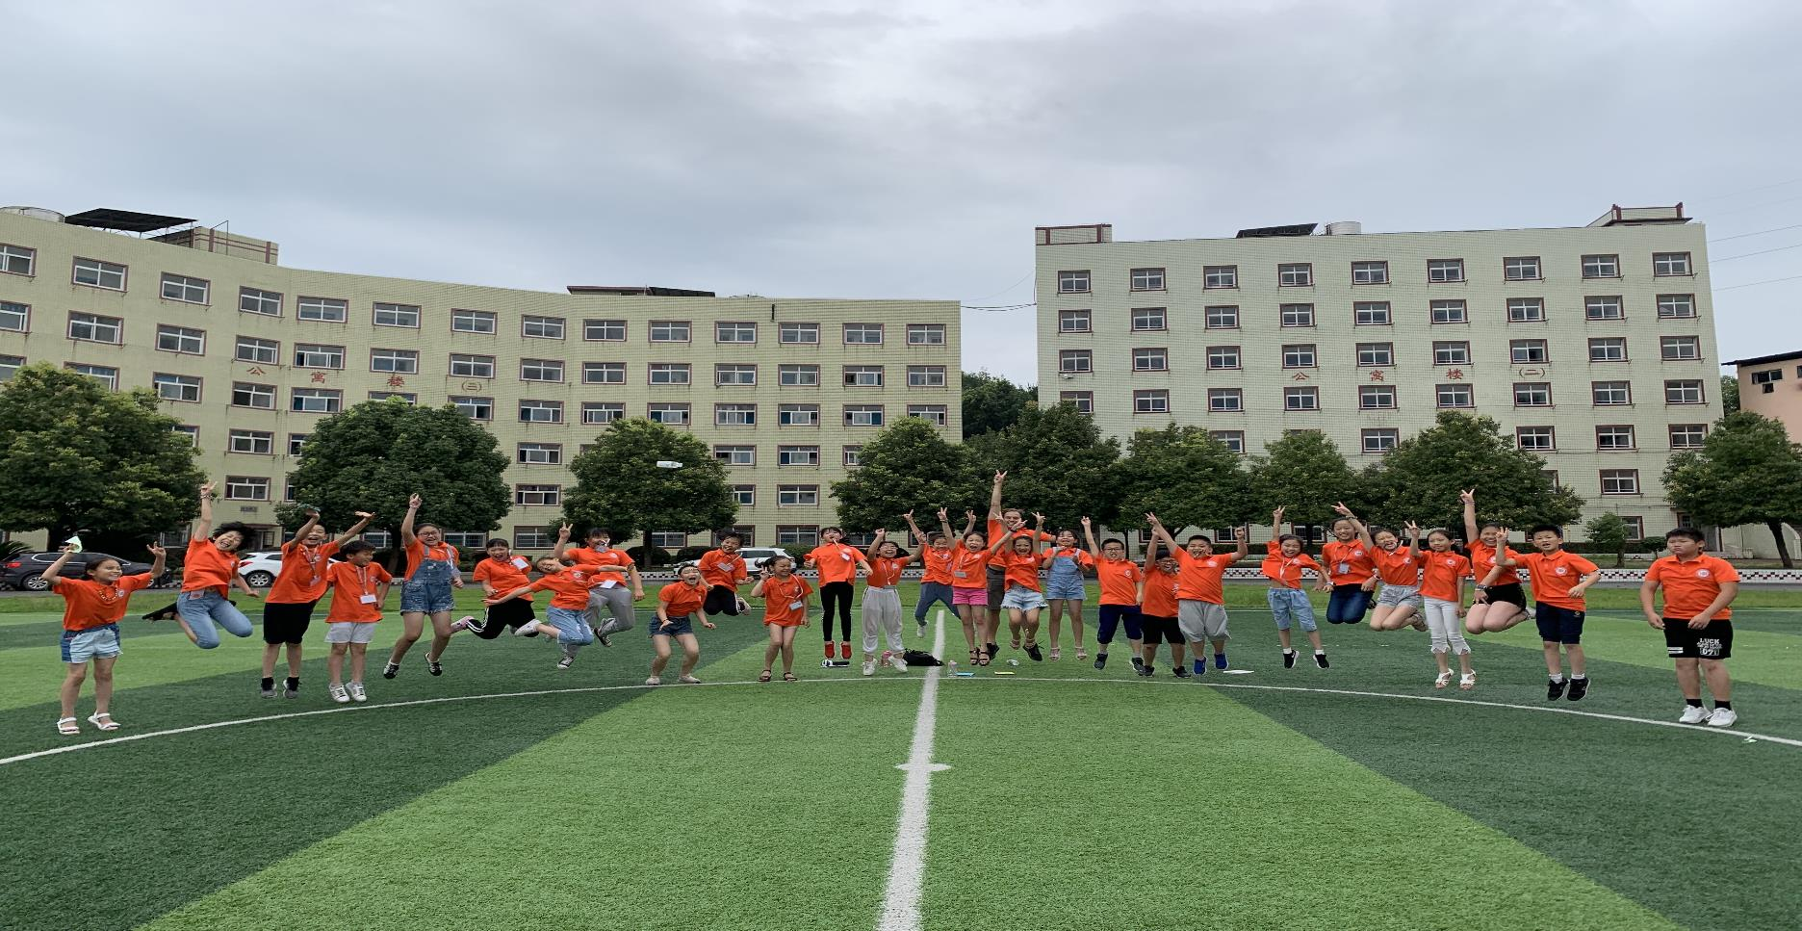
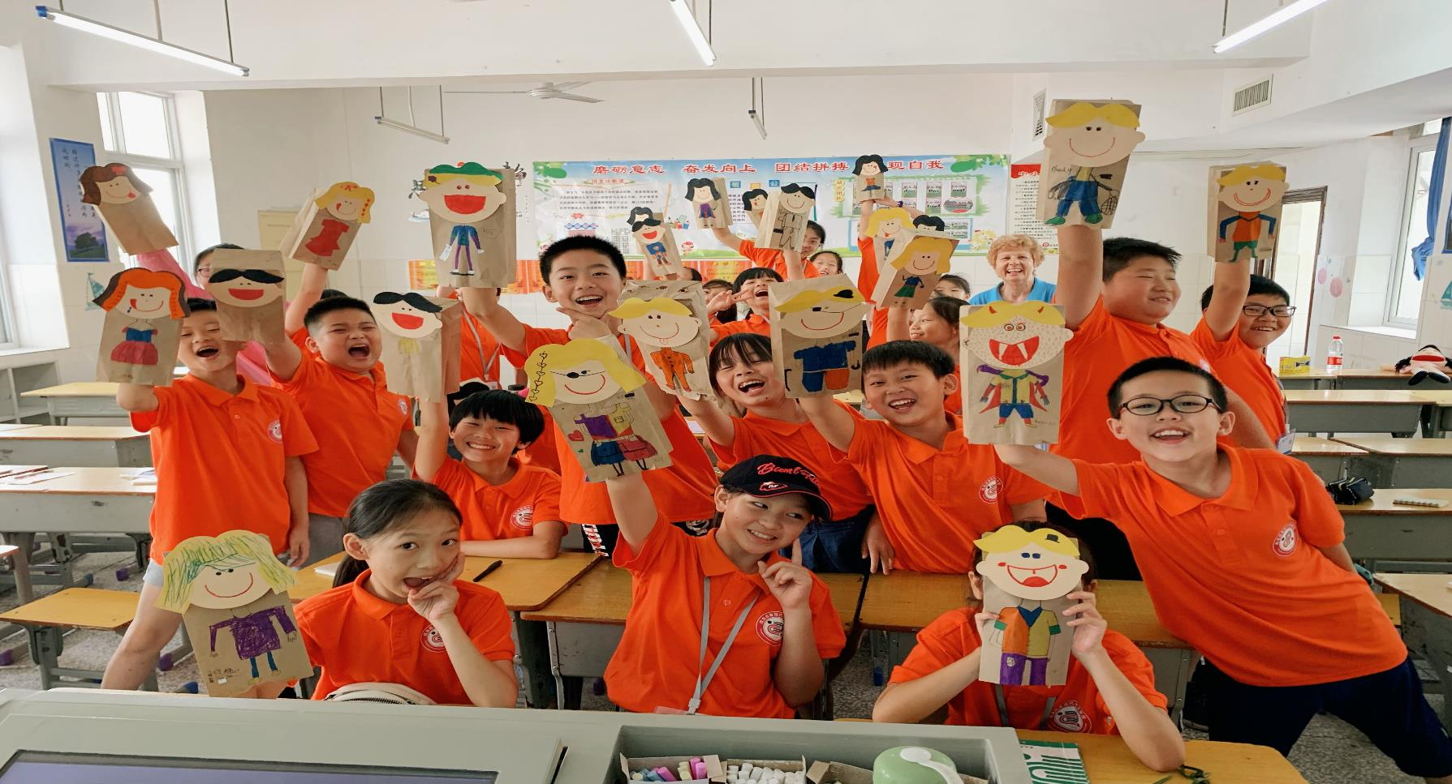

Slide 11
_____________________________________________________________________________________________________

Slide 12
_____________________________________________________________________________________________________

Slide 13
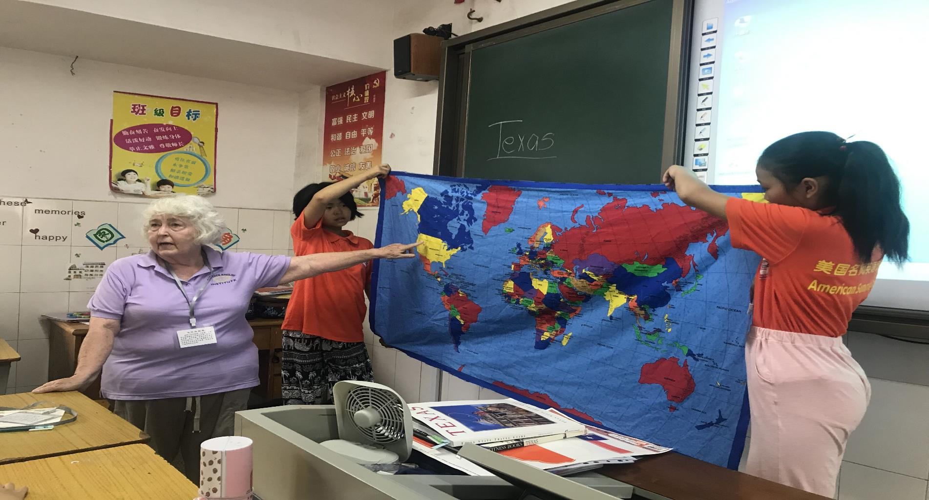
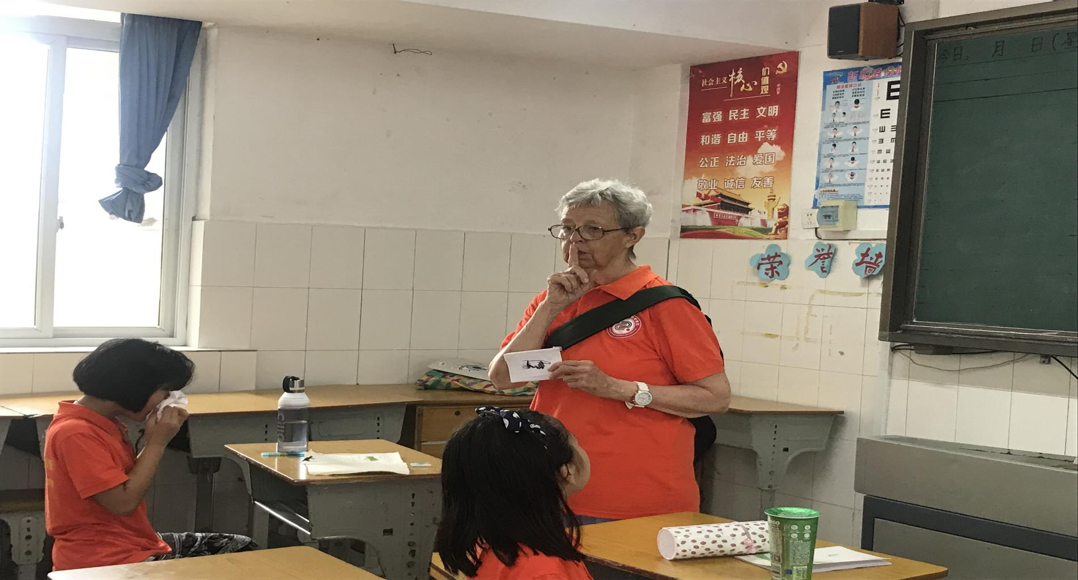
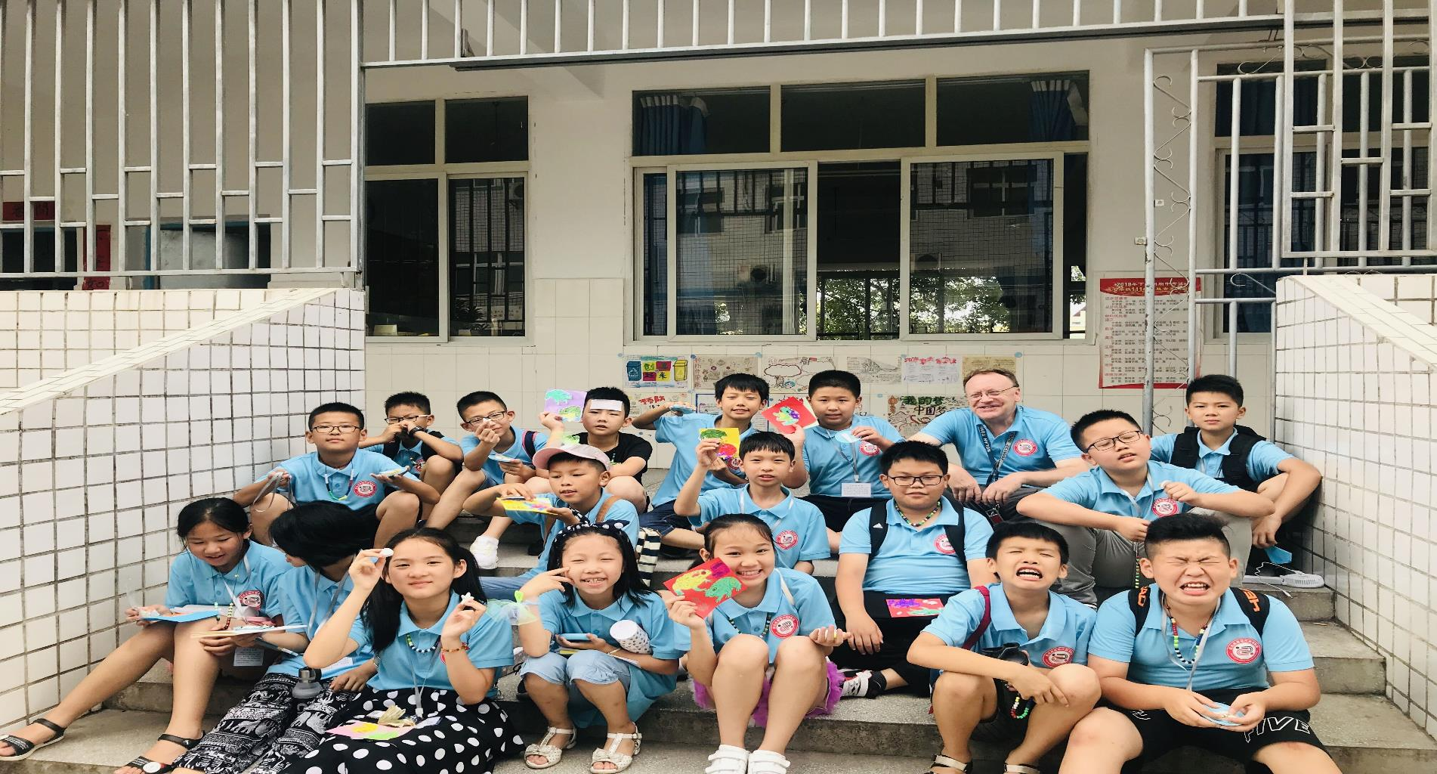
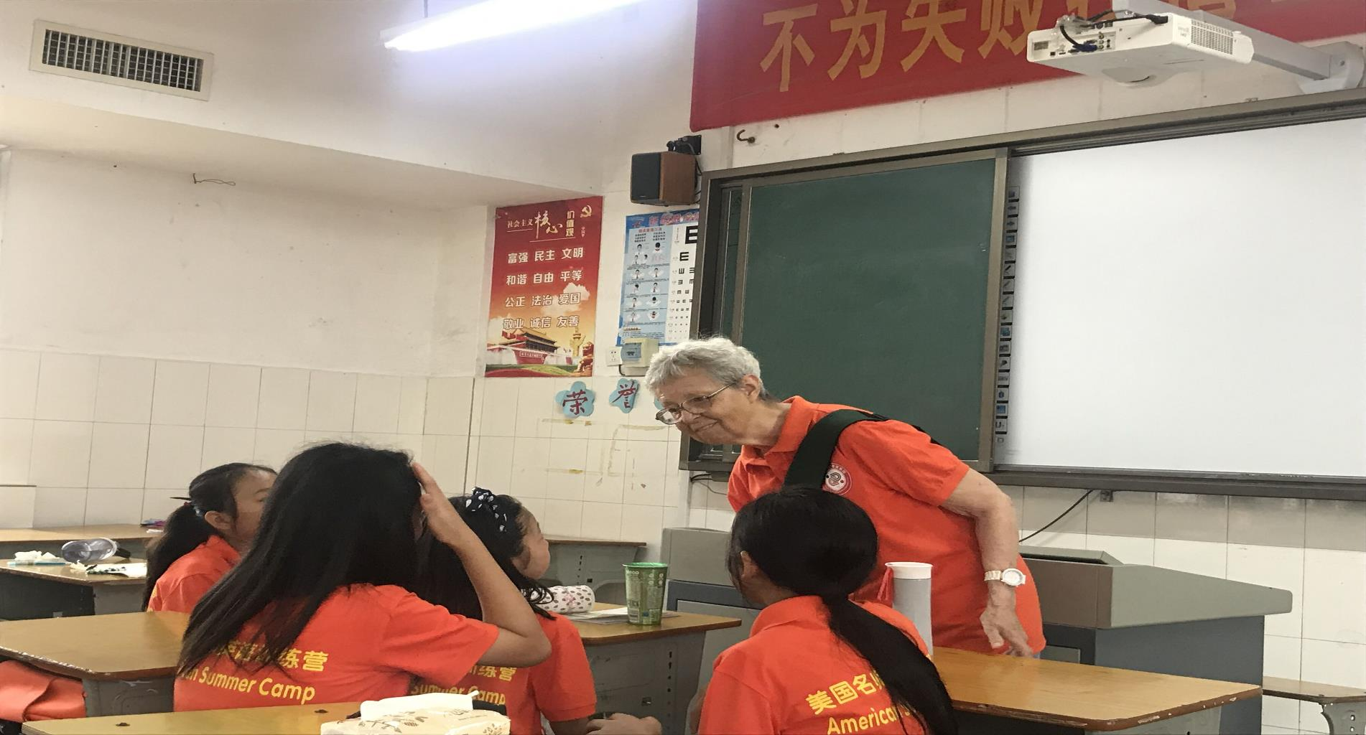

Slide 14
_____________________________________________________________________________________________________

Slide 15
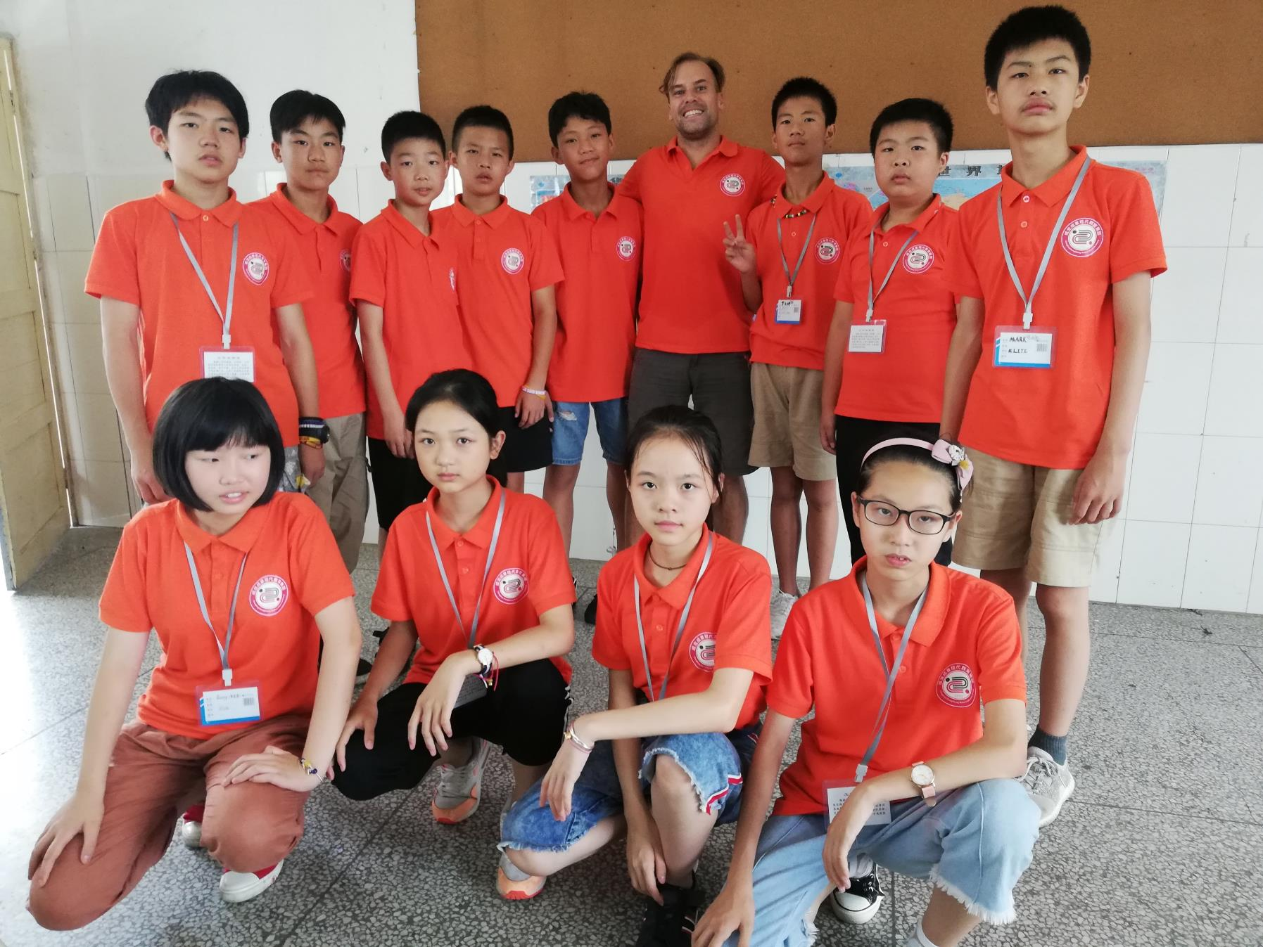
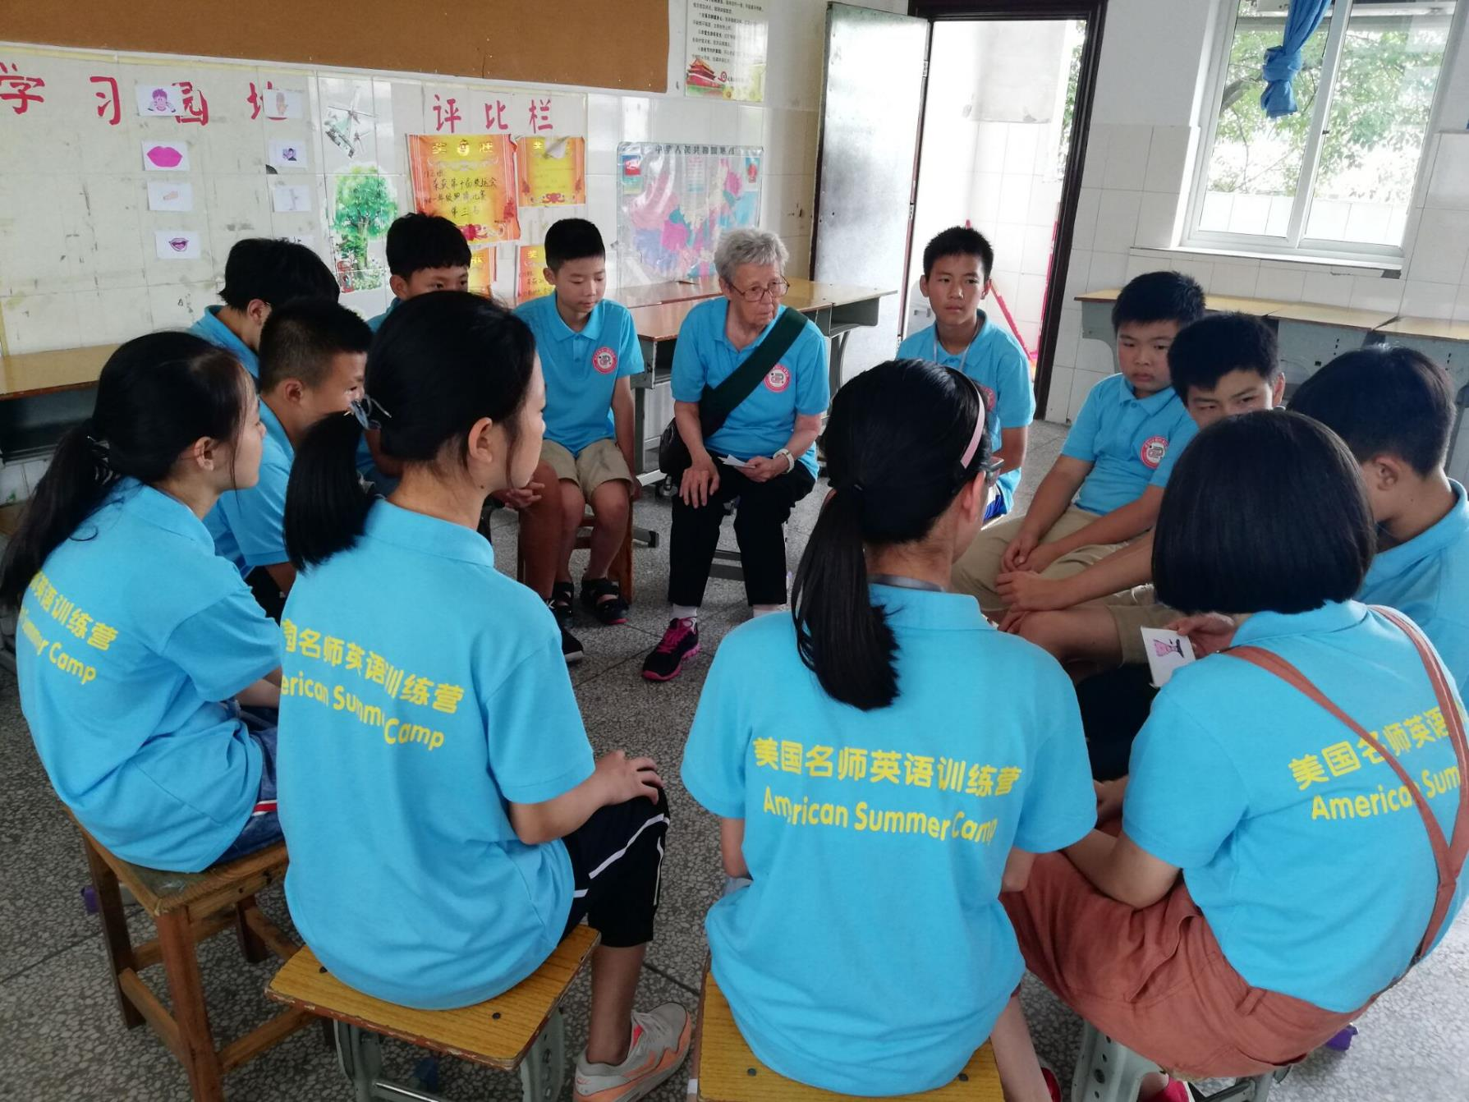
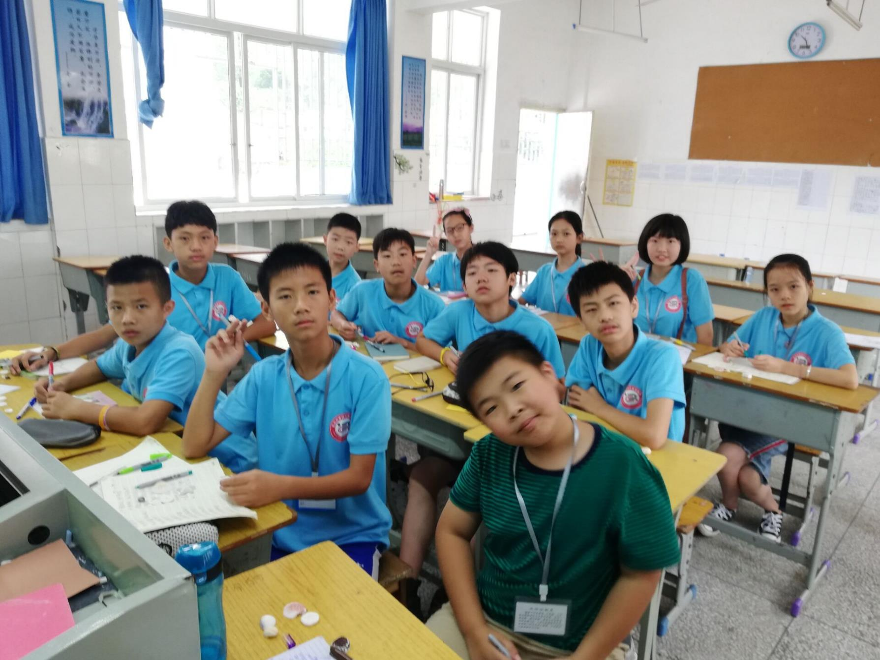
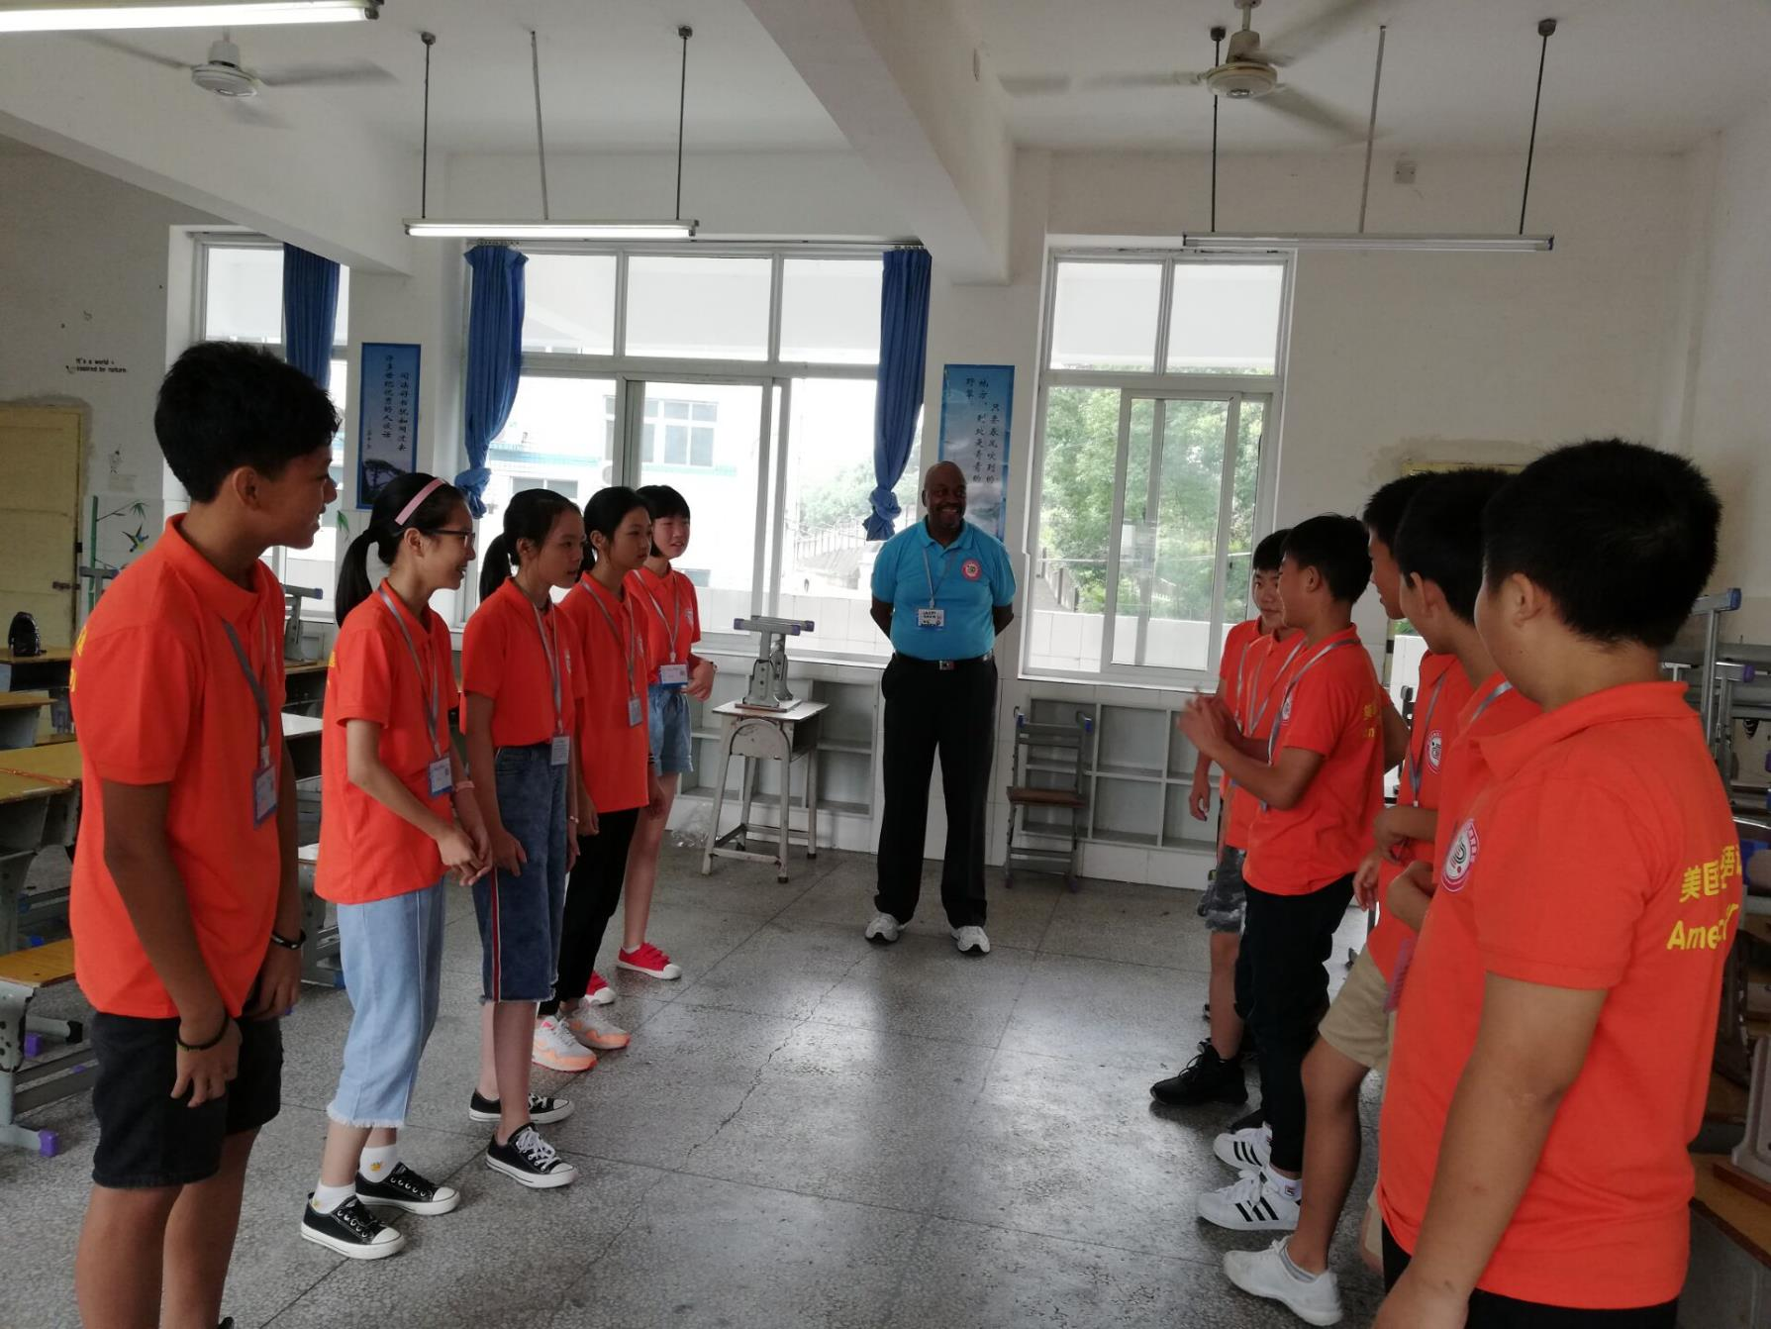

Slide 16
_____________________________________________________________________________________________________

Slide 17
_____________________________________________________________________________________________________

Slide 18
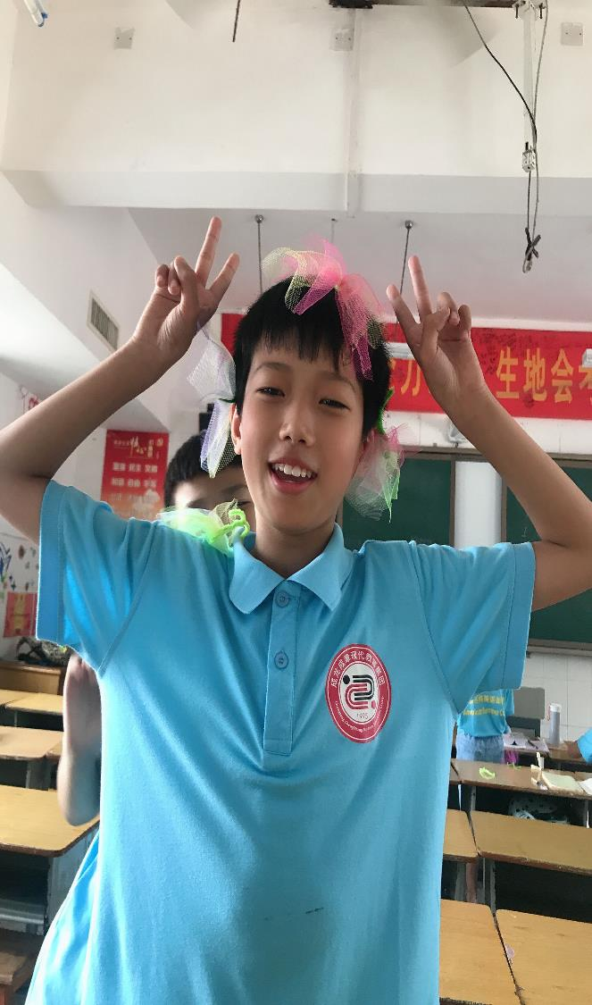
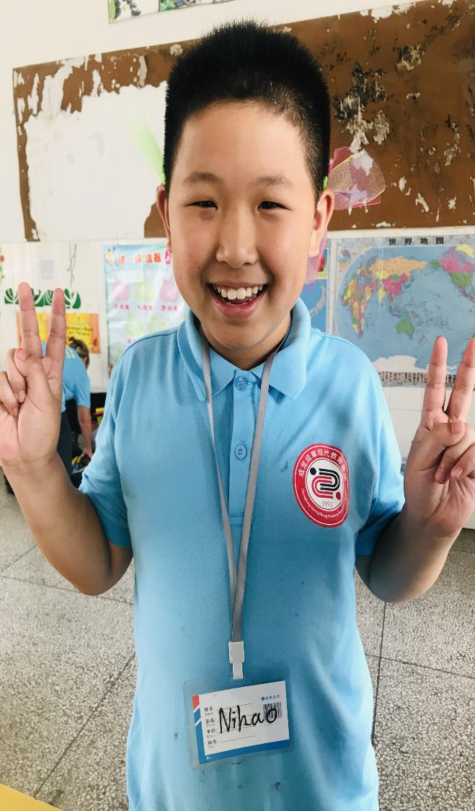
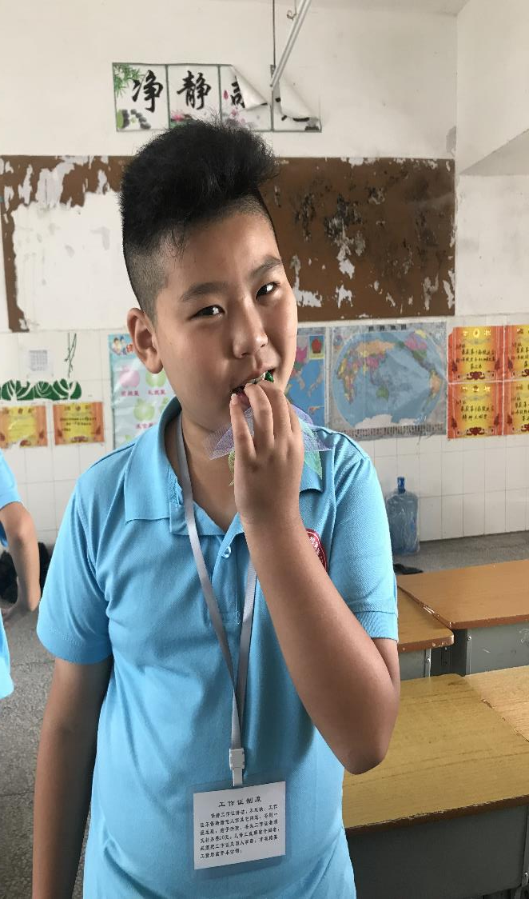

Slide 19
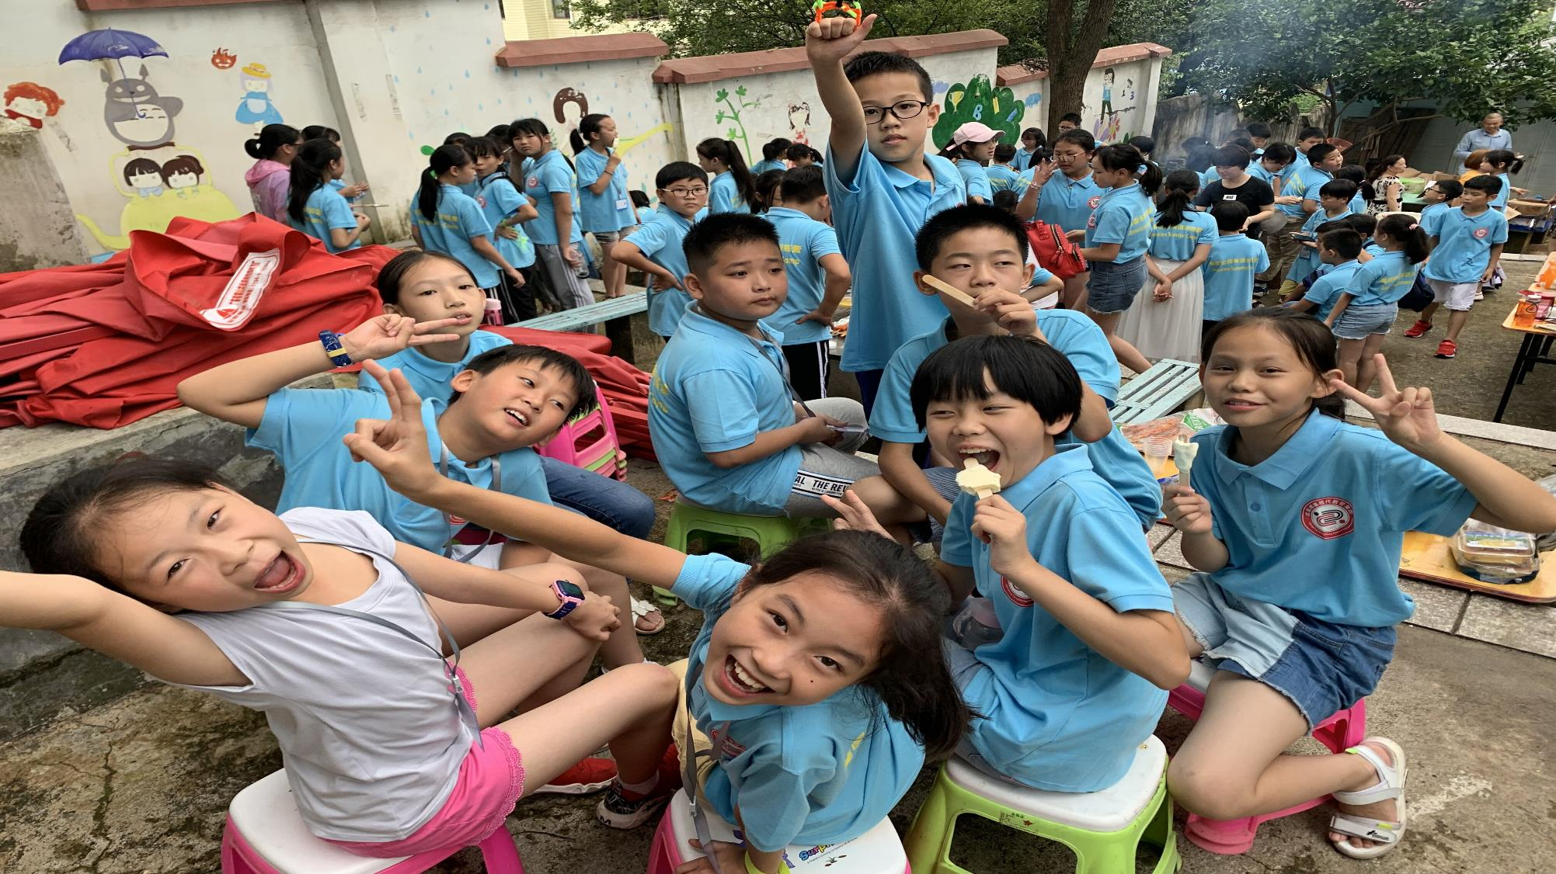

Slide 20
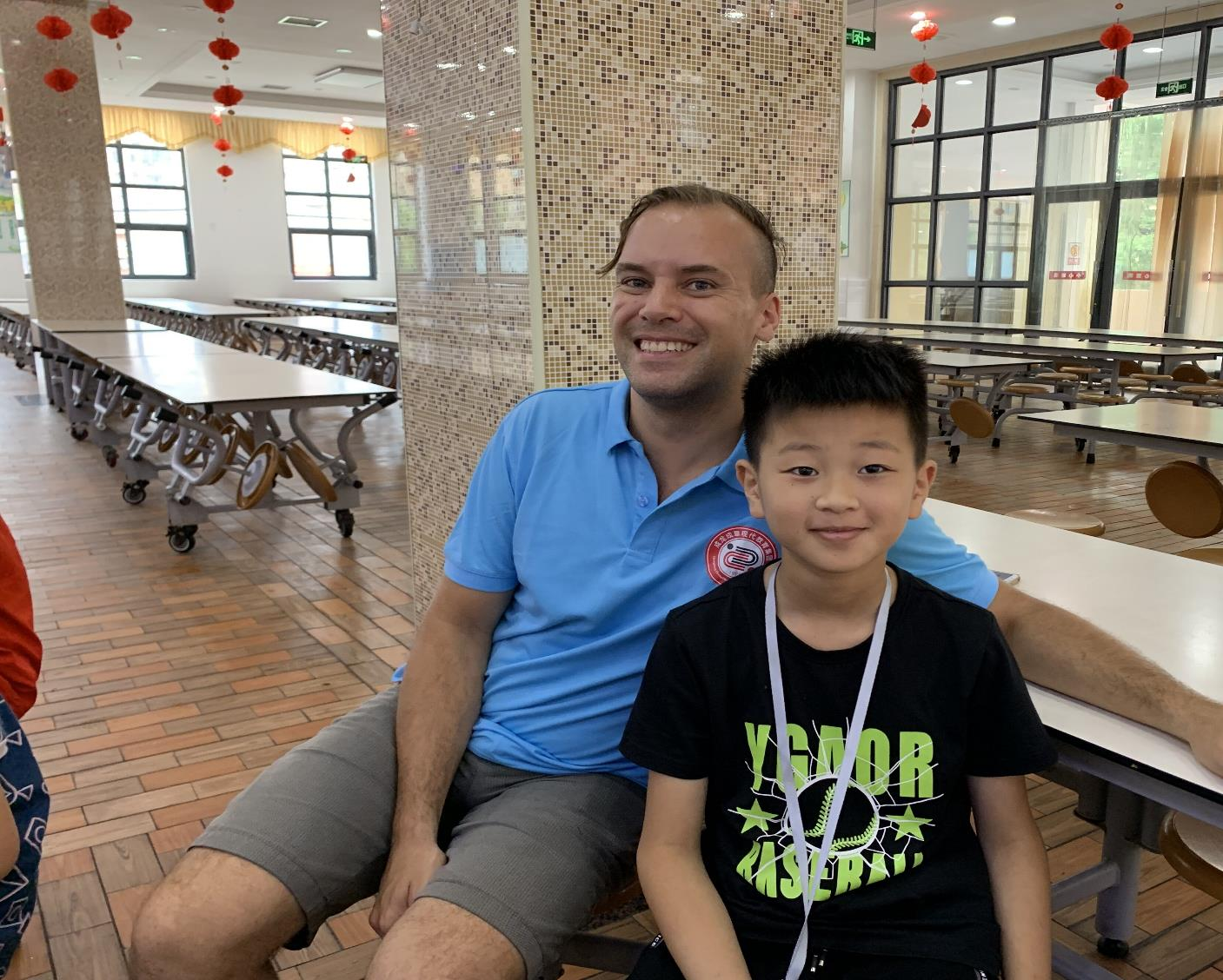
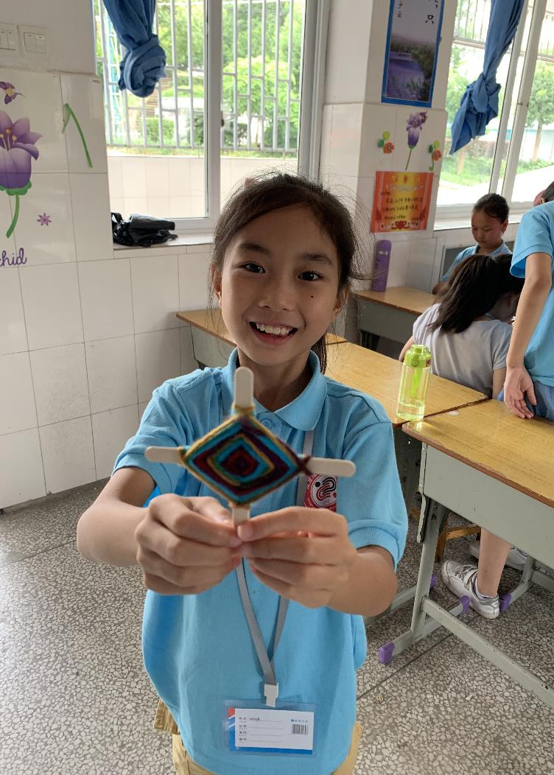

Slide 21
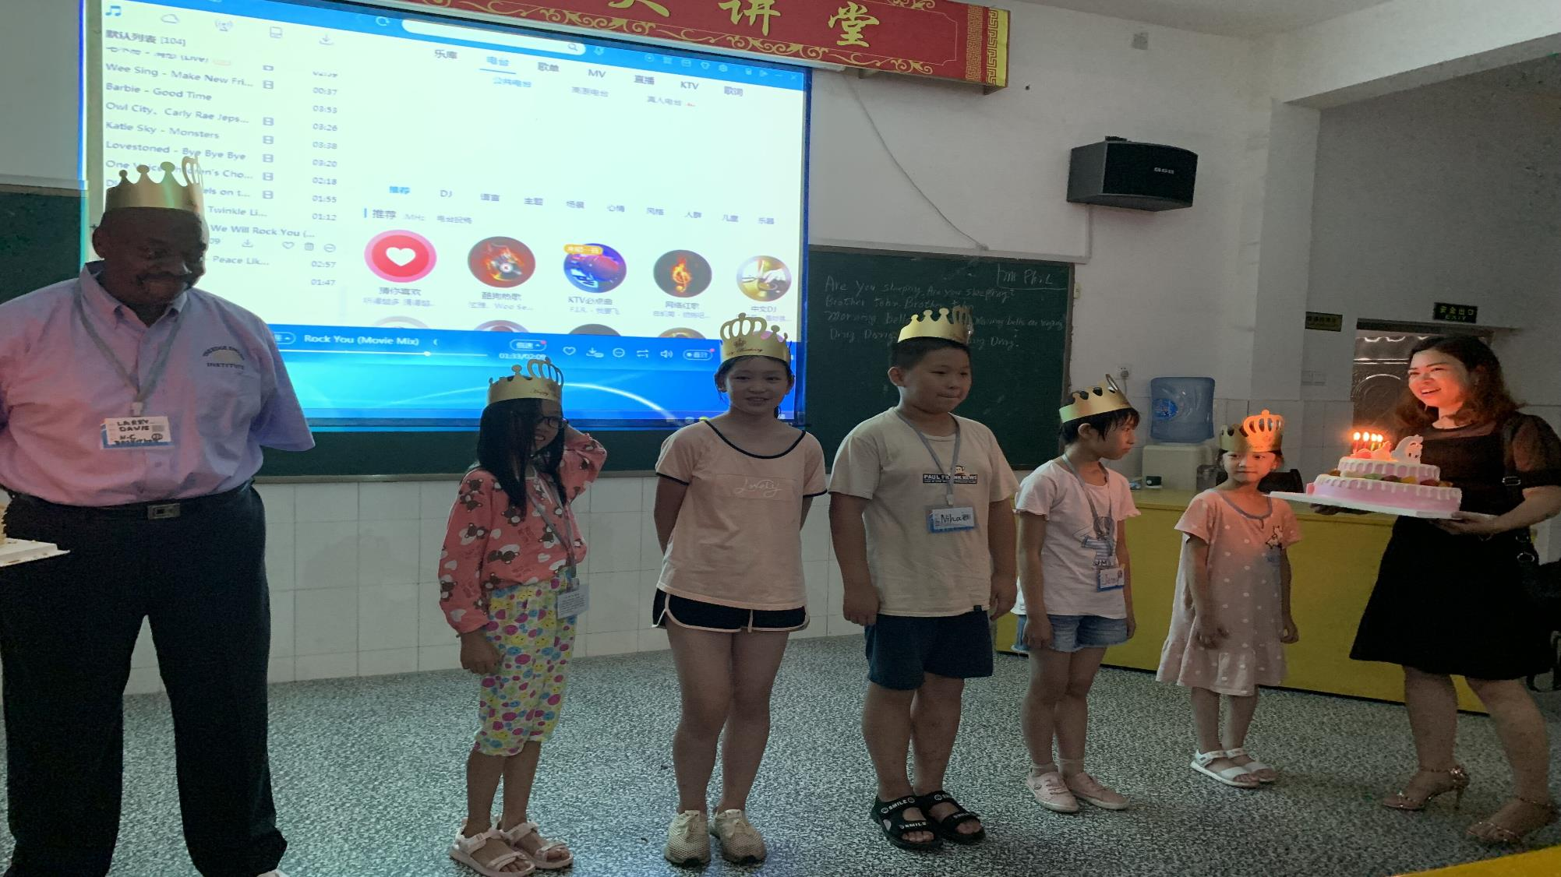

Slide 22
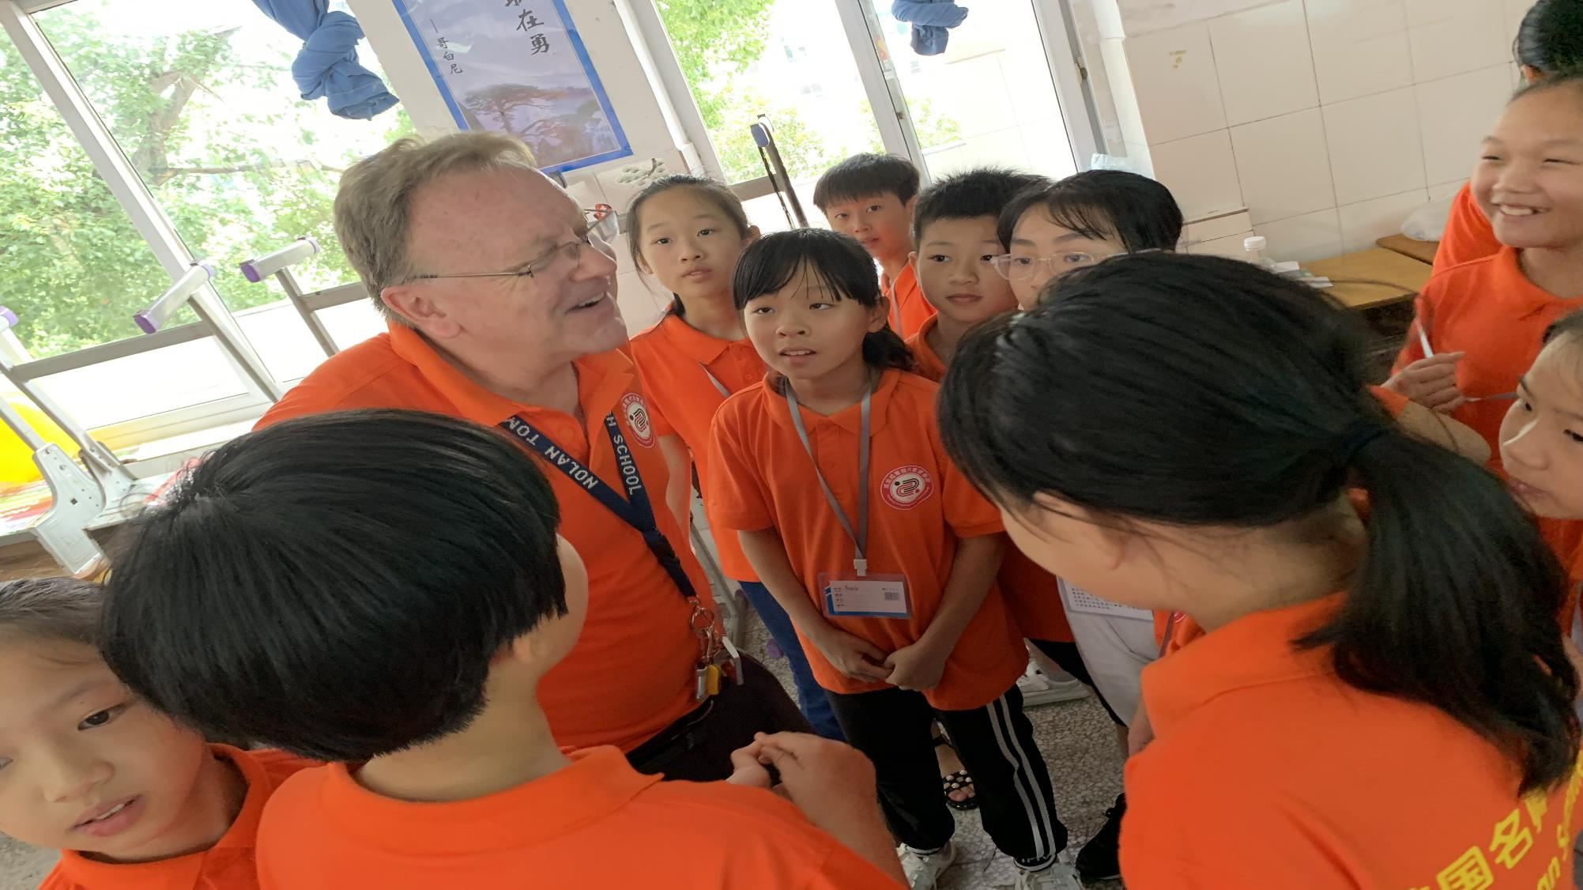

Slide 23
_____________________________________________________________________________________________________

Slide 24
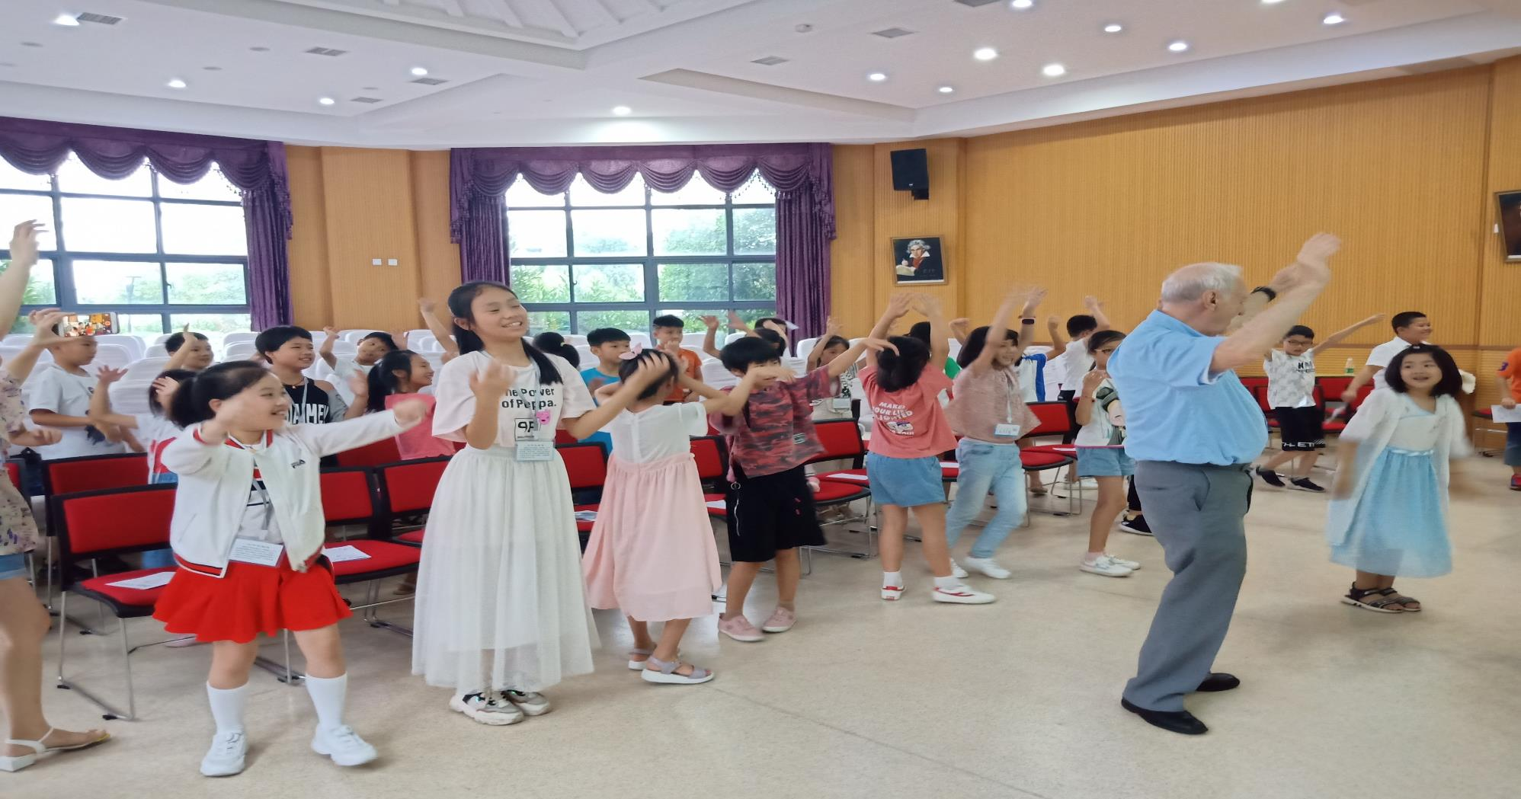
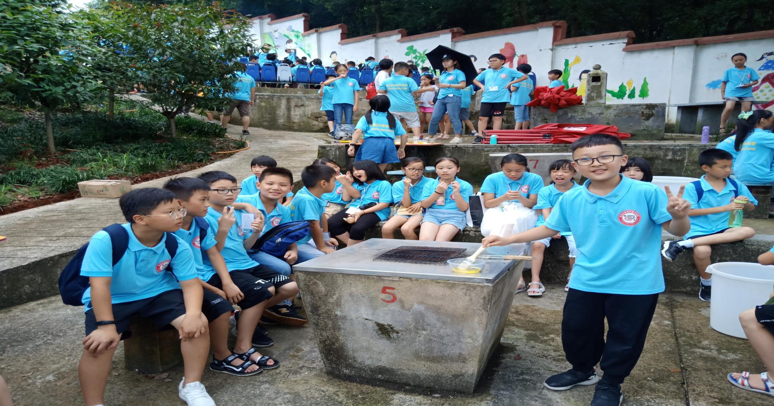
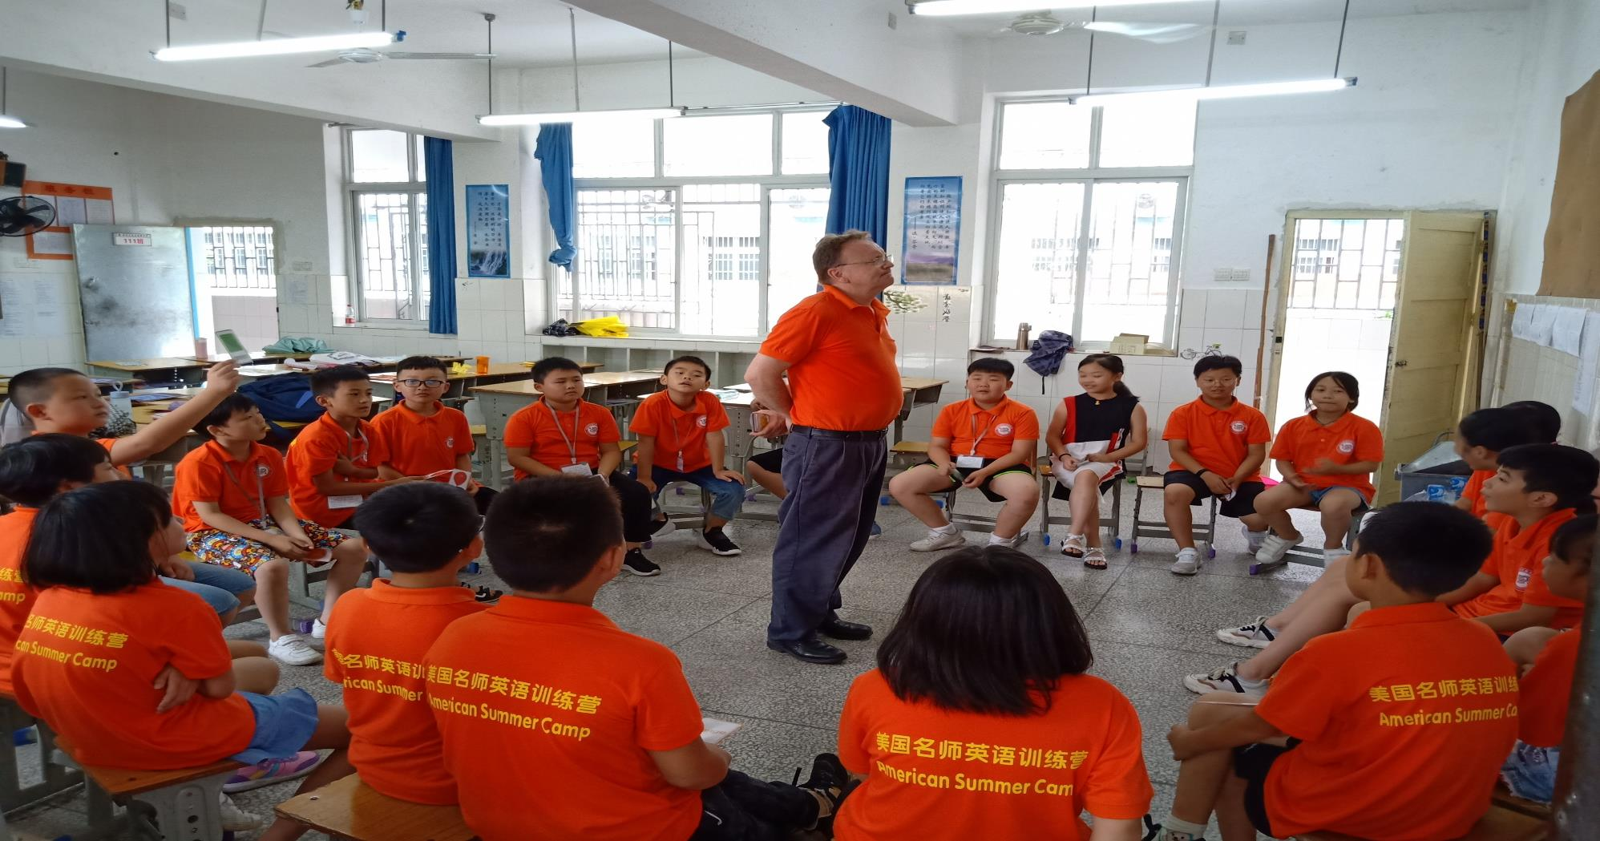
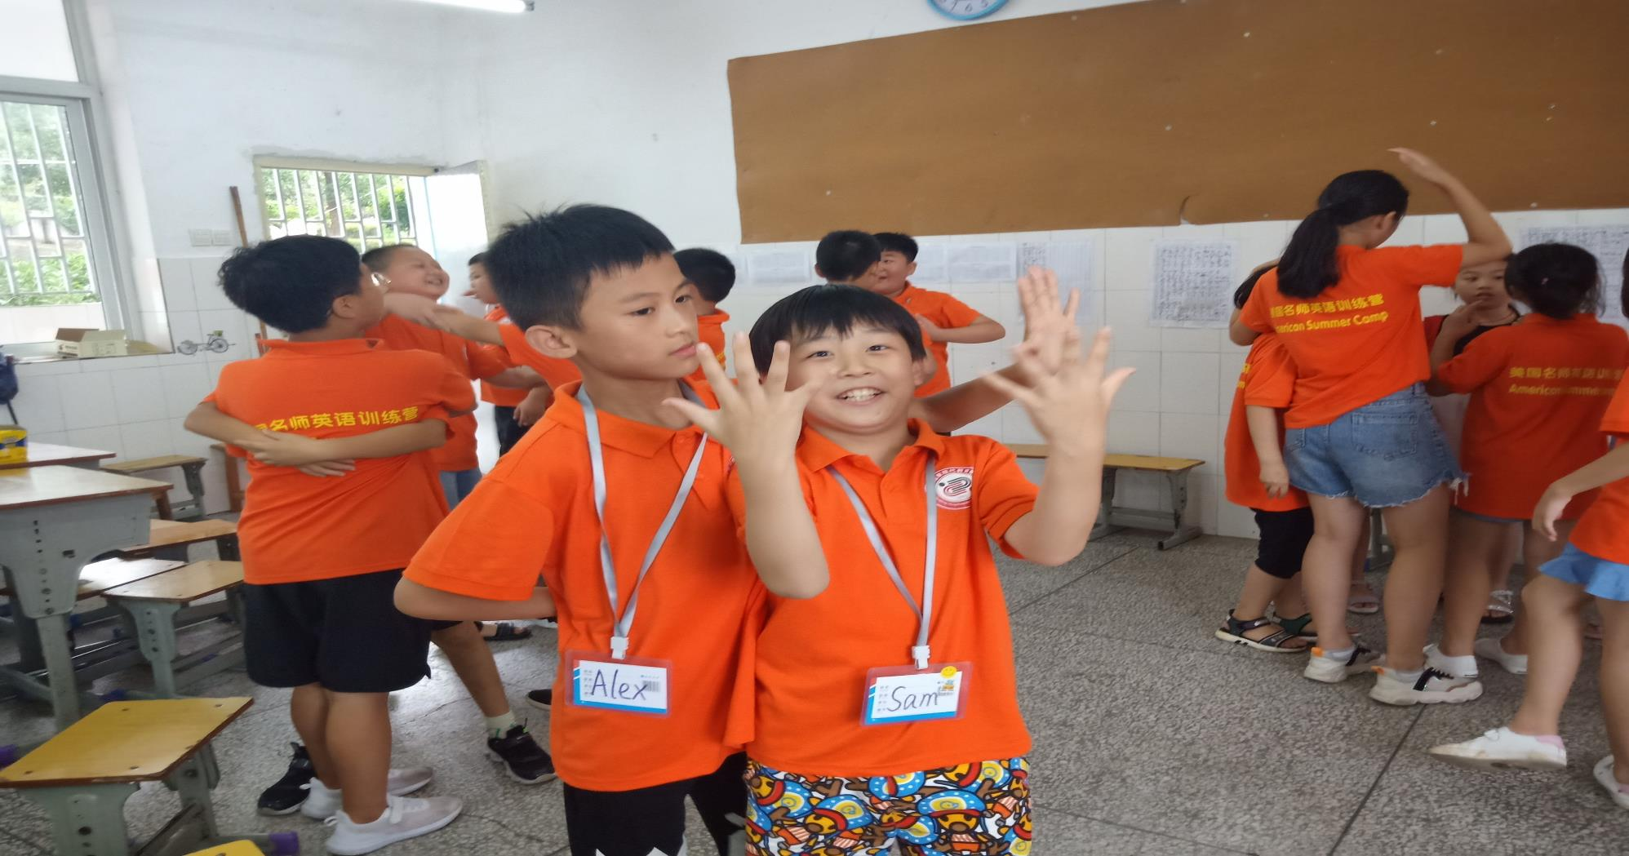

Slide 26
_____________________________________________________________________________________________________

Slide 27
_____________________________________________________________________________________________________

Slide 30
●
●
●
●
●
●
●
●
●
●
●
●
●
●
●
●
●
●
●
●
●
●
●
●
●
●
●
●
●
●
●
●
●
●
●
●
●
●
●●
●
●
●
●
●
●
●
●
●
●
●
●
●
●
●
●
●
●
●
●
●
●
●
●
●
●
●
●
●
●
●
●
●
●
●
●
●
●
●
●
●
●
●
●
●
●
●
●
●
●
●
●●
●
●
●
●
●
●
●
●
●
●
●
●
●

Slide 32
_____________________________________________________________________________________________________

Slide 44
●
●
●
●
●
●
●
●
●
●
●
●
●
●
●
●
●
●
●
●
●
●
●
●
●
●
●
●
●
●
●
●
●
●
●
●
●
●
●●
●
●
●
●
●
●
●
●
●
●
●
●
●
●
●
●
●
●
●
●
●
●
●
●
●
●
●
●
●
●
●
●
●
●
●
●
●
●
●
●
●
●
●
●
●
●
●
●
●
●
●
●●
●
●
●
●
●
●
●
●
●
●
●
●
●

Slide 48
_____________________________________________________________________________________________________

Slide 49
_____________________________________________________________________________________________________

Slide 50
_____________________________________________________________________________________________________

Slide 58
_____________________________________________________________________________________________________

Slide 61
_____________________________________________________________________________________________________

Slide 66
●
●
●
●
●
●
●
●
●
●
●
●
●
●
●
●
●
●
●
●
●
●
●
●
●
●
●
●
●
●
●
●
●
●
●
●
●
●
●●
●
●
●
●
●
●
●
●
●
●
●
●
●
●
●
●
●
●
●
●
●
●
●
●
●
●
●
●
●
●
●
●
●
●
●
●
●
●
●
●
●
●
●
●
●
●
●
●
●
●
●
●●
●
●
●
●
●
●
●
●
●
●
●
●
●

Slide 78
_____________________________________________________________________________________________________

Slide 79
_____________________________________________________________________________________________________

Slide 80
_____________________________________________________________________________________________________

Slide 81
_____________________________________________________________________________________________________

